Slide 1
2019 IPM Academy for the University of Florida, IFAS
Welcome!
Norm Leppla, University of Florida
Entomology and Nematology Department

Slide 2
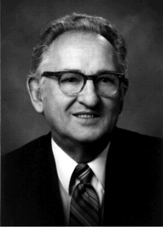
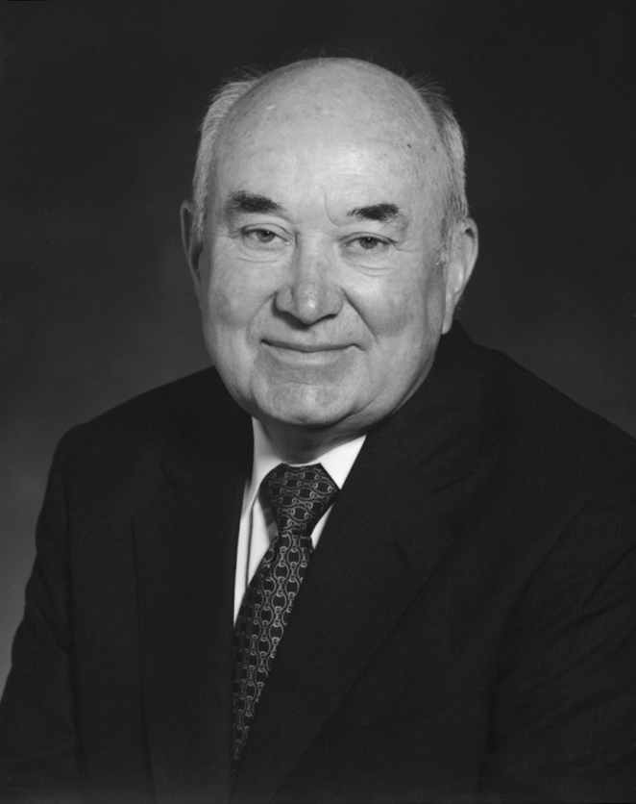
Advancement of IPM in the U. S. & Florida
FIFRA extensively amended (1972)
"Huffaker Project“ NSF, USDA, EPA (1972)
Cooperative Extension Service, IPM in every “state” 56 (1975),
“Adkisson Project” CIPM (1979-1985), CSRS (NIFA) IPM program
Regional IPM centers (4 in 2000), 1890s, 1994s
UF/IFAS lost Southern IPM Center ~2000, administration asked me to establish a coordinated IPM program for Florida
Allied IPM Florida with DPM for IPM education
Dr. Saqib Mukhtar, Associate Dean and Ag Program Leader, Florida Cooperative Extension Service, IPM administrator

Slide 3
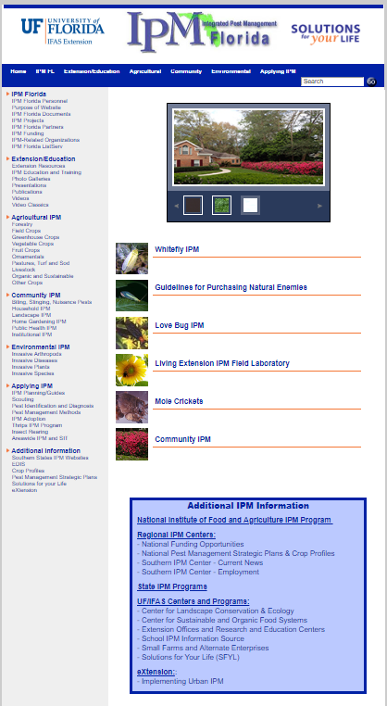
IPM Florida Coordination
The University of Florida, Institute of Food and Agricultural Sciences (UF/IFAS) IPM Program, IPM Florida, provides statewide, interdisciplinary and inter-unit coordination and assistance for UF, IFAS integrated pest management research, Extension and education.

Slide 4
2017 Crop Protection and Pest Management Extension Implementation Project for the University of Florida
IPM Florida Coordination- Norm Leppla
IPM for Florida Housing and Residential Environments- Faith Oi
Enabling the Florida Collaborative Plant Pest and Disease Diagnostic System- Amanda Hodges
Delivery of IPM for Cotton Cultivars in North Florida- Silvana Paula-Moraes
Pollinator Plants and Pollinator Health- Gary Knox

Slide 5
Current Issues and Collaboration
Single point of contact for UF/IFAS diagnostic services (led by Carrie Harmon) https://diagnostics.ifas.ufl.edu/
Pesticide tables for horticulture and other fields in EDIS publications (led by Lisa Hickey, Diana Hagan, Jason Ferrell, Lauren Diepenbrock, Gary Vallad) PRTT Adam Dale, Catharine Mannion, Fred Fishel
County and community IPM plans Martin County (Yvette Goodiel) and Pinellas County (Jeff Gellermann), Haile Plantation in Alachua County (Adam Dale, Clem Taylor, Tatiana Sanchez).

Slide 6
Purpose of the 2019 IPM Academy for the University of Florida, IFAS
UF/IFAS Extension agents will learn the core concepts and skills needed to design integrated pest management programs for vegetable, fruit and ornamental crops.
Extension agents will learn to use resources available within IFAS and beyond for diagnosing and addressing arthropod pest problems of diverse commodity groups.
I wish all of us a highly successful training and please let me know how I can help with your IPM programs. (http://ipm.ifas.ufl.edu/)

