Slide 1
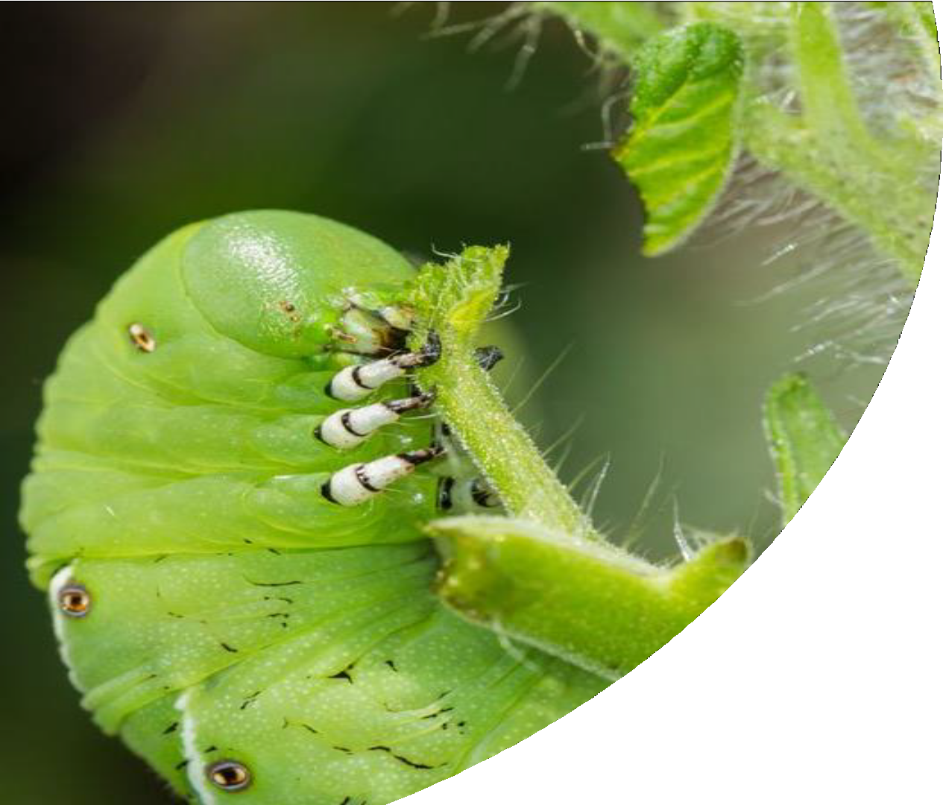
Fundamentals of Integrated Pest Management (IPM)
Lauren Diepenbrock
UF/IFAS CREC- Citrus Entomology
Extension Specialist
Image from: planetnatural.com

Slide 2
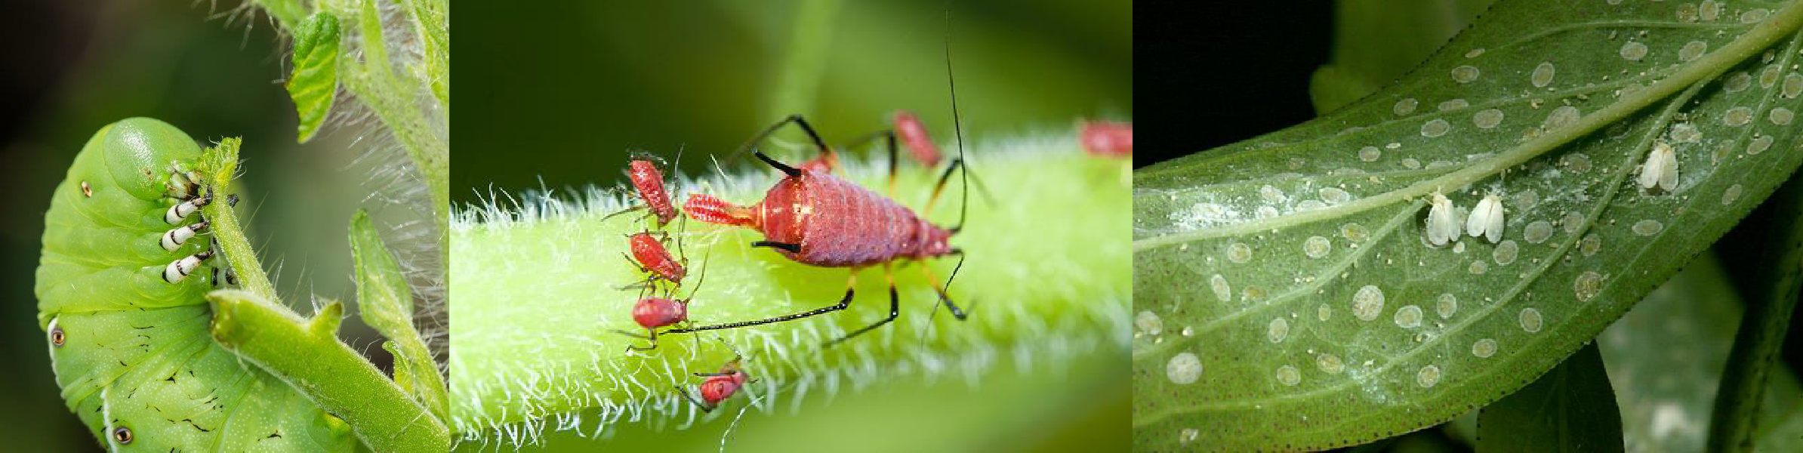
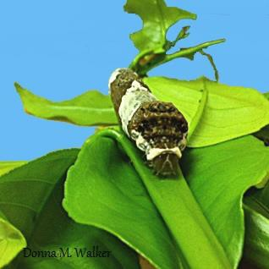
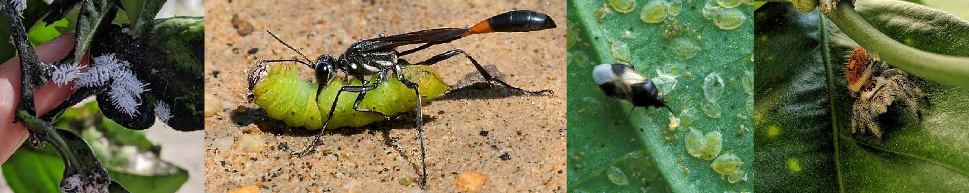
What is IPM?
Images from: planetnatural.com, sundaygardener.net, almanac.com/pest/whiteflies, heartspm.com/giant-swallowtail-butterfly.php, en.Wikipedia.orf/wiki/Anthrocoridae, Diepenbrock

Slide 3
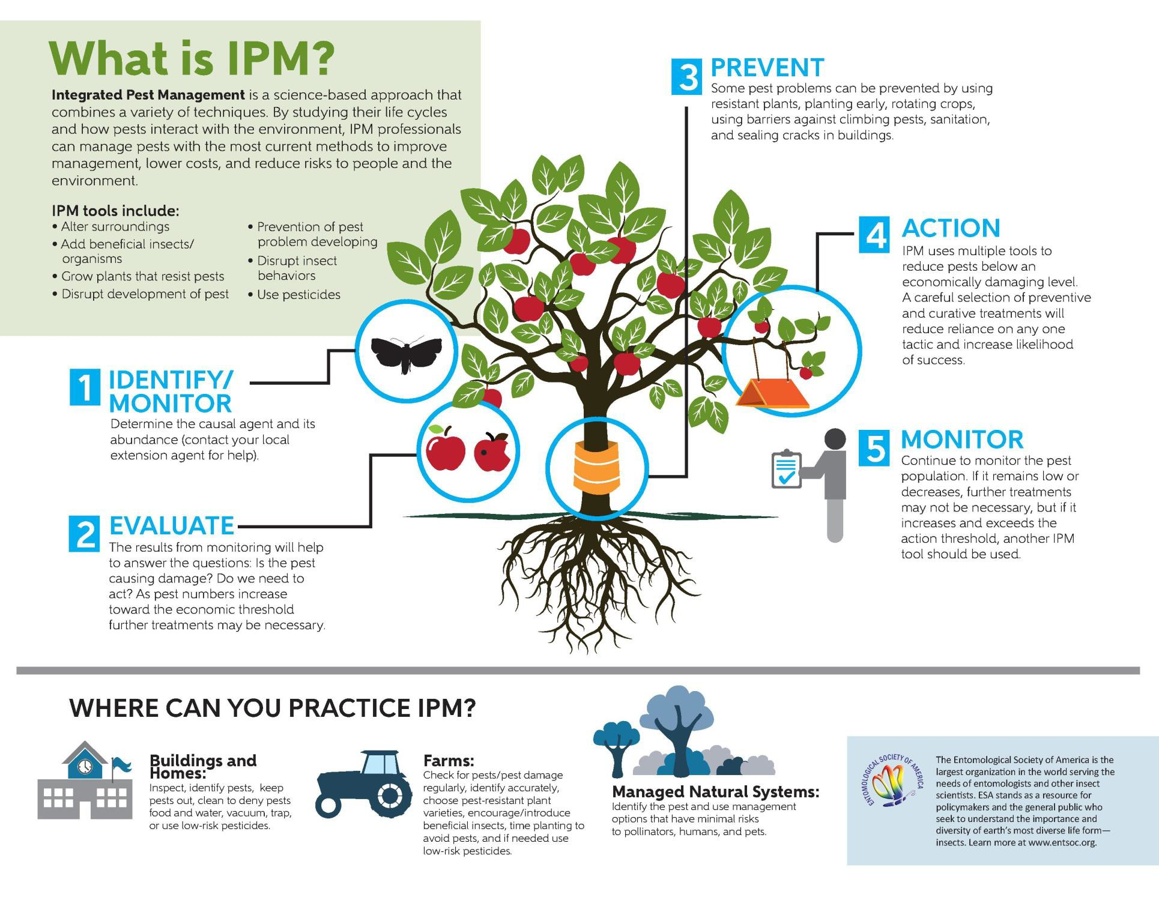

Slide 4
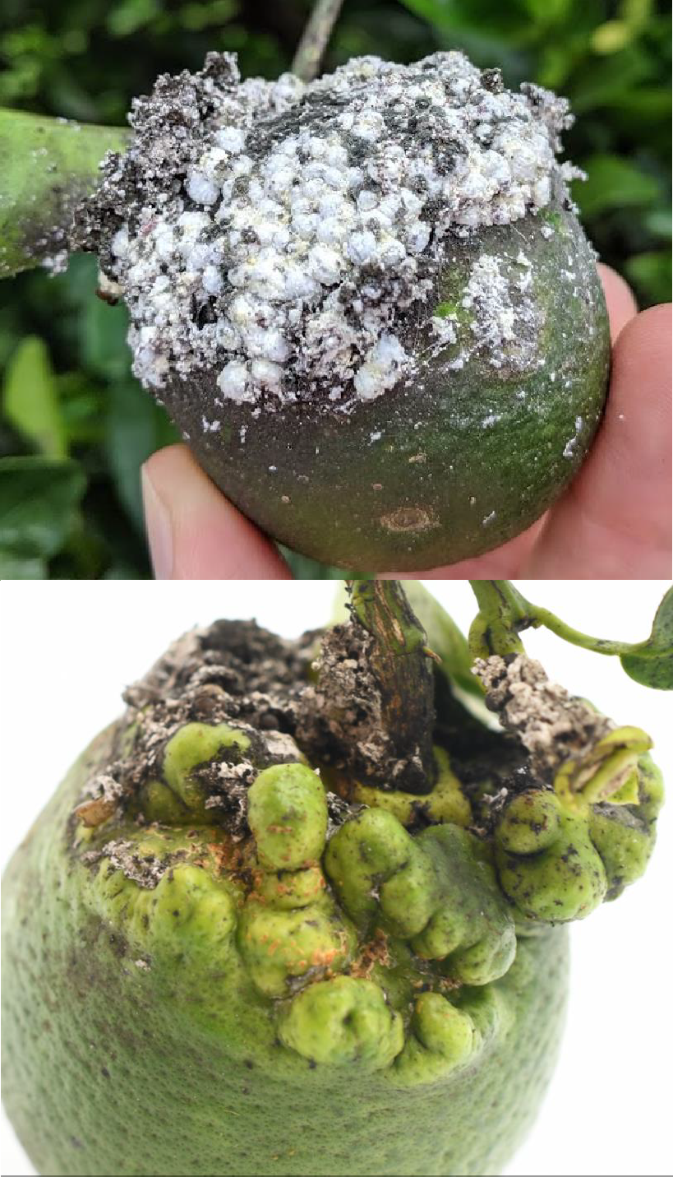
Step 1: Identify/Monitor
Identify
Determine what is causing injury to the plant(s)
How to get an ID:
Collect the suspected pest and injured vegetation Contact your crop’s entomology specialist
OR send for ID at the UF insect ID lab (http://entnemdept.ufl.edu/insectid/)
OR to FDACS-DPI
(https://www.freshfromflorida.com/Divisions- Offices/Plant-Industry/Business-Services/How-to- Submit-a-Sample-for-Identification)
Images from: Diepenbrock, T. Weeks

Slide 5
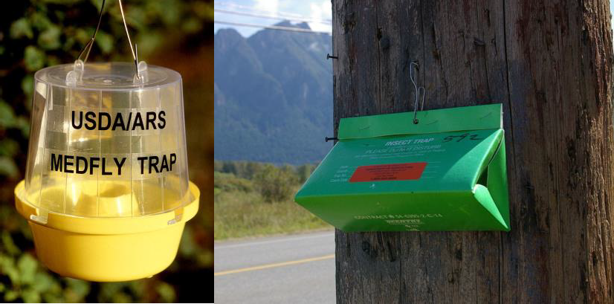
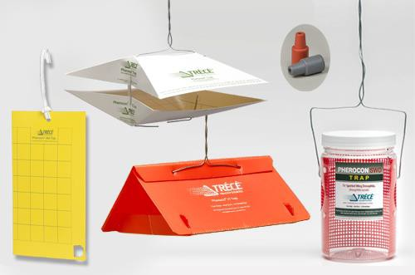
Step 1: Identify/Monitor
Monitor
Protocols exist for monitoring many pests
  See if population is increasing or decreasing
Readily available traps for many known pests
  Passive/intercept
  Attractant
Images from: https://en.wikipedia.org/wiki/Insect_trap, https://trece.com/products/

Slide 6
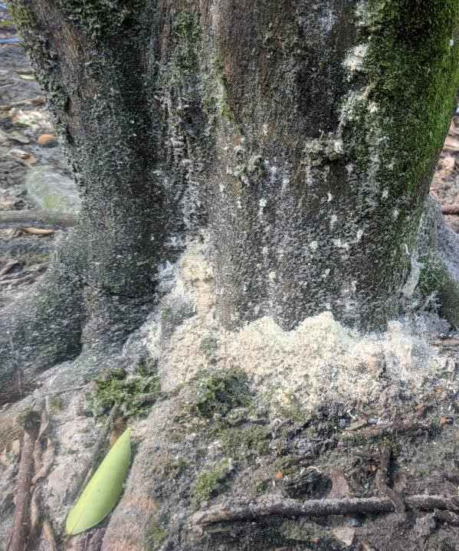
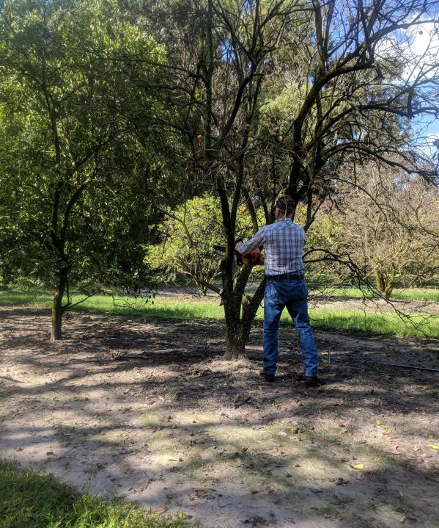
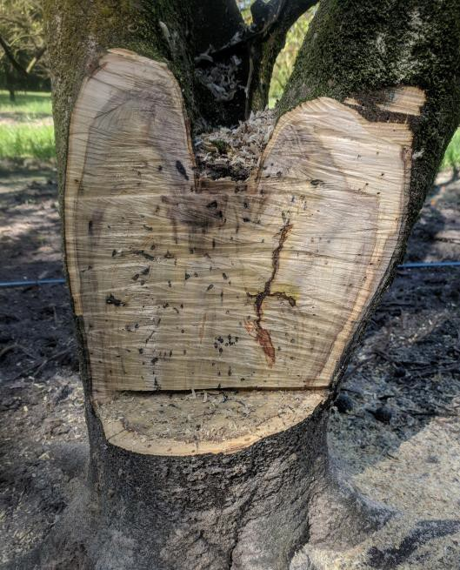
Step 1: Identify/Monitor
Case study: Grower call about sawdust Signs of injury:
Sawdust/frass from ambrosia beetles
Tree decline associated with beetle damage
Causal agent
NOT the beetle! Proper ID showed it was a generalist beetle that is attracted to dead/dying trees
Tree was infested with several species of fungi internally leading to decline and beetle infestation
No further action for beetles
necessary (fungus though…)

Slide 7
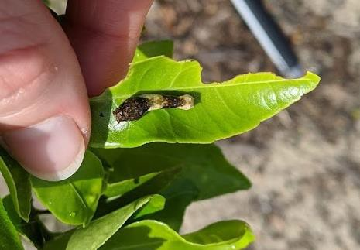
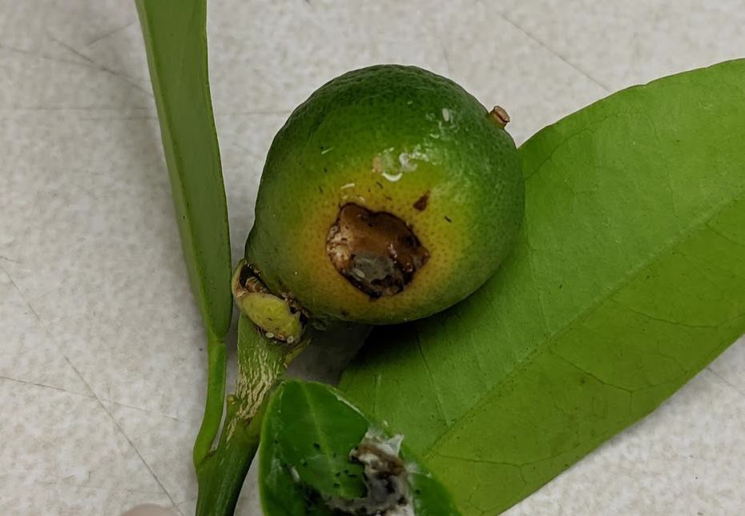
Step 2: Evaluate
Is the pest population increasing or declining?
Have natural enemies established?
Leaf injury from orangedog feeding-
Is there just INJURY or is the plant experiencing DAMAGE?
  INJURY DOES NOT ALWAYS CAUSE DAMAGE
unlikely to cause damage/losses to
tree
Fruit damage from caterpillar feeding- will lead to fruit drop and loss.

Slide 8
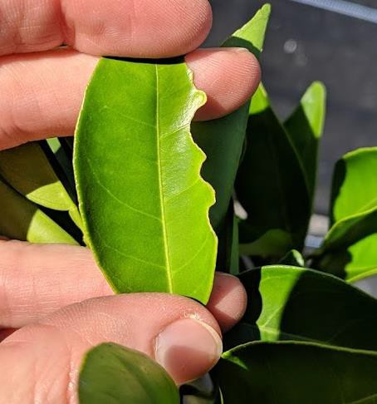
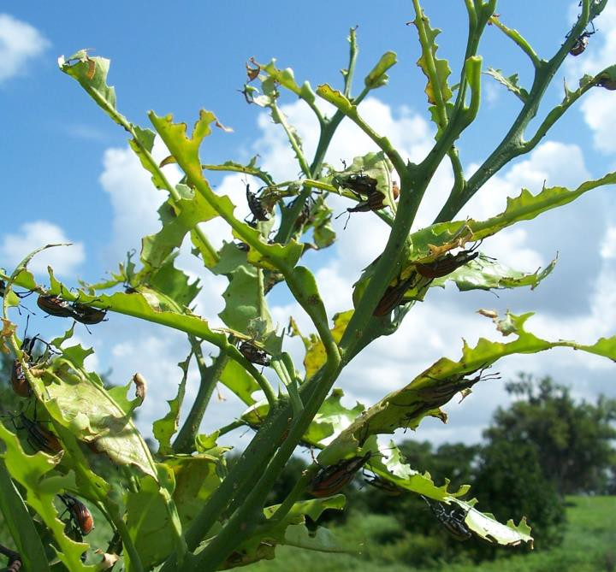
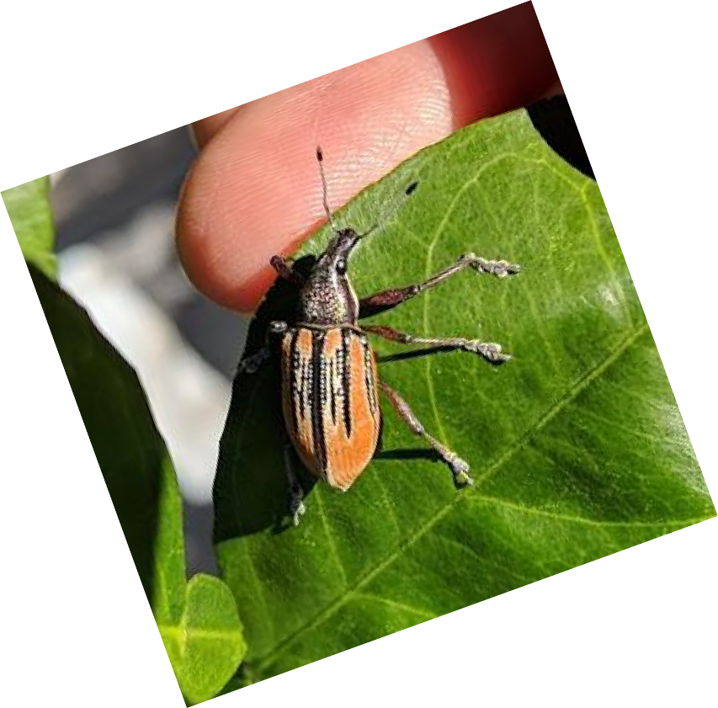
Injury vs. damage
Injury
Physical or physiological losses to plants caused by pests
Ex: reduced leaf area, reduced photosynthesis
Damage
Economic loss of plant/plant product caused by pests
Ex: reduced yield or quality
Images by: Diepenbrock, R. Stuart

Slide 9
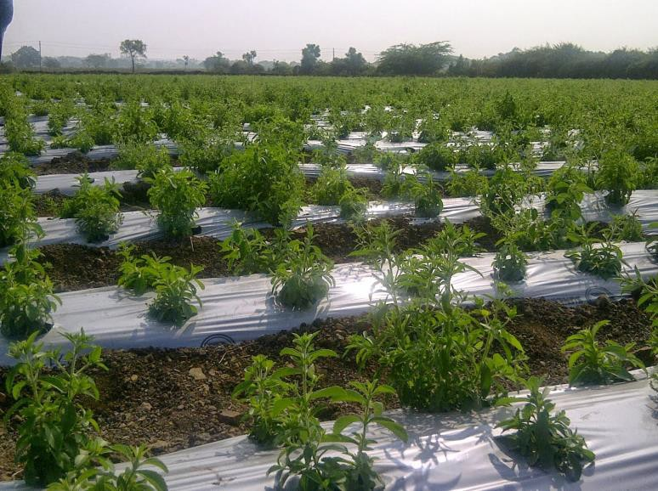
Step 3: Prevent
Exclude pests
  Physical barriers- screens, tangle trap
  Disrupt host detection- odor or visual deterrents
Plant tolerant varieties
  Can withstand pressure from pests/pathogens
Reflective mulch in stevia; creates visual deterrent to pests
Ex: Poncirus trifoliata rootstock is used for several varieties of citrus, it is tolerant to tristeza virus (CTV) and Phytophthora parasitca
Rotate crops
  With year-round temperatures ideal for many pests in FL, altering host availability by removing their preferred hosts can reduce pest pressure
Image from: http://stevia.blogspot.com/2014/01/important-of-plastic-mulch-in-stevia_17.html

Slide 10
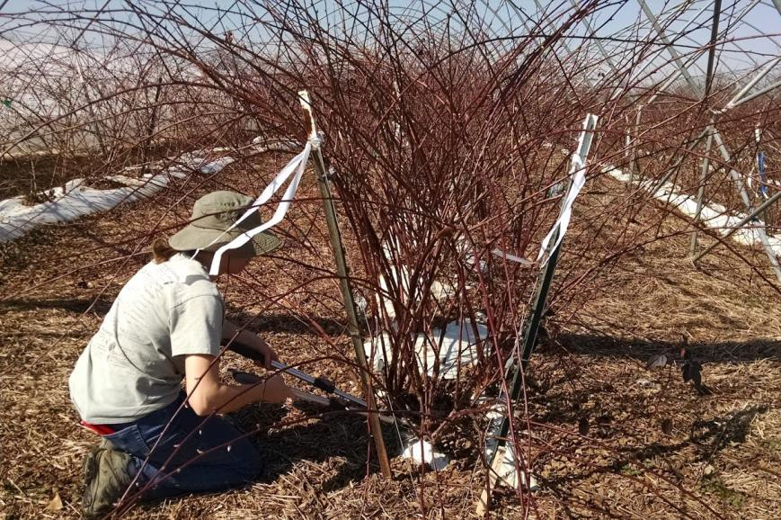
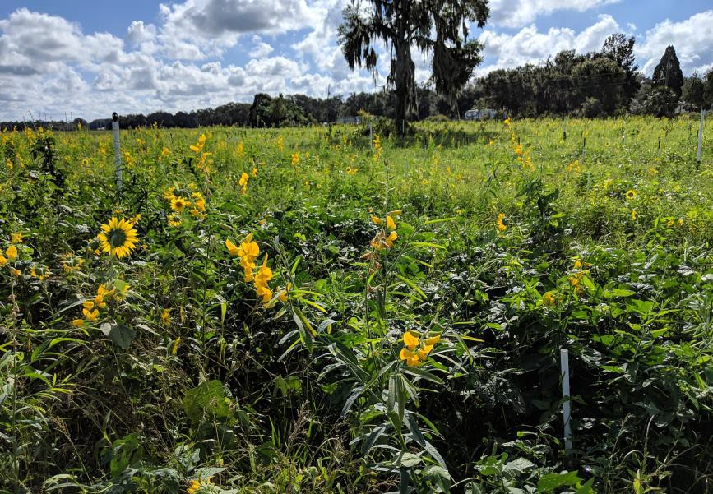
Step 4: Action
Incorporate cultural, biological, and/or chemical control tools into program of monitoring and prevention
Cultural
Pruning blackberry canes to alter
Within crop habitat manipulation
  Pruning, trellising, ground vegetation management
Near crop habitat manipulation
  Edge habitat management for beneficial species, trap crops, windbreaks
canopy density
Within crop habitat for beneficial insects

Slide 11
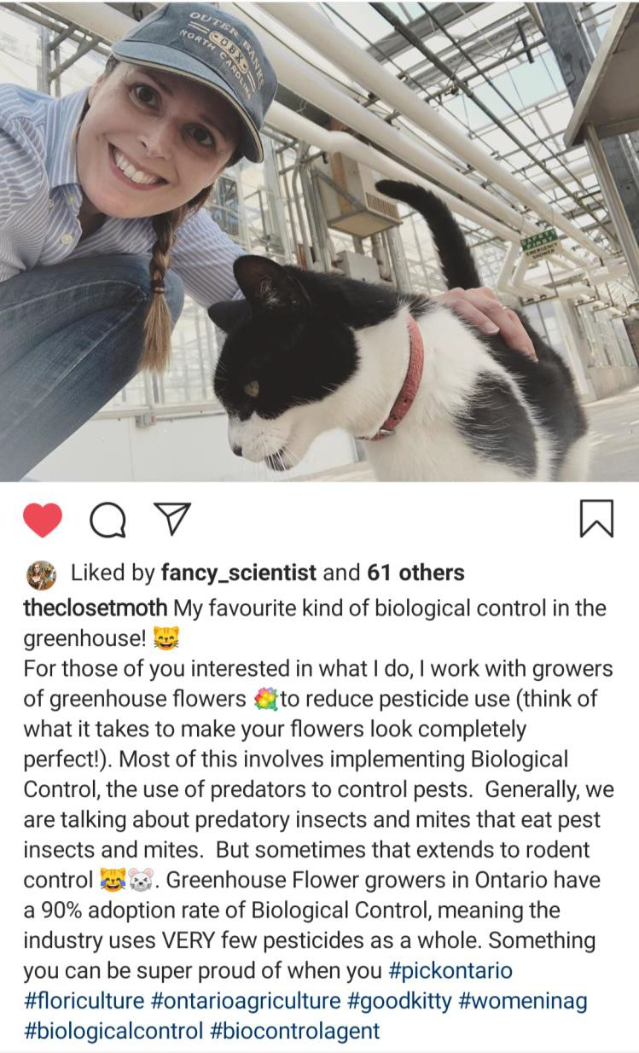
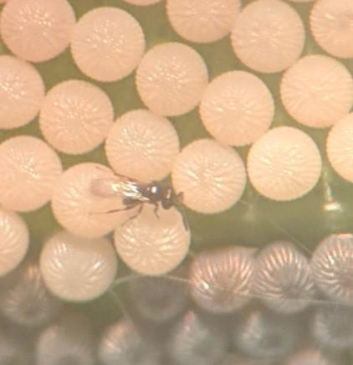
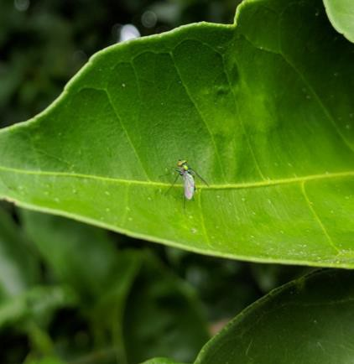
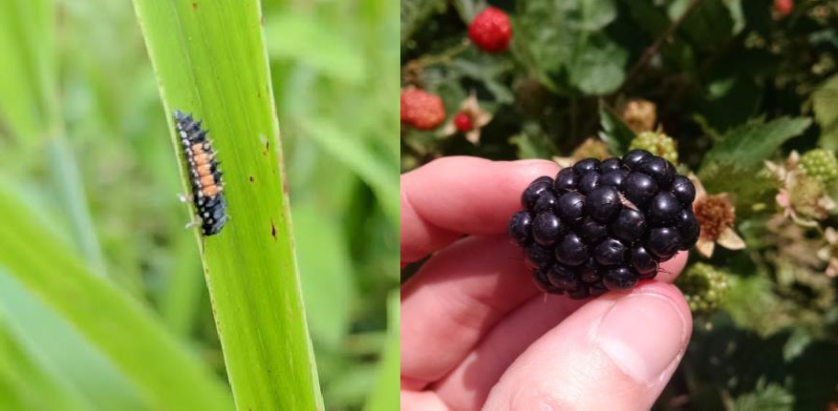
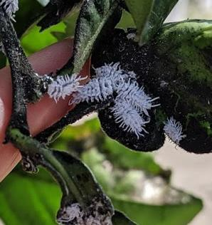
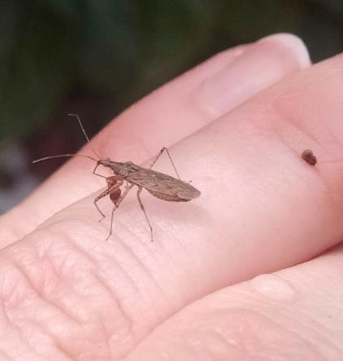
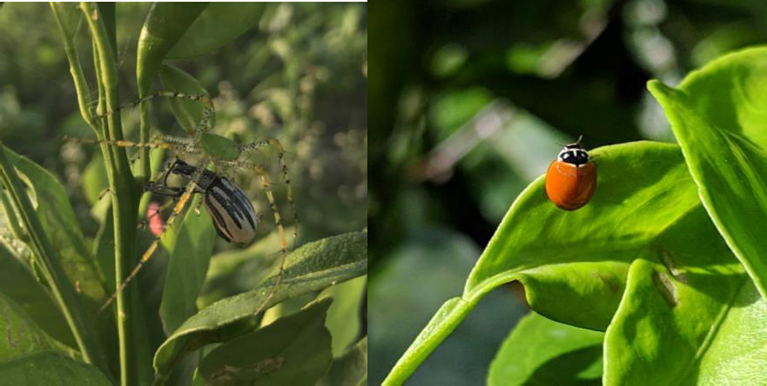
Action - biological controls
Many exist in the habitat
Can be augmented by adding
Can be supported through habitat manipulation
Images from Diepenbrock (left), Sarah Jandricic (above)

Slide 12
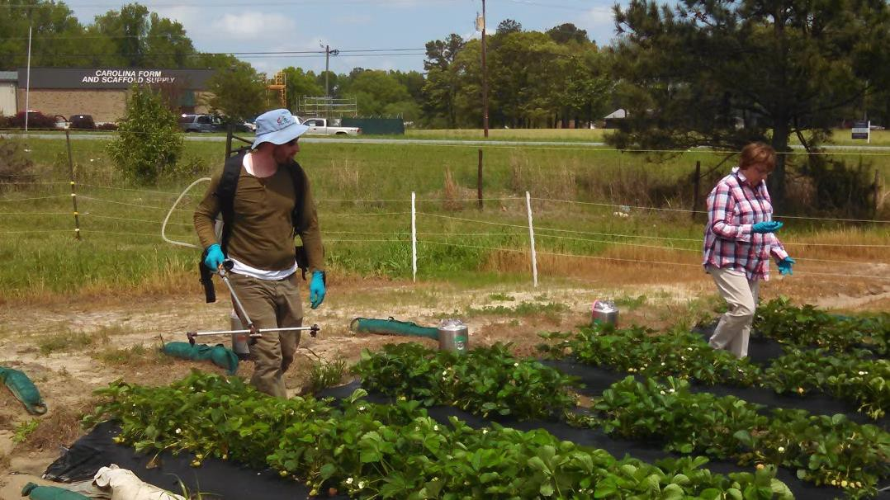
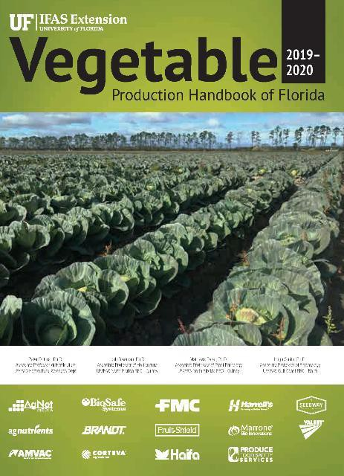
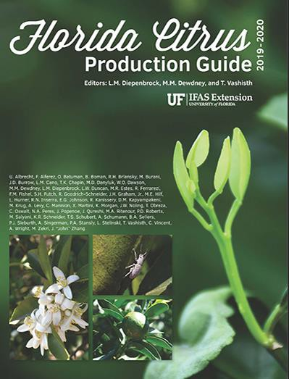
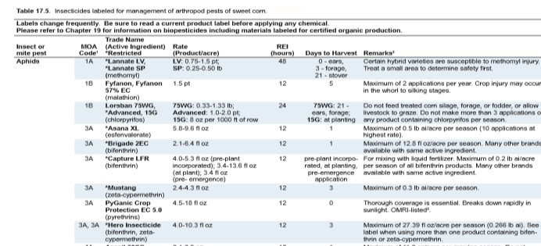
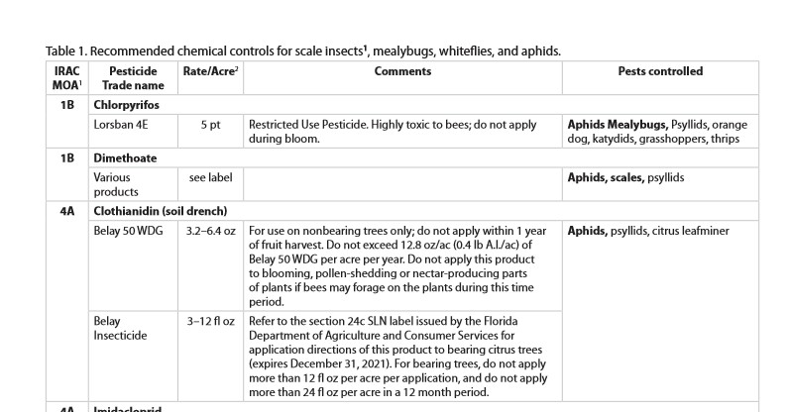
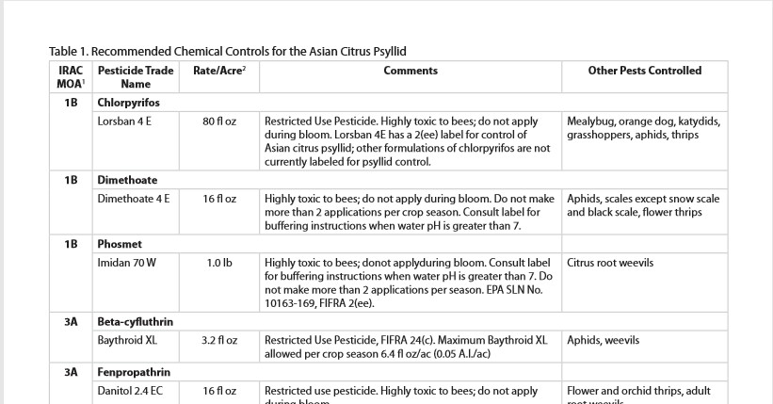
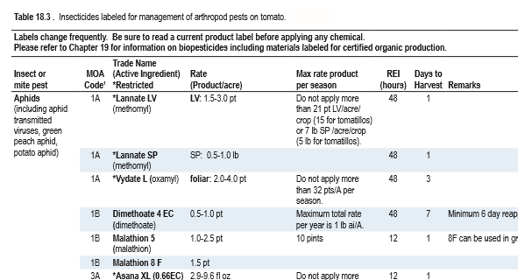
Action: chemical controls
Chemical Controls
  Organic (OMRI-approved materials only)
Conventional
More details in later presentations
Insecticide trials in strawberry (NC)

Slide 13
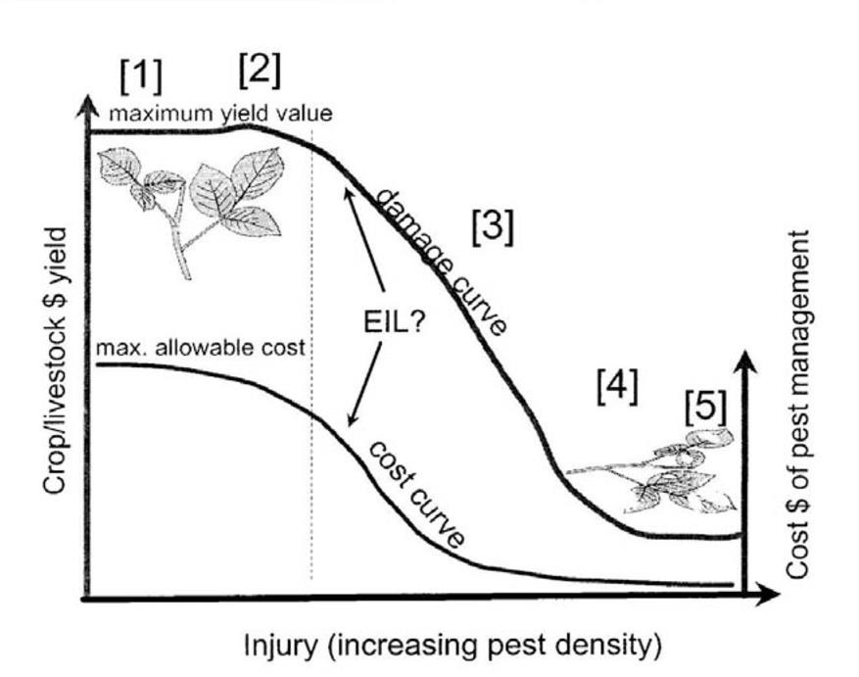
How do I know if I need to treat?
In some cropping systems, the economic threshold and injury level (EIL) are well established
  ET and EIL based on years/decades of pest data relative to crop
  Mostly determined in regions that have a winter/non-growing season
Image from: Riley 2009, Economic injury level (EIL) and economic threshold (ET) concepts in pest management

Slide 14
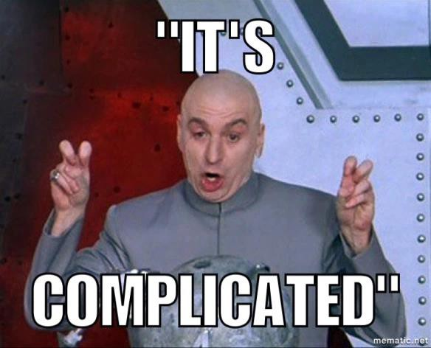
Florida’s relationship with EILs

Slide 15
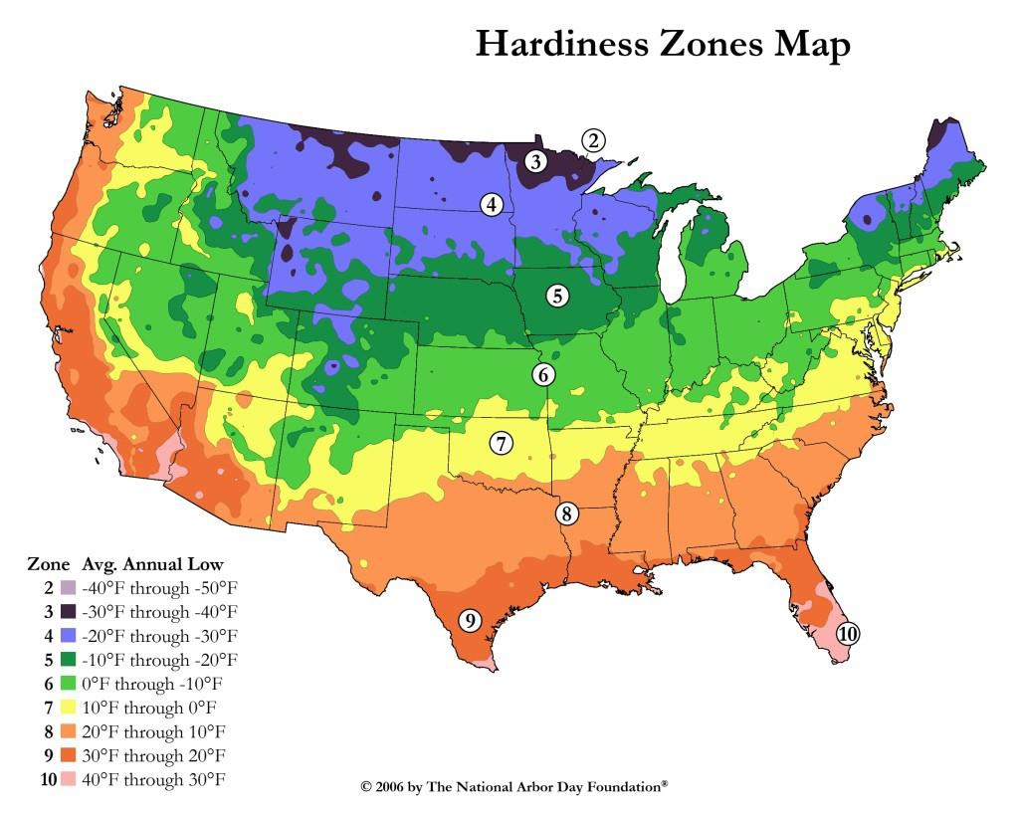
What’s so complicated?
They don’t exist for many of our crops
because
  Year-round growing weather
  No winter to knock back pest populations
  Many pests have multiple hosts and generations throughout the year
Few, if any degree-day models as it does not get and stay cool enough in most parts of Florida to make this modeling possible

Slide 16
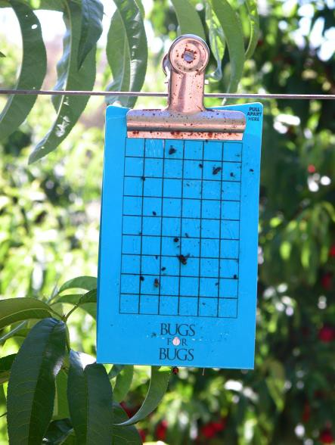
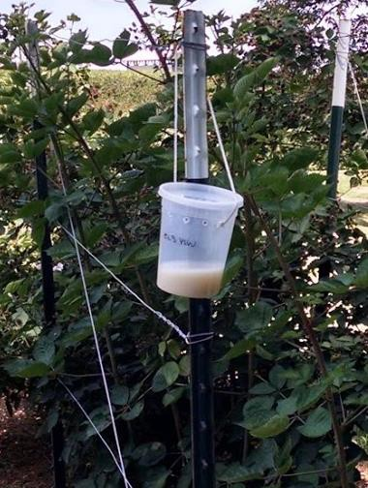
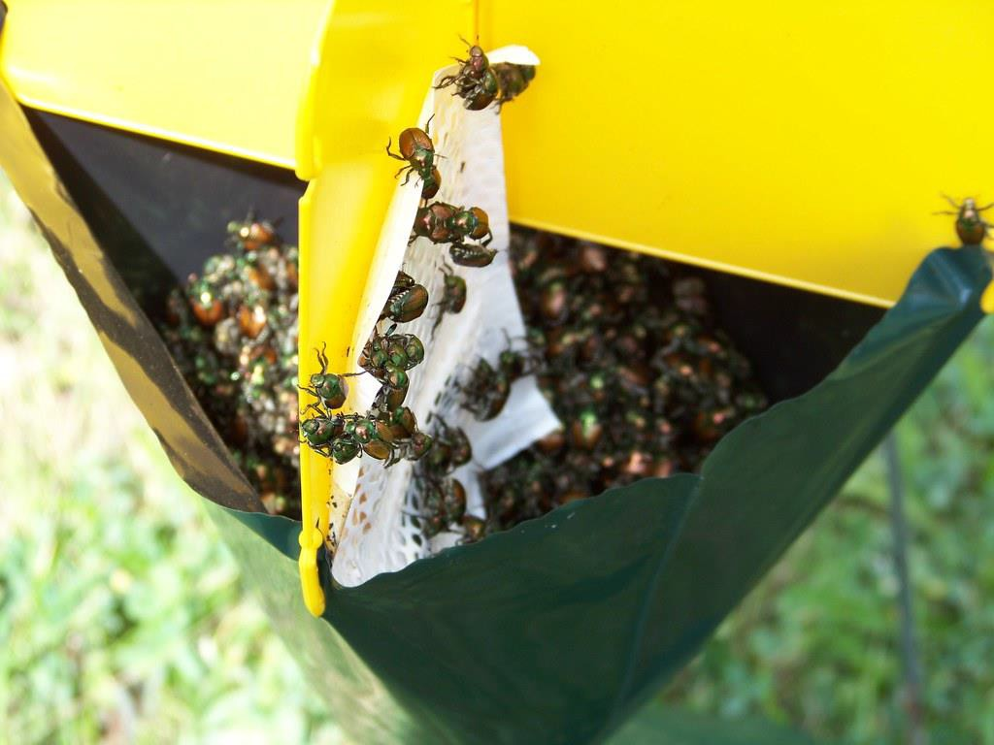
Step 5: Monitor
Continue monitoring pest to determine if further action is needed
  Is the pest population increasing/decreasing?
  Is plant health improving?
IF further chemical action is warranted, be sure to ROTATE Mode of Action (to be covered later today)
Images from: https://www.flickr.com/photos/jonna/2757904374, https://www.agric.wa.gov.au/pome-fruit/thrips-pests-pome-and-stone-fruit?page=0%2C1, Diepenbrock

Slide 17
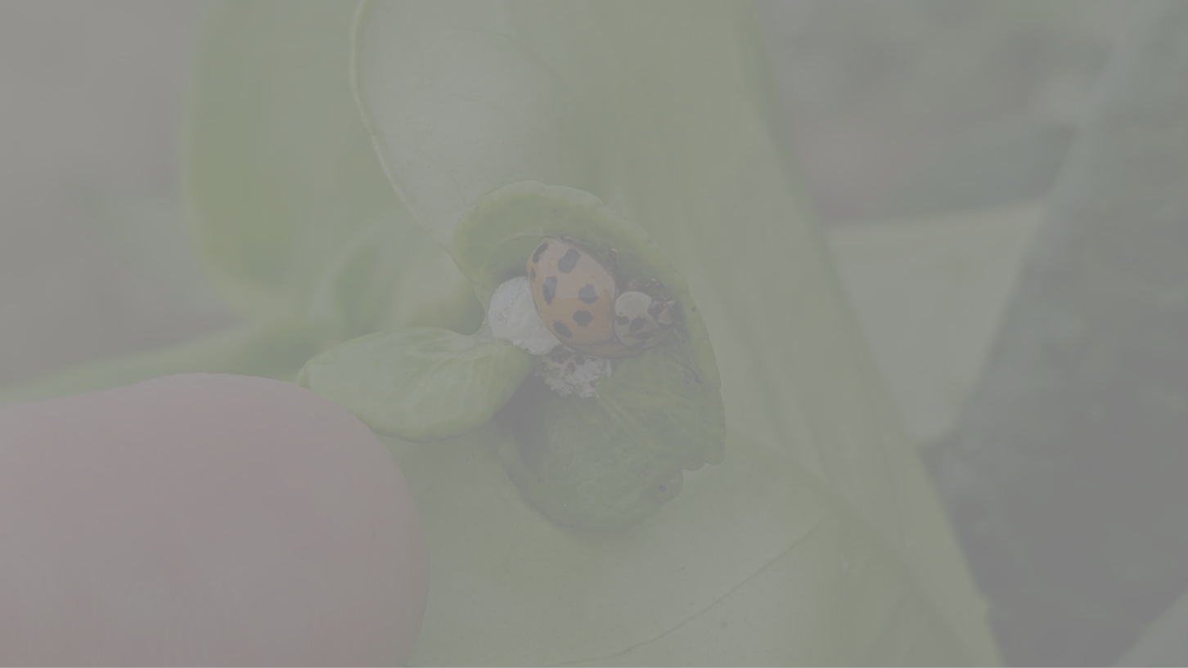
Questions?
Lauren Diepenbrock ldiepenbrock@ufl.edu 863-956-8801

