Slide 1
Addressing IPM Education through Undergraduate Curriculum and California PCA Licensing Requirements
Mary Louise Flint
Associate Director, UC Statewide IPM Program and Department of Entomology, Univ. Calif. Davis

Slide 2

In California, you must be licensed as a pest control adviser (PCA) if you
Offer recommendations on any agricultural use of a pest control product or technique or
Present yourself as an authority on pest management practices or
Solicit services or sales for any pest control product
PCAs are licensed by the California Department of Pesticide Regulation (DPR)

Slide 3
To become licensed, applicants must
Complete specific educational requirements
Pass an examination
Pay a fee
NEWLY MINTED ADVISER
45TH STREET
ANYWHERE, CA

Slide 4
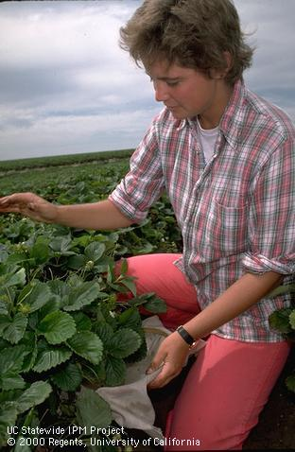
IPM has become an important component of the licensing process
In addition to other pest and pesticide-centered coursework, applicants must complete an IPM class and plant health courses.
Specific IPM knowledge requirements identified for the exam.

Slide 5

Course requirements (42 units)*
Physical and Biological Sciences (12 units)
Crop Health (9 units)—includes introductory pest sciences, plant nutrition, soils or irrigation science courses
Pest Management and Systems (6 units)-must include one IPM course, advanced pest science courses, BC, pesticides
Production systems (6 units)
Electives—an additional 9 units in areas 2,3, or 4
*internship work experience or CCA certificate can count for some units

Slide 6
Knowledge Expectations (KEs) for PCAs
Define basic info PCAs need to know when starting their first job.
UC IPM oversees the development and maintenance of KEs with an advisory committee of experienced PCAs, academics and regulators
Form basis for exam and required curriculum and study materials
First KEs created in 2000, revised in 2012 along with IPM study guide and exam

Slide 7
All PCAs must pass an exam on Pesticide Laws and Principles of IPM plus an exam in at least one area:
Insects, mites and other invertebrates
Plant pathogens
Nematodes
Vertebrate pests
Weed control
Defoliation
Plant growth regulators
Exams administered by CA Department of Pesticide Regulation

Slide 8
www.cdpr.ca.gov/docs/license/adviser.htm

Slide 9
KEs for IPM include 20 pages of specific information PCAs need to know
Ecological principles
The IPM concept
Basic knowledge about all pest groups
Management methods for IPM programs
Monitoring methods and decision making guidelines
Setting up monitoring programs and field trials
Health and environmental concerns
How to set up an IPM program

Slide 10
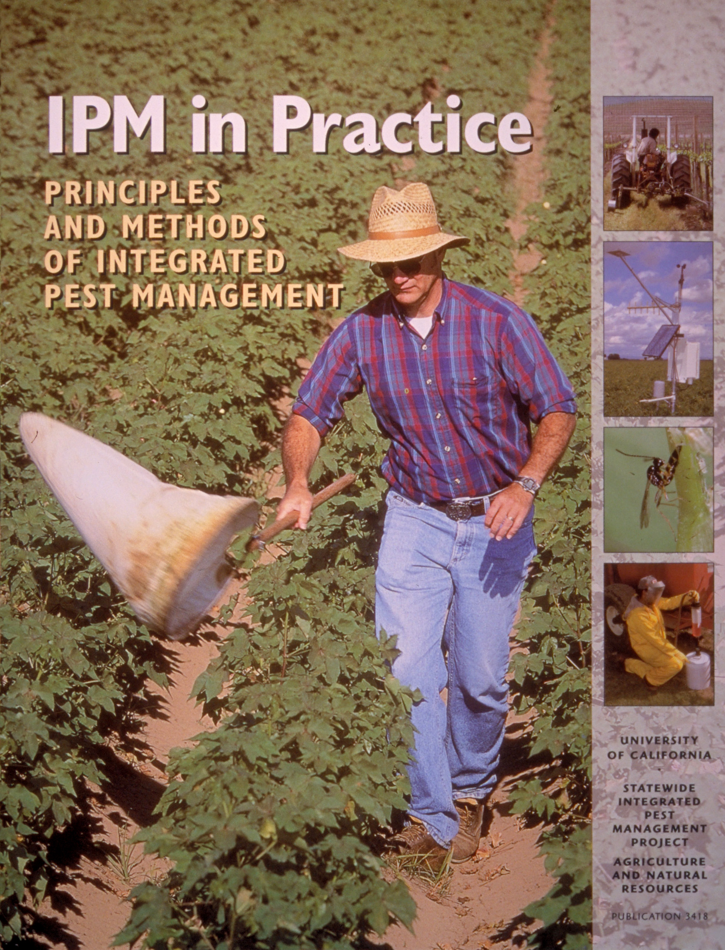
Basic study guide for PCAs
Flint and Gouveia, 2001
Second Edition available September 2012
www.anrcatalog.ucdavis.edu

Slide 11
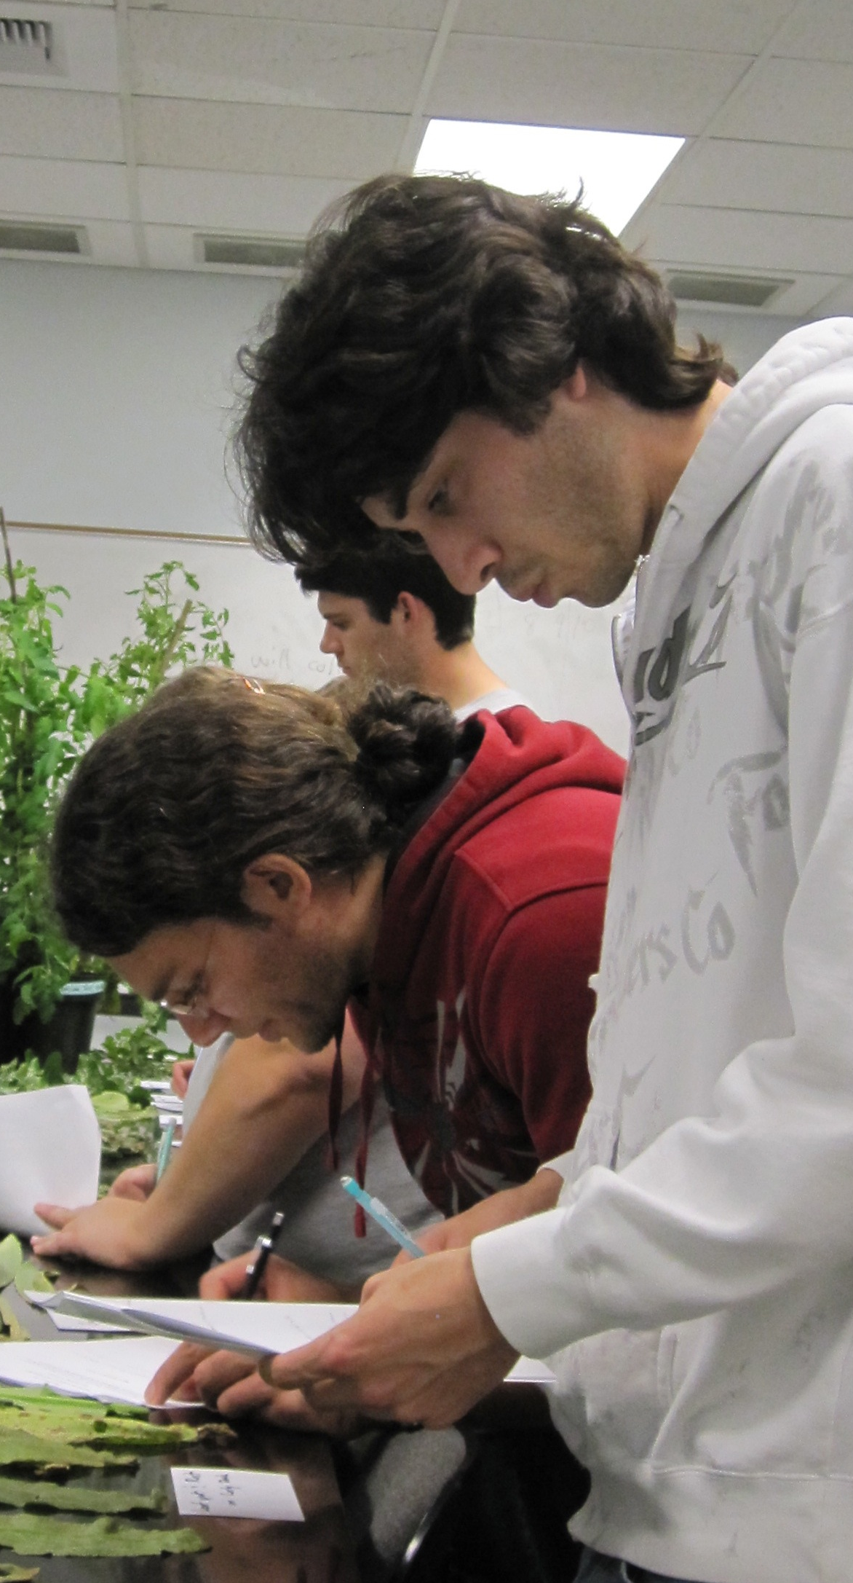
UC Davis Concepts in IPM course
Designed around the IPM KEs
Instructors: M. L. Flint (Entomology), K. Al-Khatib (Weed Science) (also R. Gilbertson Plant Pathology)
Textbook: IPM in Practice
Lecture and Laboratory
Goal is to give a practical overview of all aspects of IPM for students considering a career in pest management.

Slide 12
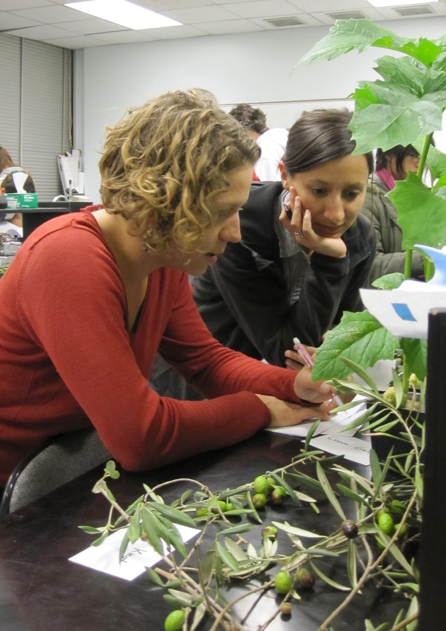
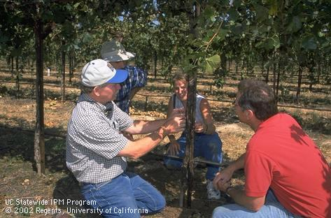
Laboratory and field experience
We bring in IPM Advisors and practicing PCAs to assist in labs

Slide 13
Weekly web assignments
Students learn how to solve problems using the UC IPM web site
  Year round IPM programs
  Pest models
  Degree-day programs
  Pest identification tools
  Environmental assessment tools
www.ipm.ucdavis.edu

Slide 14
Example Coursework for a UC Davis B.S. Student preparing to be a PCA
Physical and Biological Sciences (18 quarter units required)
General courses in biology, chemistry, ecology, botany and zoology
Crop Health (13.5 quarter units required)
PLP 120 Introduction to Plant Pathology (4)
PLS 176 Introduction to Weed Science (3)*
ENT 110 Arthropod Pest Management (5)
SSC 100 Principles of Soil Science (5)
NEM 100 or 110 Nematology (4)*
Pest Management Systems (9 quarter units required)
PLS 105 Concepts in Integrated Pest Management (3)
PLS 150 Sustainability and Agroecosytem Management (4)
ENT 135 Introduction to Biological Control (4)
Production Systems (9 quarter units required)
PLS110A Principles of Agronomic Crop Production (3)
PLS110C Crop Management Systems for Vegetable Production (4)
PLS 112 Forage Crop Ecology (3)
PLS 113 Biological Applications in Tree Fruit Management (2)*
PLS 171 Principles and Practices of Plant Propagation (4)*
+These are just example courses. Many additional UC Davis courses would qualify.
* These extra courses would be used towards the 13.5 unit “electives” requirement.

Slide 15
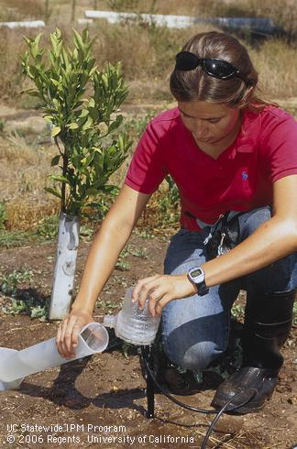
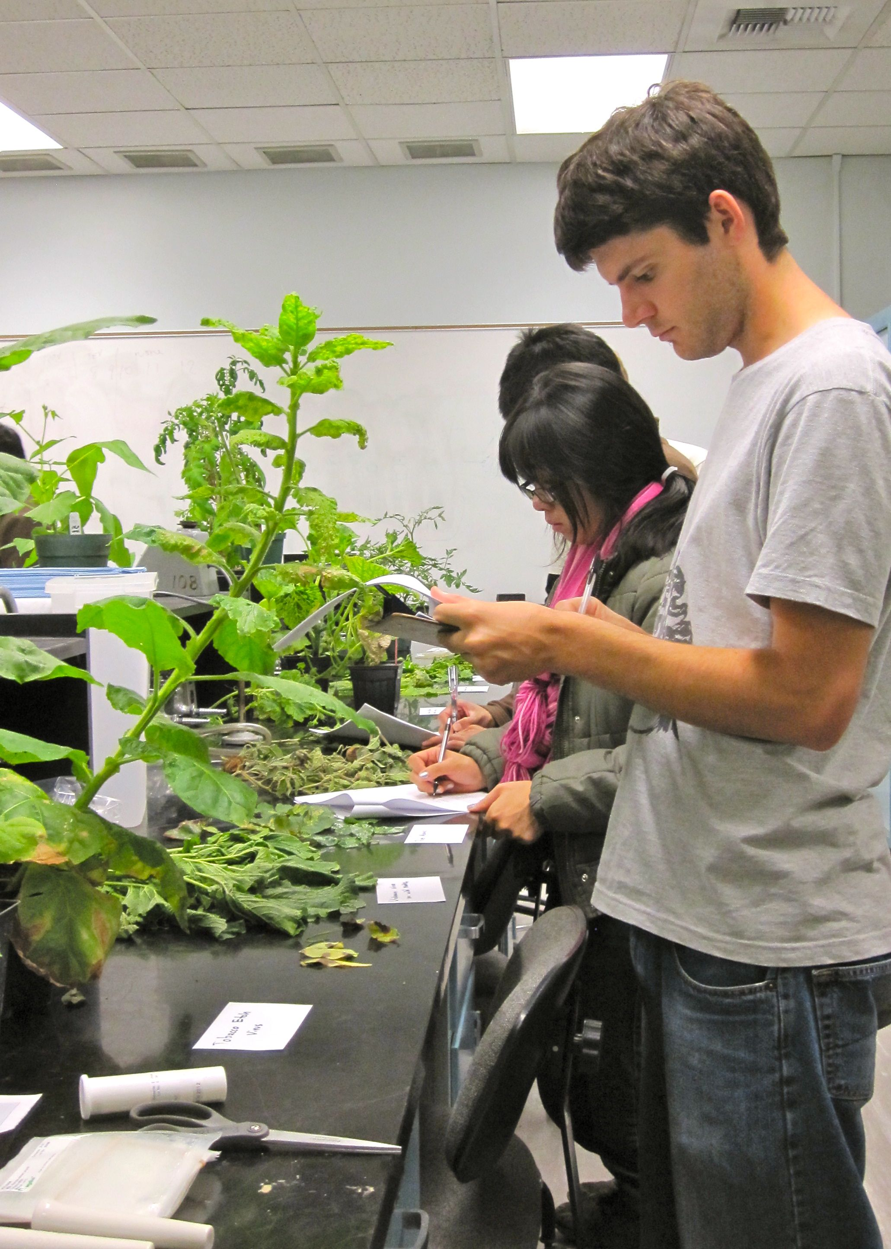
The future
About two-thirds of our class are interested in becoming PCAs
Good job market for PCAs
Class is full each year

Slide 16
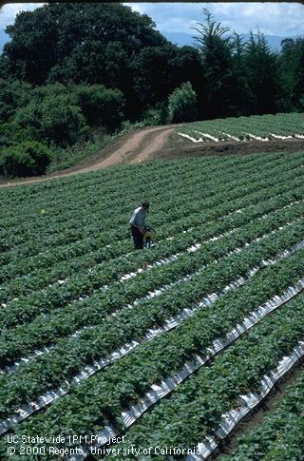
California’s PCA educational program has been a good cooperative project
Experienced PCAs in the field
California Department of Pesticide Regulation
University of California teaching academics
UC Cooperative Extension
UC IPM Program
Students and PCA applicants have benefited from
clear guidelines and practical requirements

