Slide 1
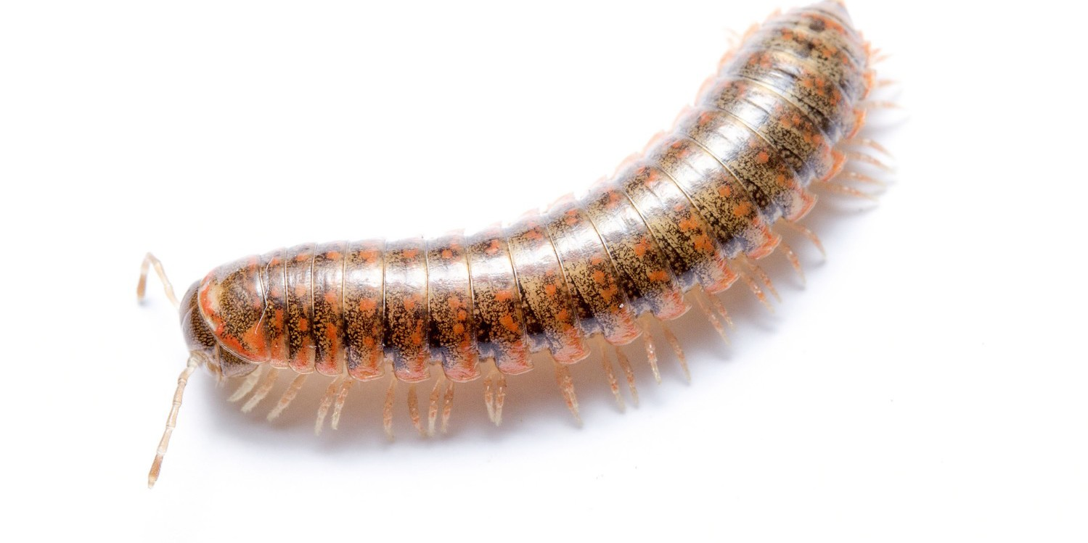

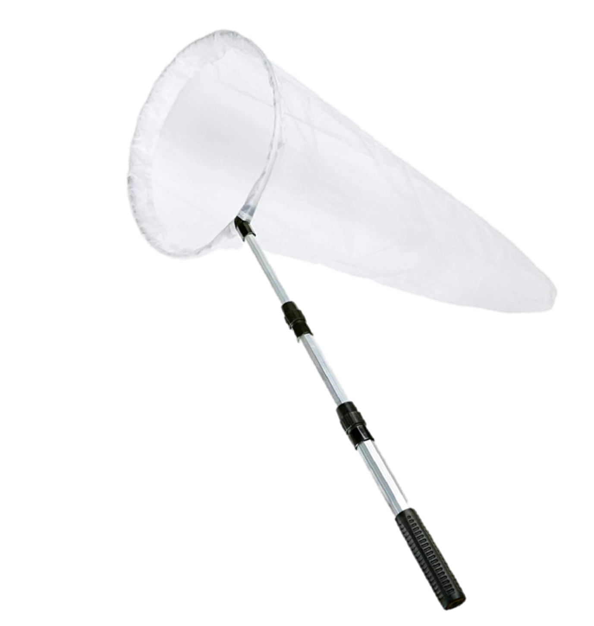



Arthropod Identification & Scouting
Adam Dale
IPM Academy 2019

Slide 2
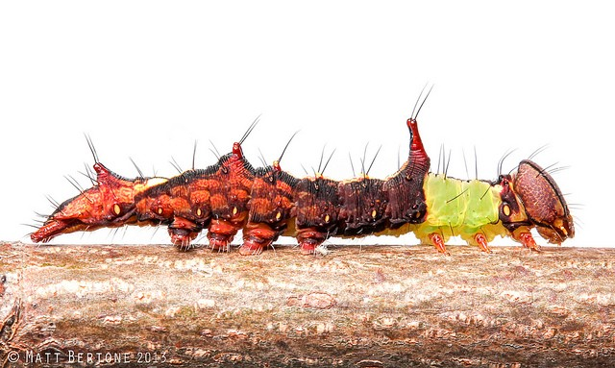
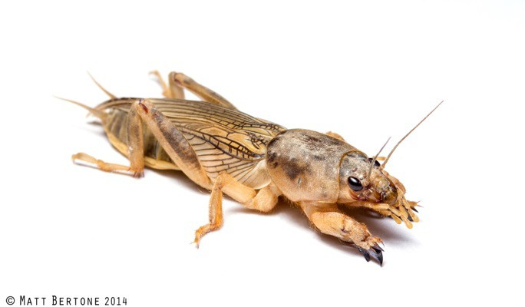
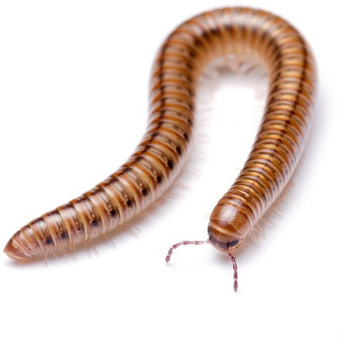
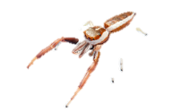
What is an arthropod?

Slide 4
http://edis.ifas.ufl.edu https://entnemdept.ifas.ufl.edu/creatures/
http://entnemdept.ufl.edu/insectid/ ljbuss@ufl.edu
http://nematology.ifas.ufl.edu/assaylab/index.html NEMALAB@ifas.ufl.edu
http://entomology.ifas.ufl.edu/extension/ http://entomology.ifas.ufl.edu/people-directory/
http://ifasbooks.ifas.ufl.edu/p-153-helpful-harmful- harmless.aspx

Slide 5
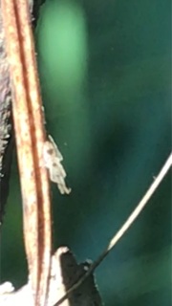
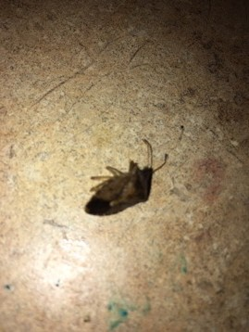
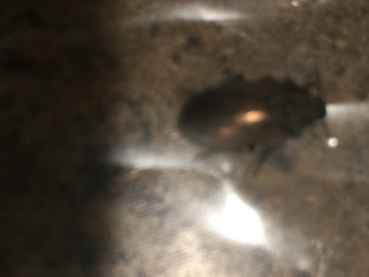

Slide 6
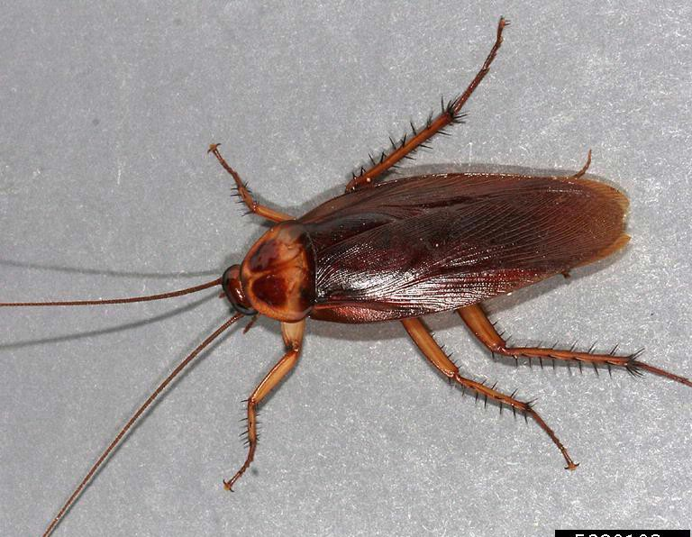
Common name: Palmetto bug
Common name: Water bug
Common name: Kakerlac
Common name: Bombay canary
Common name: American cockroach
The Challenges of Common Names
Scientific name: Periplaneta americana

Slide 7
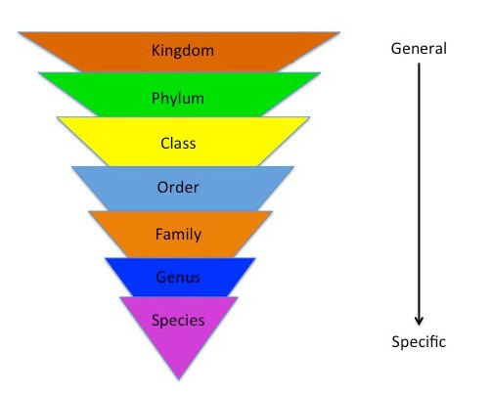
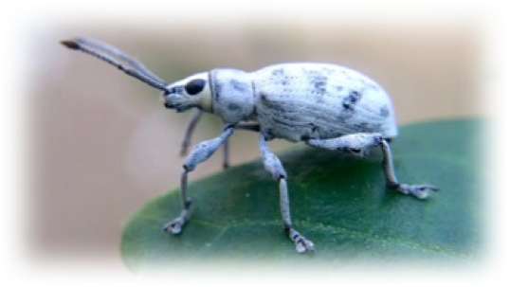
Ab

Slide 8
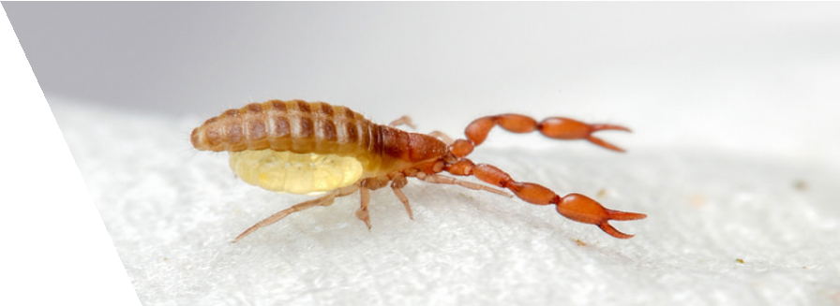
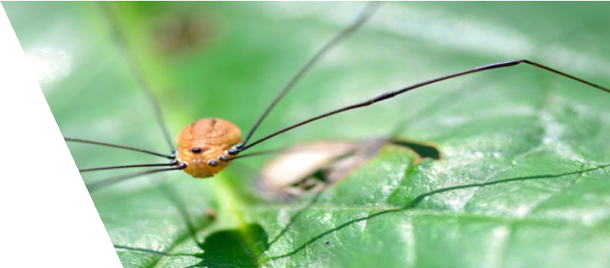
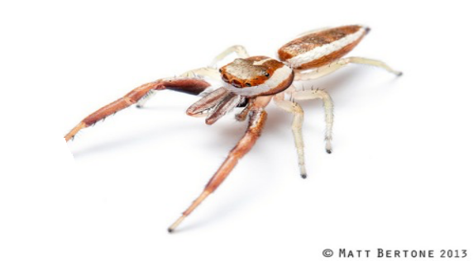
Arachnids
Orders of Arachnids
Scorpiones (scorpions)
Pseudoscorpiones (false scorpions)
Acari (ticks and mites)
Opiliones (daddy-longlegs
/harvestmen)
Araneae (spiders)

Slide 9
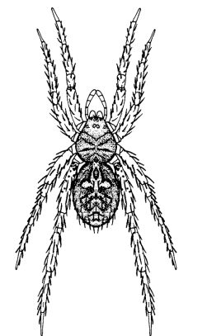
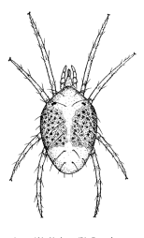

Slide 10
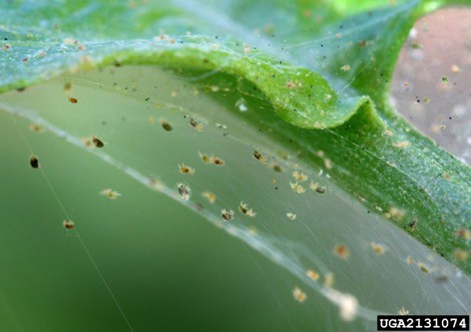
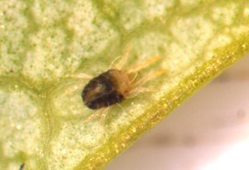
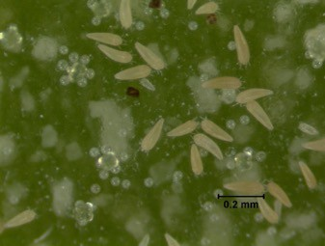
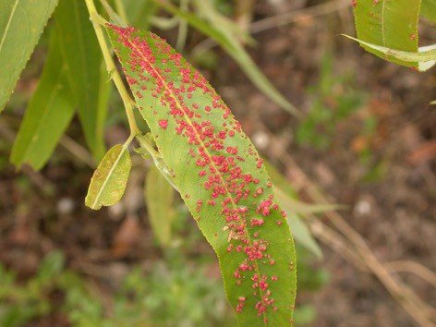
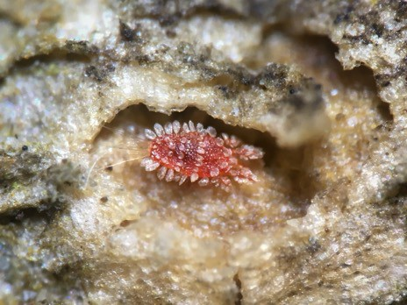
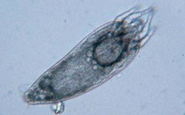

Slide 11
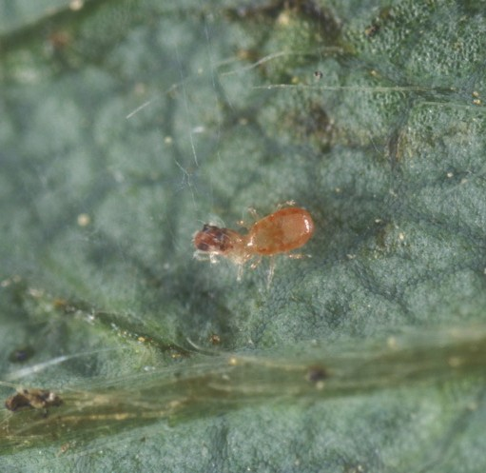
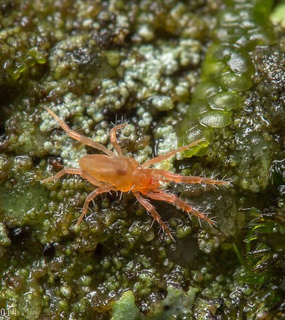
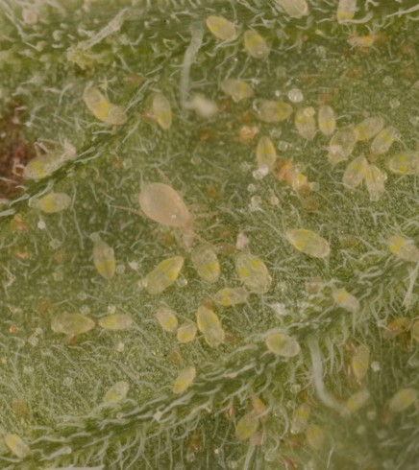
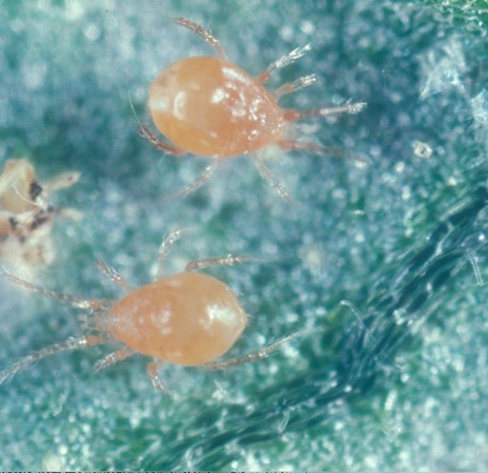
Horticulturally relevant predatory mites

Slide 12
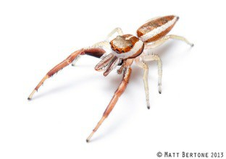
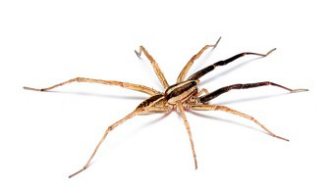
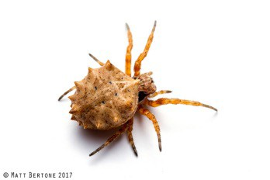
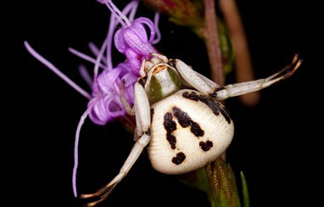

Slide 13
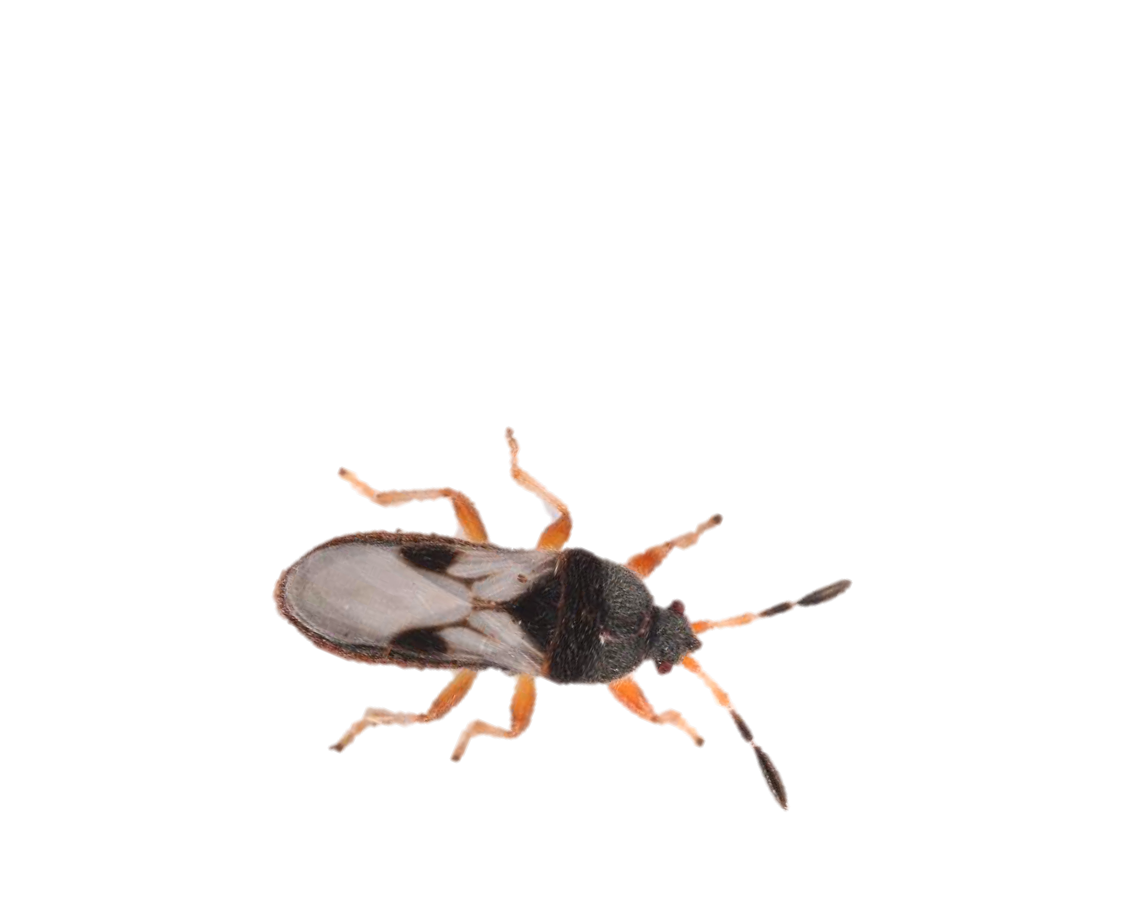



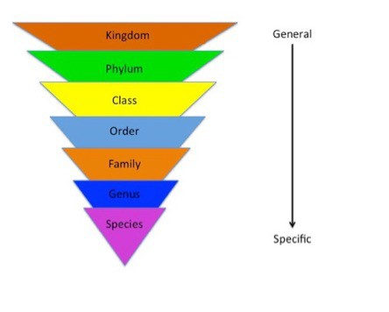

Slide 14
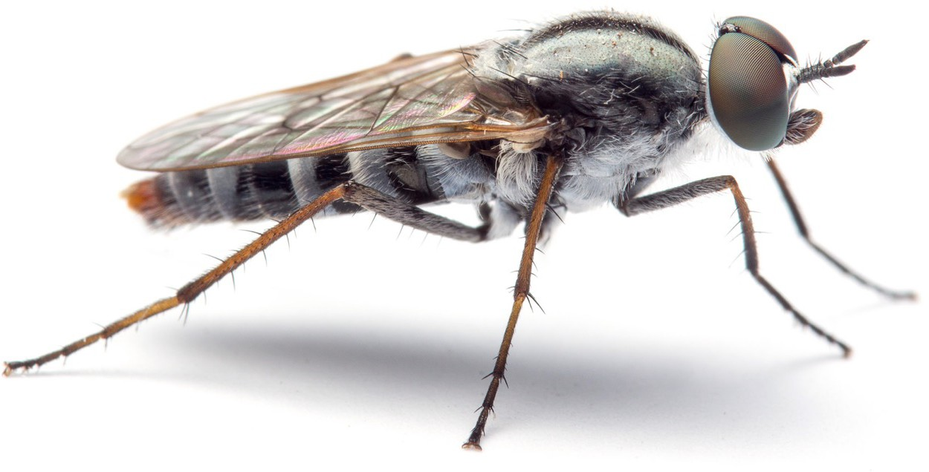
The insect body
Insect bodies are separated into three distinct
functional units:
Head
Thorax
Abdomen
3
2
1

Slide 15
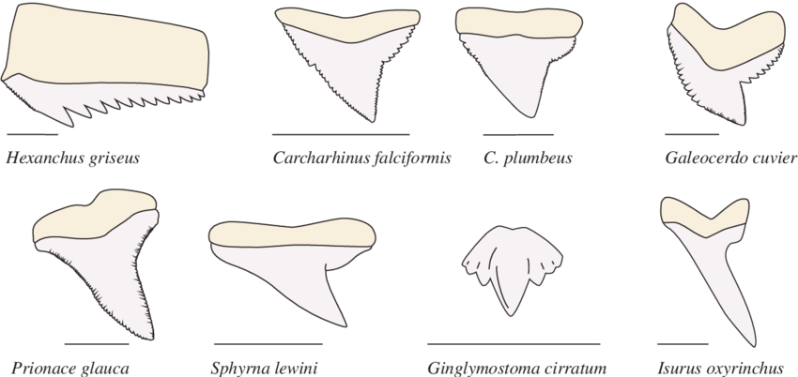
Do you know your mouthparts?

Slide 16
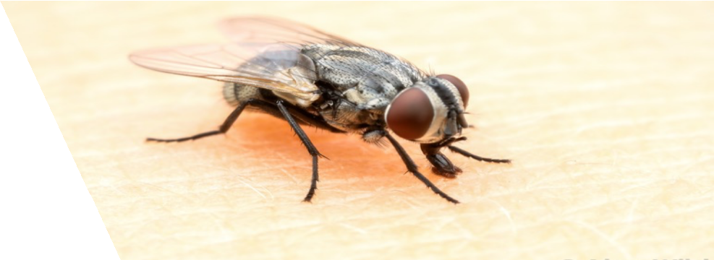
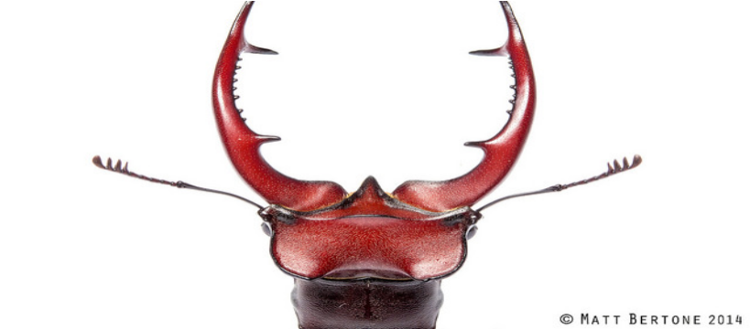
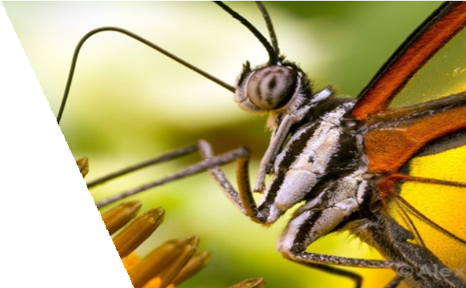
Insect Mouthparts
Chewing
Piercing-sucking
Rasping-sucking
Sponging
Siphoning

Slide 17

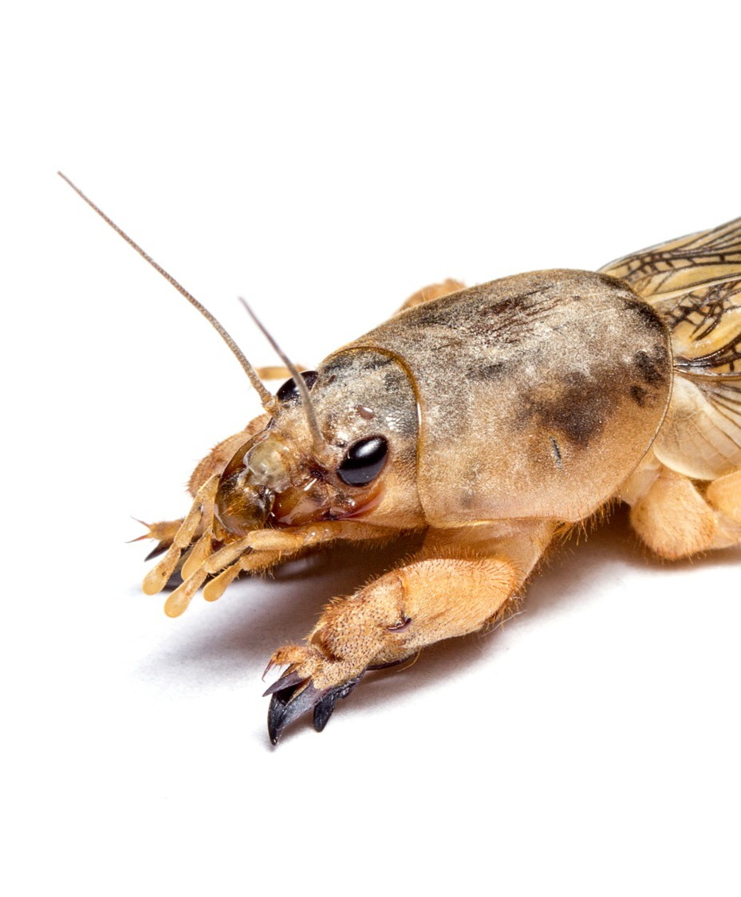
Mouthparts
Mandibles
Maxilla (Palps)

Slide 18
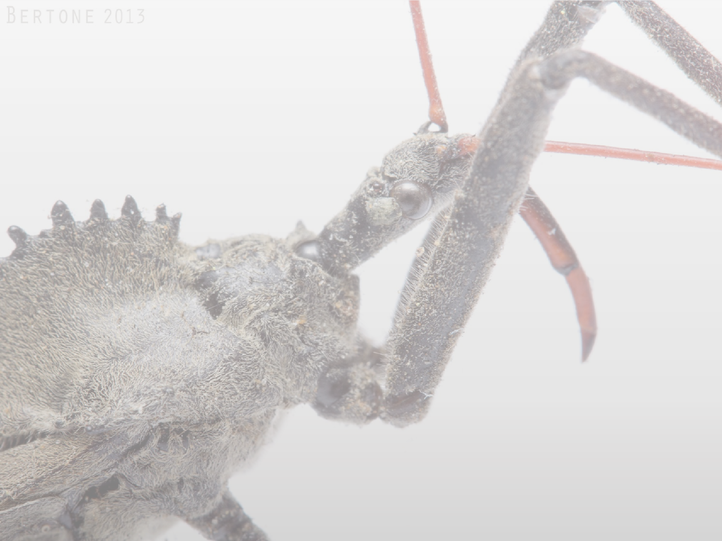
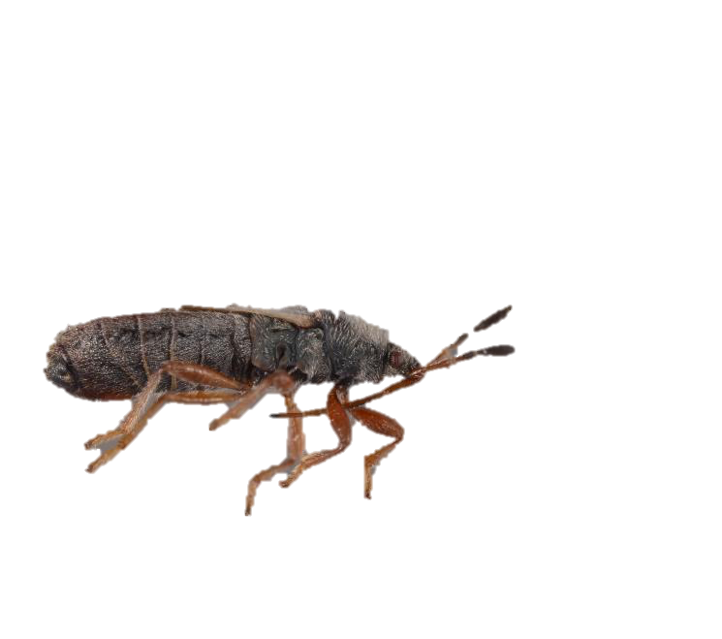
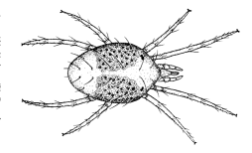
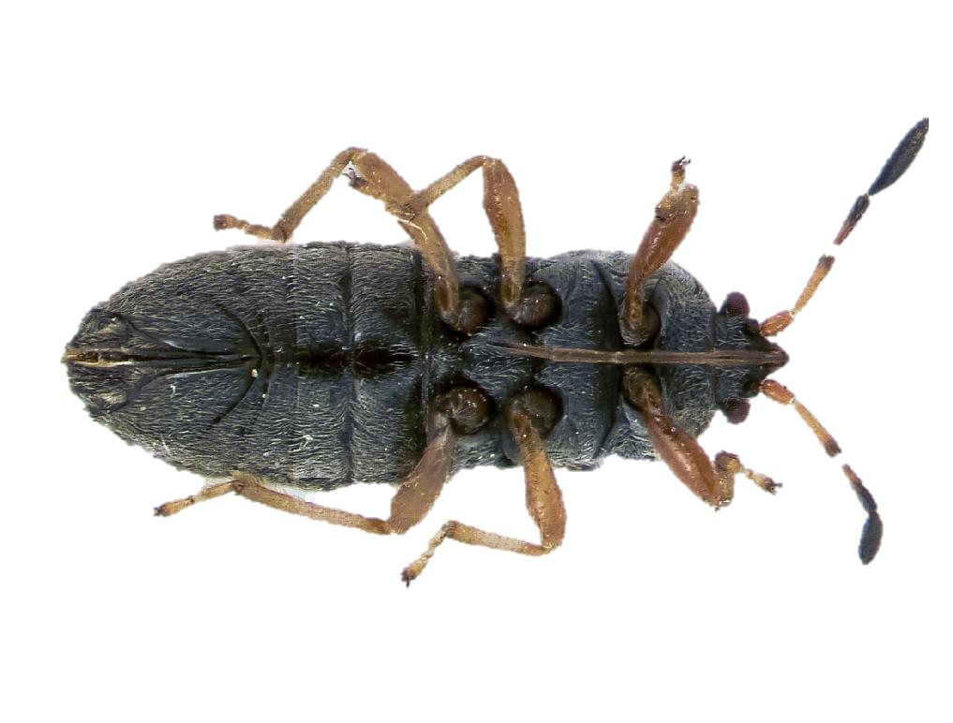
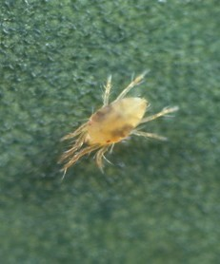
Piercing-sucking Mouthparts
Mouthparts are modified into stylets for piercing plant tissues or arthropod prey
Mouthparts extract nutrients from host plants or prey

Slide 19
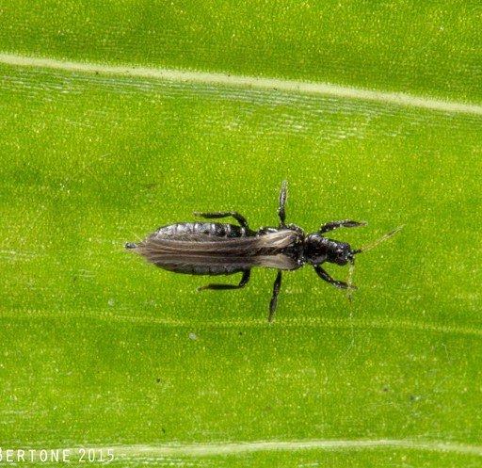
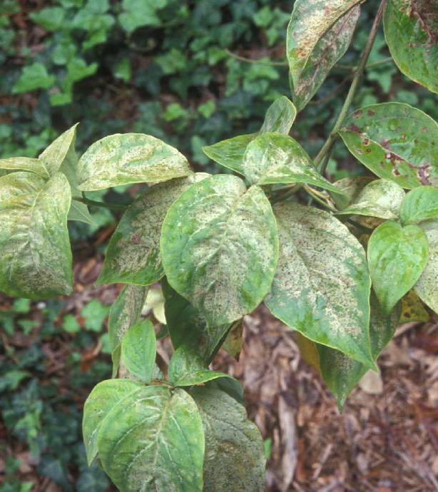
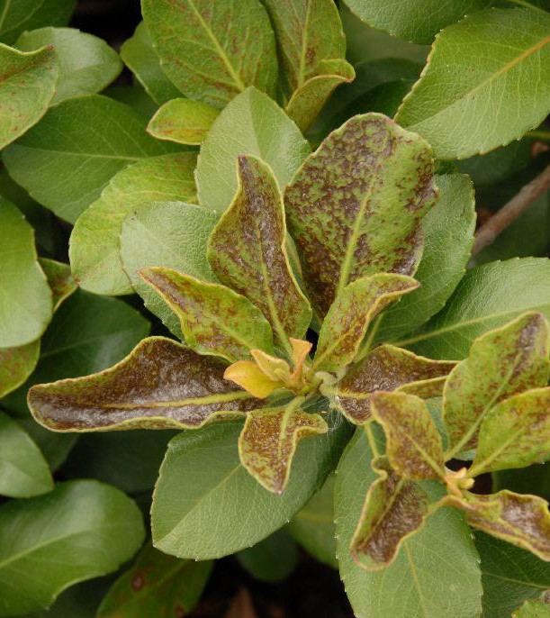
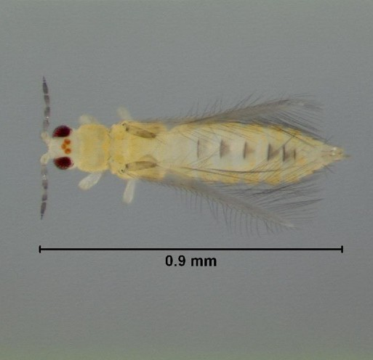
Rasping-sucking Mouthparts
A combination of piercing-sucking and chewing
Scrape surface of plant tissue and lap up the sap

Slide 20
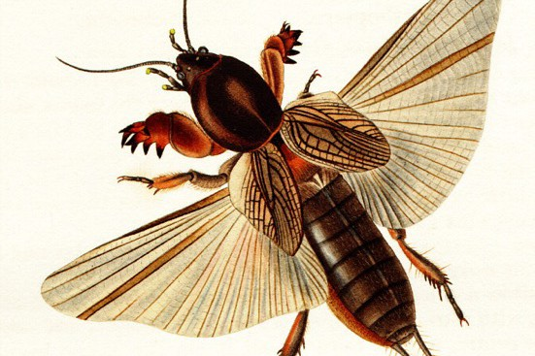
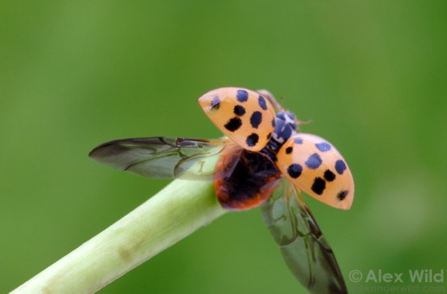

Who has wings?
Most adult insects have wings, but there are exceptions!
Immature insects never have wings
Groups with no wings: Fleas, springtails, silverfish
Groups with two wings (1 pair): Flies, male scale insects
Groups with four wings (2 pairs): Beetles, Earwigs, True bugs, Wasps, Bees, Crickets, and many others

Slide 21




annual cicada (Tibicen sp.)
© MATT BERTONE 2013

Slide 24




Short-winged Mole Cricket (Orthoptera: Gryllotalpidae: Neoscapteriscus abbreviatus)

Slide 26




Slide 27




Slide 28


Slide 29


Immature Insects
Typically the most damaging life stage
Incomplete metamorphosis: Nymph
Complete metamorphosis: Larva

Slide 30

spersal
ely taxonomically e stages

Slide 32





Slide 33



Slide 34


Slide 35



Slide 36





Slide 37



Slide 38


Contact info:
agdale@ufl.edu
352-273-3976
dalelab.org
Questions?

