Slide 1


How to Purchase High Quality Commercial Predators
Norm Leppla & Ken Johnson
University of Florida/IFAS
IPM Florida
ESA-SEB Annual Conference 2010

Slide 2




Quality Control for Predators
IOBC

Slide 3

International Organization for Biological Control
to facilitate and advance cost-effective rearing of high quality insects and other arthropods in support of biological control and integrated pest management
http://www.amrqc.org

Slide 4
Workshops of the IOBC, WGQC (AMRQC)
1982 Gainesville, Florida E. F. Boller and D. L. Chambers
1984 Wadenswil, Switzerland E. F. Boller and D. L. Chambers
1986 Guatemala City, Guatemala C. 0. Calkins
1988 Vancouver, Canada C. 0. Calkins
1991 Wageningen, Netherlands F. Bigler and J. C. van Lenteren
1992 Horsholm, Denmark F. Bigler
1993 Rimini, Italy M. Benuzzi and N. C. Leppla
1995 Santa Barbara, California R. F. Luck and N. C. Leppla
1998 Cali, Colombia N. C. Leppla and T. R. Ashley
2003 Montpellier, France P. De Clercq, S. Grenier and N. C. Leppla
2007 Montreal, Canada S. Grenier and C. S. Glenister
2010 Vienna, Austria P. De Clercq and T. A. Coudron

Slide 5
ANBP's Objectives
Members of ANBP are expected to adhere to a code of ethics which encourages the highest standards in the production and marketing of natural enemies.
Strengthen the commercial natural enemy industry.
Promote research and education on the use of natural enemies.
Develop quality certification programs for natural enemies.

Slide 6

ASTM International
ASTM International is a non-profit international organization with the purpose of "the development of standards on characteristics and performance of materials, products, systems and services; and the promotion of related knowledge.
Subcommittee E35.30 on Natural Multi-Cellular (Metazoan) Biological Control Organisms develops standard definitions, classifications, appropriate test methods, and recommended practices for quality, handling, distribution and use of natural multi-cellular biological control organisms.
(E35 Pesticides and Alternate Controls)

Slide 7
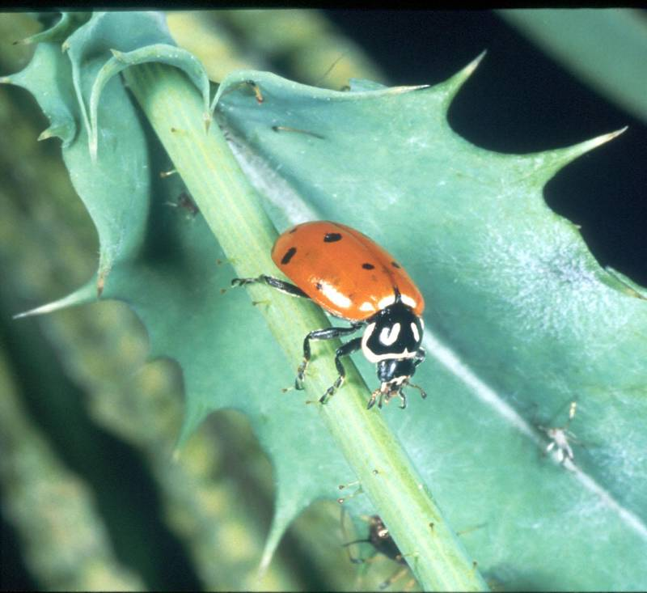
Specifications- Requirements for a product or service
Standards- The level of quality at which a specification is written

Slide 8
ASTM Specification for Cryptolaemus montrouziere
This specification covers information on and the test method for determining the purity, sex ratio, and number of adults in shipments of the predatory beetle Cryptolaemus montrouzieri (Order Coleoptera; Family Coccinellidae).
Because the efficacy of the biological control of mealybug by C. montrouzieri depends on accurate release numbers, presence of male and female species, and absence of live product contaminants, accurate packaging and maintenance of purity and viability of C. montrouzieri shipments is, therefore, essential for the effective management of the target pests. This specification is intended for use by producers and end-users of the specified biological control agent.

Slide 9
Guidelines for Purchasing and Using Commercial Natural Enemies and Biopesticides in Florida and Other States
N. C. Leppla and K. L. Johnson
More than 47 biological control companies provide nematodes, mites, insects, and bioinsecticides for pest management in Florida and the Southeast.
Predators are sold by 26 companies, 10 supply mites and 16 supply insects.
These companies list 12 mite species and 19 insects.

Slide 10
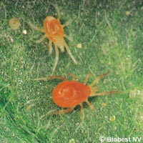
Commercial Predatory Mites
Laelapidae
1. Hypoaspis aculeifer
2. Hypoaspis miles
Phytoseiidae
Amblyseius (Neoseiulus) californicus
Amblyseius cucumeris
Amblyseius (Neoseiulus) degenerans
Amblyseius fallacis
Amblyseius swirskii
Galendromus helveolus
Galendromus occidentalis
Mesoseiulus (Phytoseiulus) longipes
Phytoseiulus macropilis
Phytoseiulus persimilis
*Plus predatory
mites on leaves

Slide 11
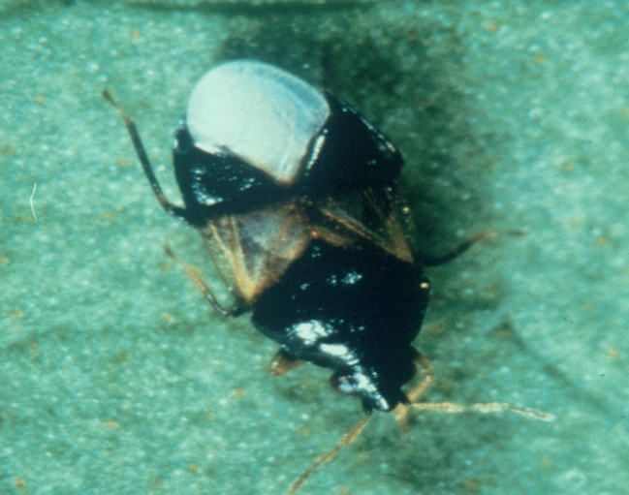
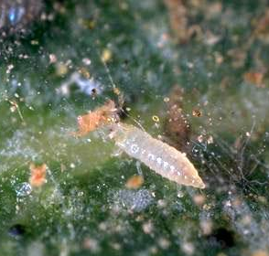
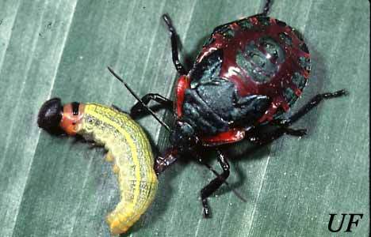
Commercial Predatory Insects
THYSANOPTERA
Thripidae
5. Scolothrips sexmaculatus
HEMIPTERA
Anthocoridae
Orius insidiosus
Orius laevigatus
Orius spp.
Pentatomidae
4. Podisus maculiventris

Slide 12
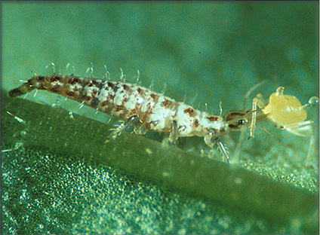
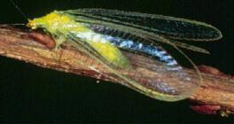
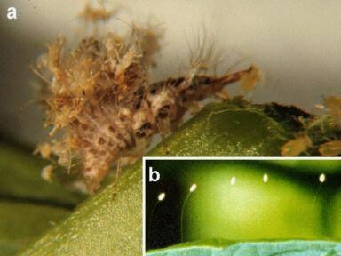
Commercial Predatory Insects
NEUROPTERA
Chrysopidae
6. Chrysoperla carnea
Chrysoperla rufilabris
Chrysoperla spp.

Slide 13
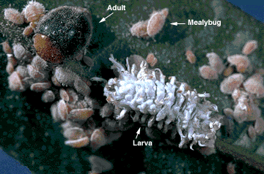
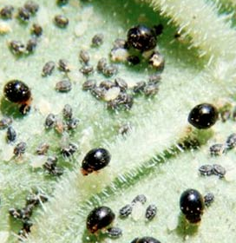
Commercial Predatory Insects
COLEOPTERA
Coccinellidae
9. Adalia bipunctata
10. Cryptolaemus montrouzieri
Cybocephalus nipponicus
Delphastus catalinae
Hippodamia convergens
Rhyzobius (Lindorus) lophanthae
Stethorus punctillum

Slide 14
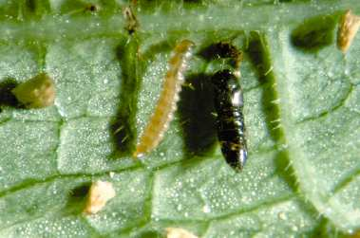
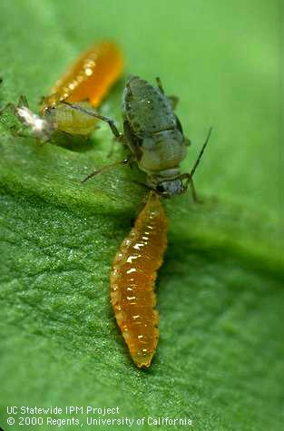
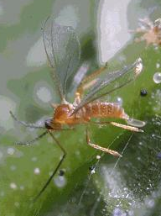
Commercial Predatory Insects
Histeridae
16. Carcinops pumilio
Staphylinidae
17. Atheta coriaria
DIPTERA
Cecidomyiidae
18. Aphidoletes aphidimyza
Feltiella acarisuga

Slide 15
Customer Service
Many of these companies provide detailed information on how to use their products.
The best companies deliver excellent customer service for site-specific biological control.
The marketplace ultimately determines the value of using commercial natural enemies.

Slide 16
Natural Enemy Quality Control References
van Lenteren, J. C. (ed.). 2003. Quality Control and Production of Biological Control Agents, Theory and Testing Proc. CABI Publishing. 327 p. (Leppla, N. C. Guidelines for quality control of commercially produced natural enemies).
Schneider, J. C. (ed.). 2009. Principles and Procedures for Rearing Quality Insects. Mississippi State University. 352 p. (Leppla, N. C. The basics of quality control for insect rearing).

Slide 17

IPM Florida: The UF, IFAS Statewide IPM Program
http://ipm.ifas.ufl.edu

