Slide 1
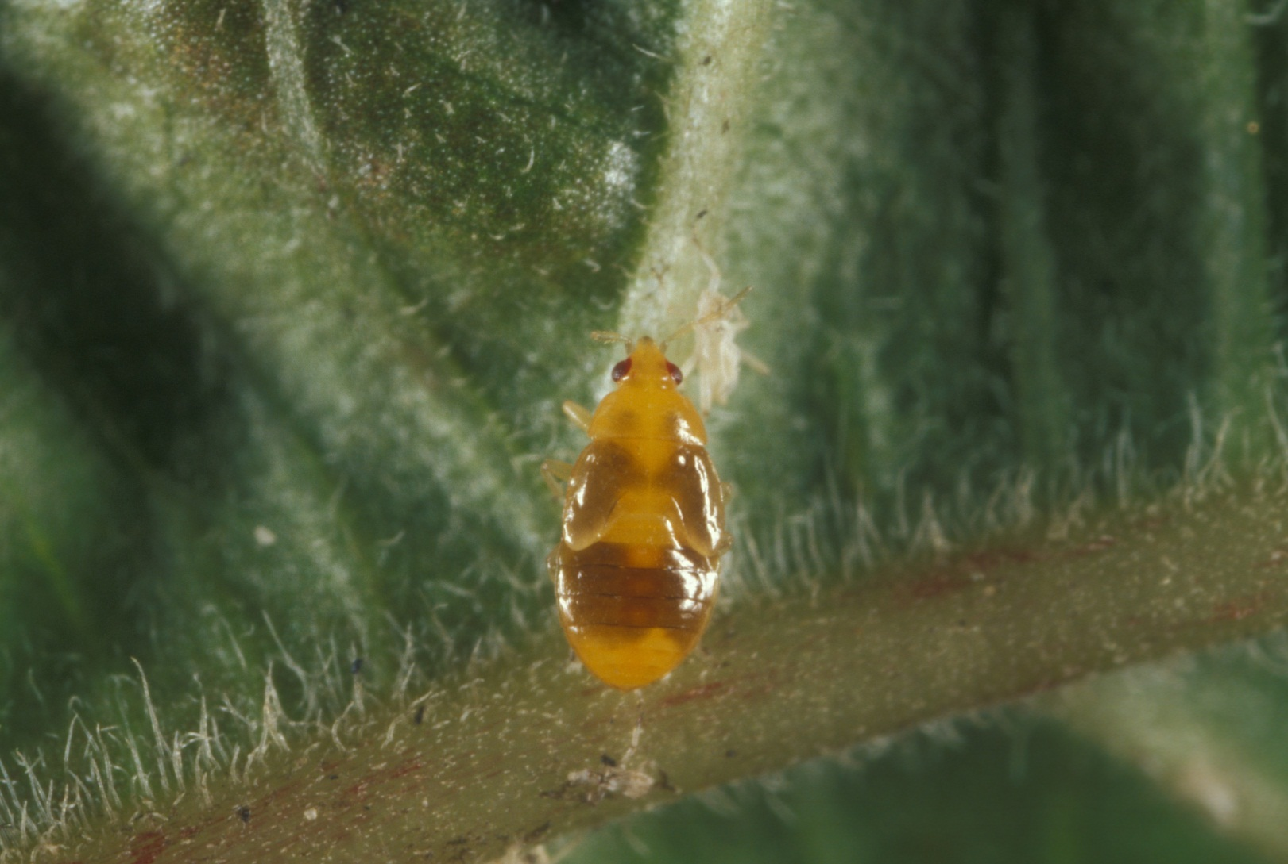
IPM THEORY & PRACTICE ENY6934 NORM LEPPLA & JOE FUNDERBURK FIRST FIVE WEEKS-LECTURES ON KNOWLEDGE REQUIREMENTS OF IPM PROGRAMS & CASE STUDIES OF IPM TACTICS & PROGRAMS

Slide 2
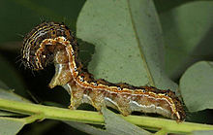
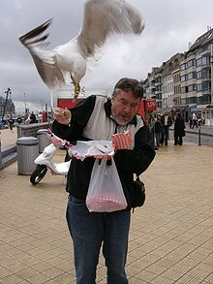
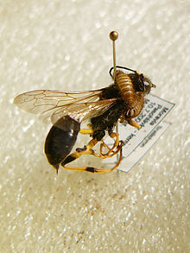
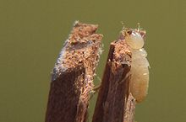
PEST: A SPECIES THAT INTERFERES WITH HUMAN ACTIVITIES, PROPERTY, OR HEALTH, OR IS OBJECTIONABLE http://en.wikipedia.org/wiki/Pest_(organism)
Caterpillars cause
crop damage
Seagulls steal
human food
Termites cause
structural damage
Carpet beetle larvae damaging a
specimen of Sceliphron destillatorius
in an entomological collection

Slide 3
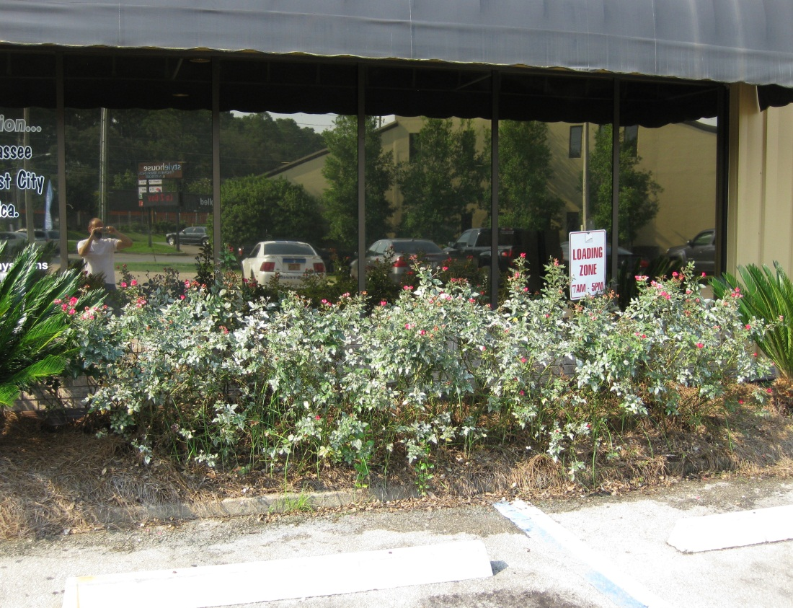
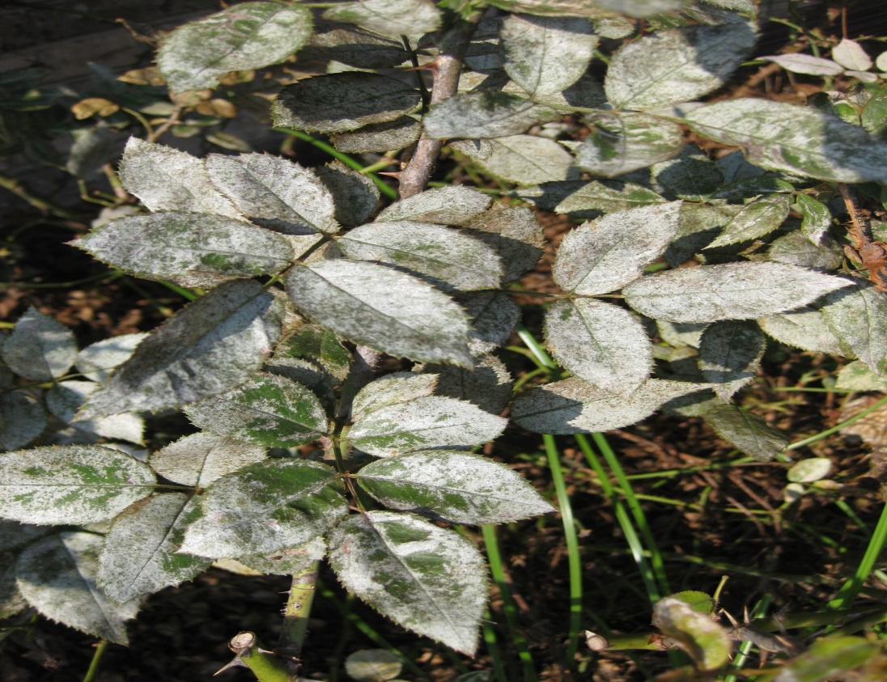
TO TOLERATE A PEST OR NOT TO TOLERATE? DECISION MAKING IN PEST MANAGEMENT injury: effects of pests on host physiology damage: measureable loss of host utility
Selenothrips injury (damage?)on knockout roses

Slide 4
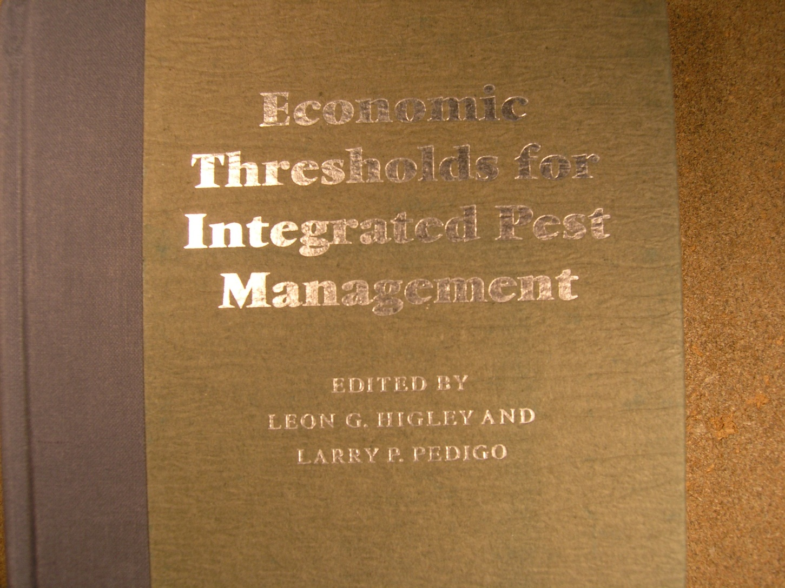
UNDERSTANDING BIOECONOMICS & DETERMINING PEST STATUS ECONOMIC INJURY LEVELS

Slide 5
JOE FUNDERBURK, UNIVERSITY OF FLORIDA,
Applying Ecological Information: Vertically Integrated IPM Using Thrips, Tospoviruses, and Vegetables As An Example
Photo Cheryle O’Donnell

Slide 7
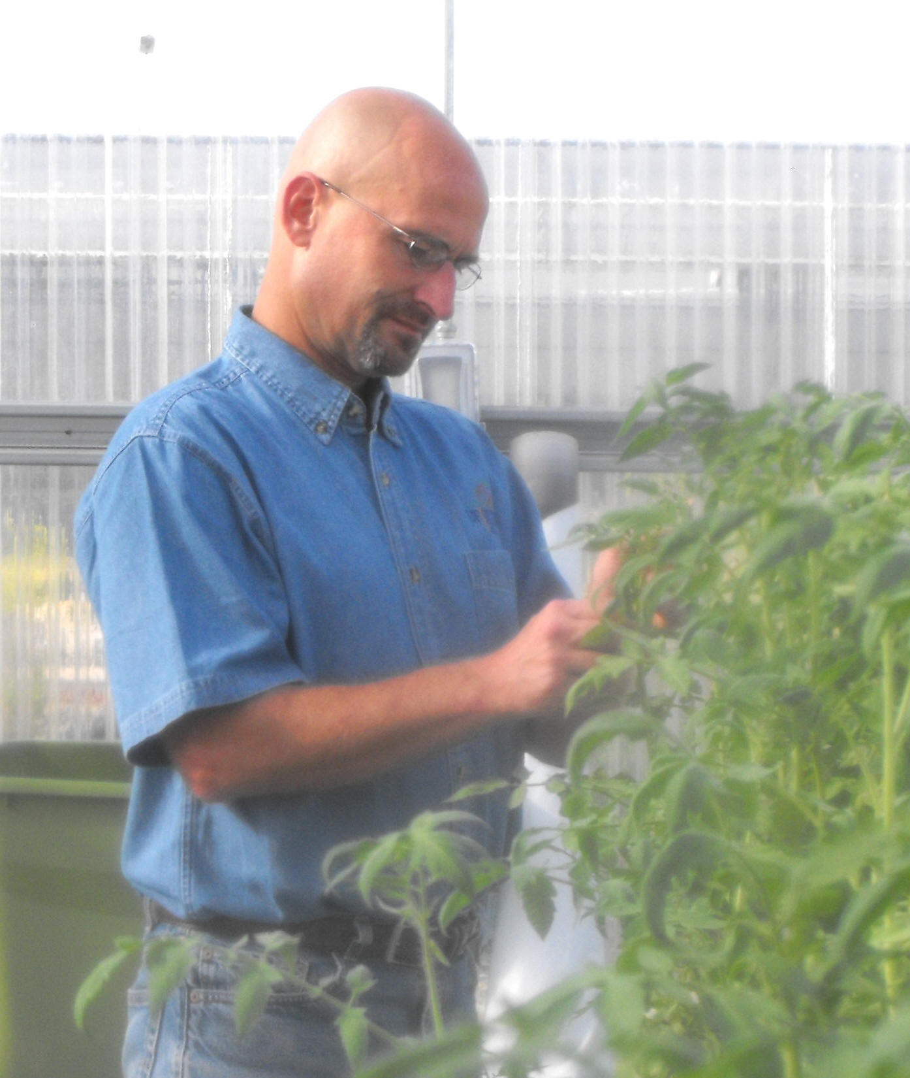
Hugh Smith, Asst Professor UF-Gulf Coast REC Balm, FL
Knowledge requirements to develop an Improved management program for whiteflies and tomato yellow leaf curl virus - - -
strategies to reduce insecticide use

Slide 8
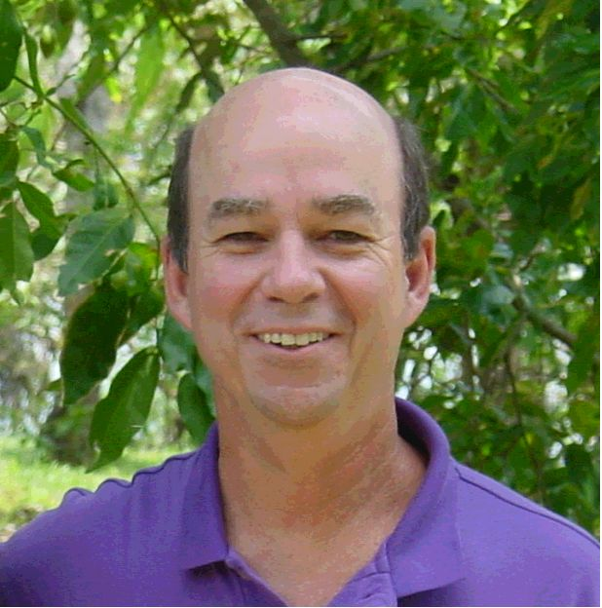
JOE EGER RESEARCH SCIENTIST DOW AGROSCIENCES TAMPA, FL
BIOLOGICAL PRODUCTS AND IPM:
SPINETORAM/SPINOSAD IN CROPS
SENTRICON SYSTEM FOR TERMITES

