Slide 1
Basics of Integrated Pest Management
Norm Leppla, Director
UF/IFAS Statewide IPM Program
Citrus IPM workshop
Indian River REC
Ft. Pierce, Florida

Slide 2
IPM Components
What is integrated pest management (IPM)?
How to respond to a new invasive pest.
Example of response to western flower thrips.
How to obtain IPM information.

Slide 3
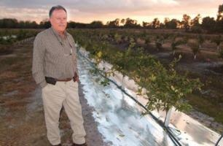
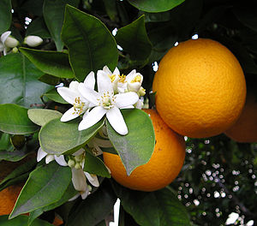
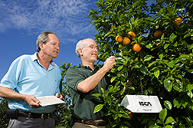
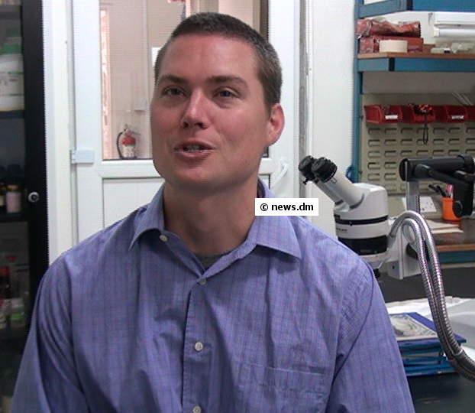
Experts in Citrus IPM
Mike Ziegler
Agricultural Resource Management
UF
Dr. David Hall
Dr. Phil Stansly
UF
USDA
Dr. Jawwad Qureshi
FDACS
Dr. Norm Leppla
Dr. Eric Rohrig
UF
UF
Dr. Larry Duncan

Slide 4
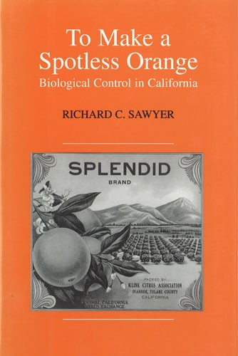
Integrated Pest Management
Supervised Control
“The Integrated Control Concept”
“Insect Control and the Balance of Nature”
Vernon M. Stern
Ray F. Smith,
Robert van den Bosch
Kenneth S. Hagen Hilgardia 1959
Ray. F. Smith
William W. Allen Scientific American 1954
Biological control + chemical control , if needed
Private Sector Crop Advisors

Slide 5
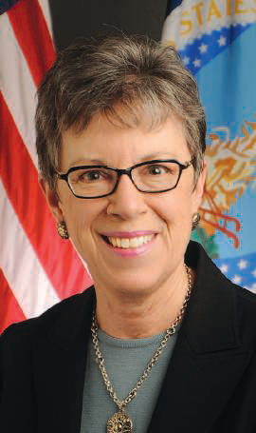
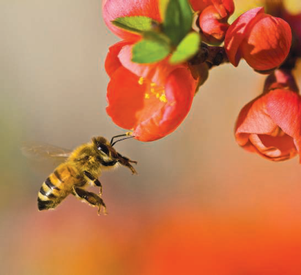
Honey Bee Colony Collapse Disorder (CCD)
“To fully address the range of interacting factors that contribute to bee declines, the EPA-USDA task force is taking a landscape-level systems approach to bee research and rescue, examining land-use patterns, nutritional stress associated with available forage, exposure and susceptibility to parasites and pathogens, bee genetic diversity, and the means to augment pollinator forage in all landscapes, in addition to minimizing pesticide exposures.
A meta-analysis should guide attention to the most urgent research. Steps to improve collaboration and information sharing among commercial beekeepers, agricultural producers, the research community, and other stakeholders will also be laid out. The task force’s goal is to turn around this decline as we proceed with our work over the next 5 to 10 years. As our knowledge increases during this time, there will be constant evaluation of research priorities and actions.”
Catherine Woteki , Chief Scientist and Under Secretary for Research, Education and Economics at the U.S. Department of Agriculture
SCIENCE VOL 341 16 AUGUST 2013

Slide 6
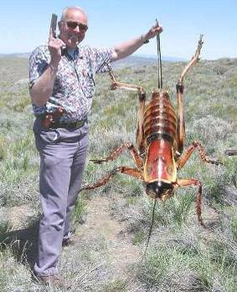
What is IPM?
IPM is the coordinated use of pest and environmental information and available pest control methods to prevent unacceptable levels of pest damage by the most economical means with the least possible risk to people, property, & the environment.

Slide 7
Complete IPM Program
Biological knowledge
Monitoring and inspection
Act to control pests when necessary
Choose least-risk options
Long-term, preventative practices
Evaluation and records
Pesticide management
Continual improvement

Slide 8
IPM System
Pest outbreaks & disease epidemics
Environmental contamination
Human health hazards
Pest mgmt. costs
Reduce risks
INCREASE…
Reliability
Sustainability
Chem
Biological Control
Cultural Methods

Slide 9
INTEGRATED PEST MANAGEMENT
Invasive Pest
Resistant Crop
Competitors
Natural enemies
Resistant varieties
Vulnerable Crop
Pesticide Program
New insecticides
New formulations
Application methods
Resistance management
IPM Program
Cultural practices
Scouting, ID of pests & NEs
Conservation of NEs
Augmentation of NEs
Reduced-risk insecticides
Resistance management

Slide 11
IRAC Insecticide Classification
Acetylcholine esterase inhibitor (Carbamates, Carbaryl; Organophosphates, Malathion)
GABA-gated chloride channel antagonists (Cyclodiene organochlorines, chlordane; Phenylpyrazoles, Fipronil)
Sodium channel modulators (Pyrethroids, Pyrethrins, Bifenthrin; DDT, Methoxychlor, DDT)
Nicotinic Acetylcholine receptor agonists (Neonicotinoids, Imidacloprid; Nicotine Nicotine; Sulfoxaflor, Sulfoxaflor
Nicotinic Acetylcholine receptor allosteric activators (Spinosyns, Spinosad)
Chloride channel activators (Avermectins, Abamectin; Milbemycins)
Juvenile hormone mimics (Juvenile hormone analogues, Methoprene, Fenoxycarb, Pyriproxyfen)
Miscellaneous nonspecific (multi-site) inhibitors (Alky halides, Methyl bromide, Chloropicrin, Sulfuryl fluoride)
Selective homopteran feeding blockers (Pymetrozine, Flonicamid)
Mite growth inhibitors (Clofentezine)
Microbial disruptor of insect midgut membranes (Bacillus thuringiensis and the insecticidal proteins they produce; Bacillus sphaericus)
Inhibitors of mitochondrial ATP synthase (Diafenthiuron; Organotin miticides, Azocyclotin)
Uncouplers of oxidative phosphorylation via disruption of proton gradient (Chlorfenapyr; Sulfuramid)
Nicotinic acetylcholine receptor channel blockers (Nereistoxin analogues, Bensultap)
Inhibitors of chitin biosynthesis, type 0 (Benzoylureas, Diflubenzuron)
Inhibitors of chitin biosynthesis, type 1 (Buprofezin)
Moulting disruptor, Dipteran (Cyromazine)
Ecdysone receptor agonists (Diacylhydrazines, Tebufenozide)
Octopaminergic receptor agonists (Amitraz)
Mitochondrial complex III electron transport inhibitors (Hydramethylnon)
Mitochondrial complex I electron transport inhibitors (METI acaricides and insecticides, Fenpyroximate, Rotenone)
Voltage-dependent sodium channel blockers (Indoxacarb)
Inhibitors of acetyl CoA carboxylase - Lipid synthesis, growth regulation (Tetronic and Tetramic acid derivatives, Spirotetramat)
Mitochondrial complex IV electron transport inhibitors (Zinc phosphide, Cyanide)
Mitochondrial complex II electron transport inhibitors (Beta-ketonitrile derivatives, Cyenopyrafen)
Vacant
Vacant
Ryanodine receptor modulators (Diamides, Chlorantraniliprole)
(UN) Compounds of unknown or uncertain mode of action (Azadirachtin, Azadirachtin; Cryolite, Cryolite)

Slide 12
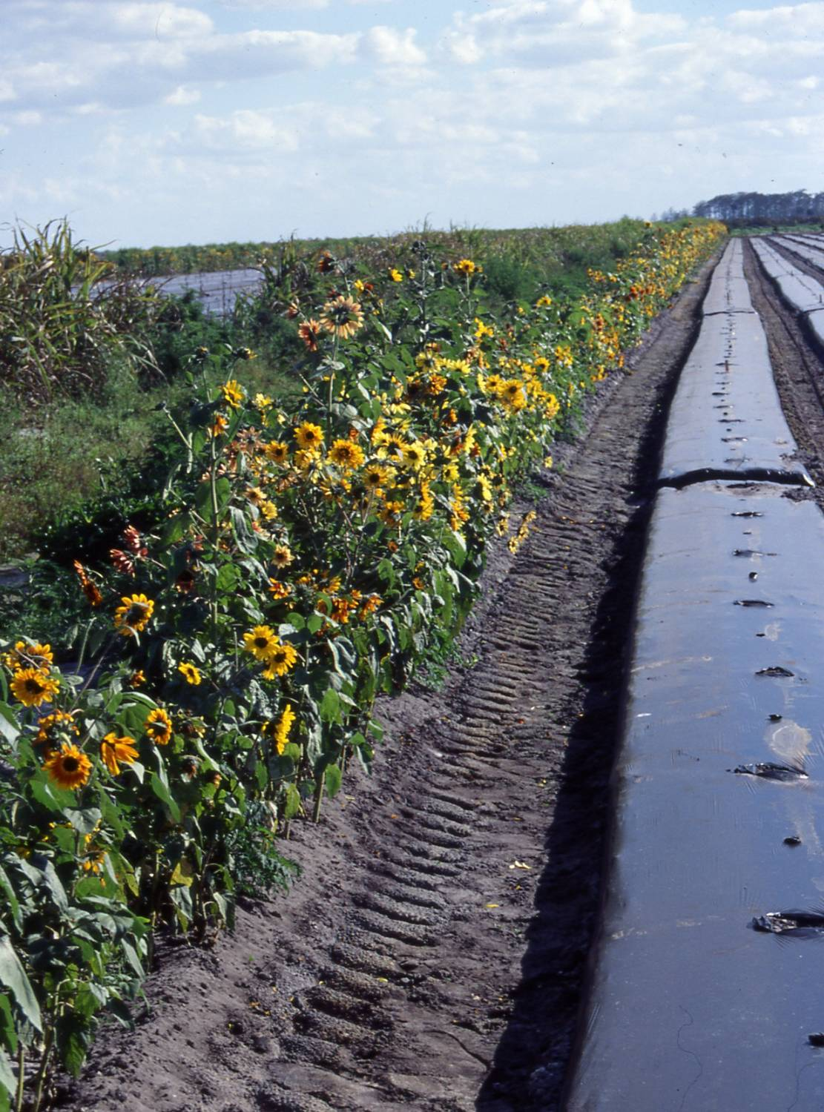
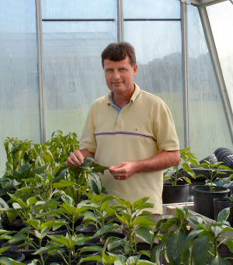
Western Flower Thrips in Pepper
Sunflowers
More Orius
Fewer thrips
Dr. Joe Funderburk

Slide 14
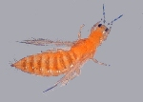
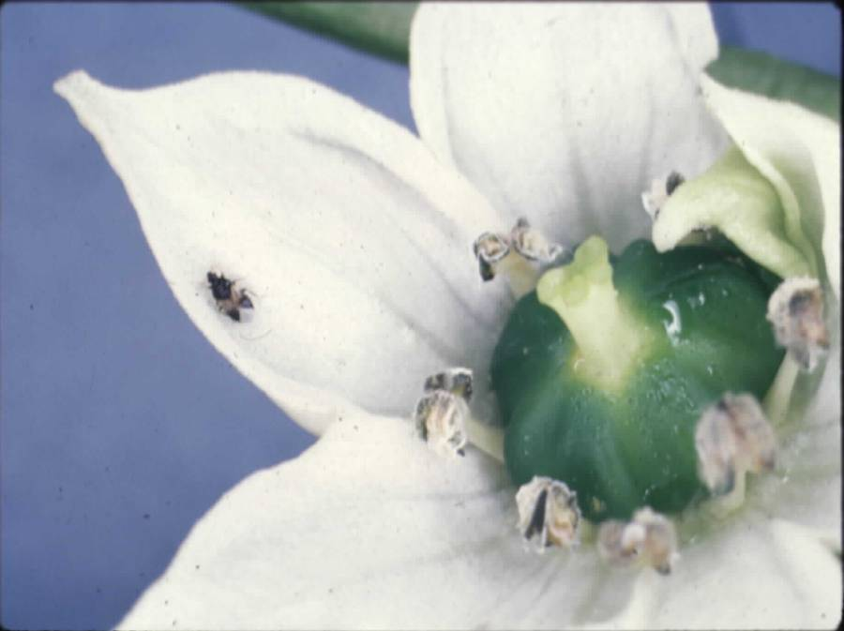
Pepper
Capacity of minute pirate bugs to reduce thrips populations
F. tritici
Suppression
1 predator/~180 thrips
Control
1 predator/50 thrips
Joe Funderburk
Orius insidiosus (Say)

Slide 16
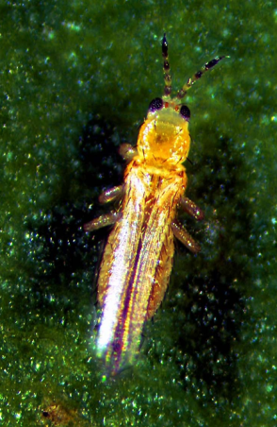
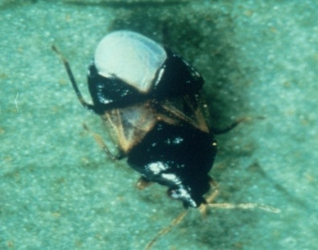
Western flower thrips
thrips larvae
Orius
50
Pepper
fenpropathrin
0.8
40
30
20
0.4
10
0
0.0
0.8
12
spinosad
8
per flower
Thrips per flower
0.4
4
Pirate bugs
0
0.0
0.8
12
untreated
8
0.4
4
0
0.0
14 17 19 21 24 28 31 3
May & June 1996
Funderburk, Stavisky & Olson 2000

Slide 17
Bioassay of Spinetoram toxicity to WFT
Pepper
Percent WFT Mortality
8 μg/ml
1000 μg/ml
IPM
Grower
Non-IPM
Grower
J. Funderburk, et al. 2008
Notes:
Thomas = IPM – Pero = Non IPM

Slide 18
Pest Resistant Crop - IPM
Conserve Competitors
Conserve Natural enemies
Frankliniella tritici (Fitch) Frankliniella bispinosa (Morgan) Frankliniella fusca (Hinds) Frankliniella schultzei (Trybom)
Orius insidiosus (Say)
Predaceous mites
Other predators
Augment natural enemies
Cultural Practices
Host-free period
Sanitation
UV reflective mulch
Resistant varieties
Predators
Reduced-risk insecticides
Spinosad and spinetoram
Scouting & ID of pests and NE
Resistance management
Economic thresholds
Radient (spinetoram)
Intrepid (methoxyfenozide)
Tomato spotted wilt virus

Slide 19
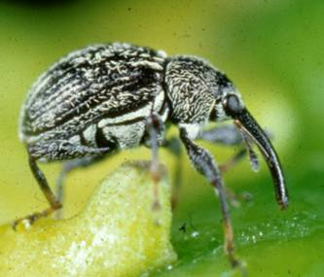
PEPPER
IPM for WFT in Florida
Distinguish adult & larval thrips, & ID adults.
Econ. thresholds: ~10 WFT/flower & ~3 larvae/fruit.
When peppers are flowering, use insecticides for thrips & other pests that conserve minute pirate bugs.
Never use insecticides that induce WFT.
Use ultraviolet-reflective mulch.
Use sunflower & other refugia to provide a source of minute pirate bugs.
Vertically integrate management of thrips & other pests, e.g., pepper weevil and Lepidoptera.

Slide 20
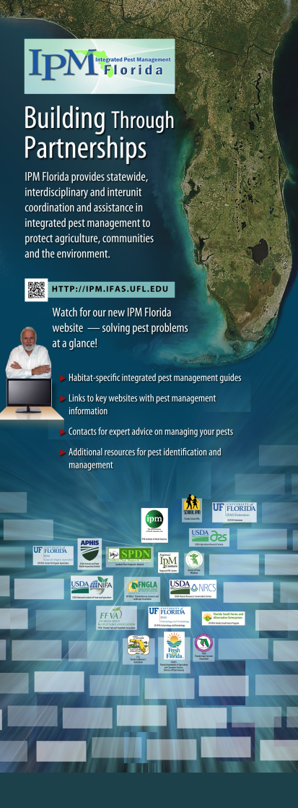
Direct Access to IPM Information
Habitat-specific IPM guides, fact sheets.
EDIS articles, Featured Creatures, etc.
Links to specialized websites with IPM
management information specific to
a crop or situation.
Key contacts for expert advice on
managing pests.
Additional resources for pest
identification and management,
e.g., diagnostic services.

Slide 21
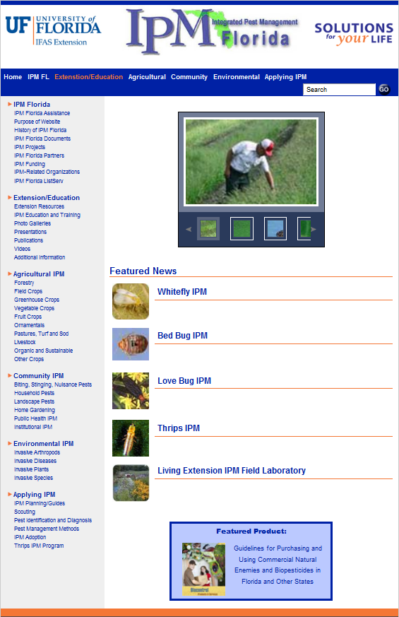
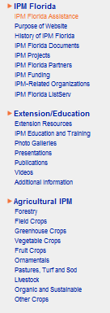
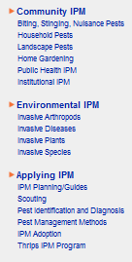

Slide 22
IPM Florida provides statewide, interdisciplinary and inter-unit coordination and assistance for UF/IFAS integrated pest management research Extension and education faculty
http://ipm.ifas.ufl.edu

