Slide 1
Trends in Biological Control in the
United States
Norman C. Leppla, Professor of Entomology
UF/IFAS Entomology and Nematology Department

Slide 2
Trends in Biological Control in the United States
What is biological control and what isn’t
Brief History of Biological Control in the U.S.
Status of Biological Control in the U.S.
Commercial Biological Control (ANBP)
Trends in Biological Control
Biological Control Needs
Notes:
Read objectives

Slide 3
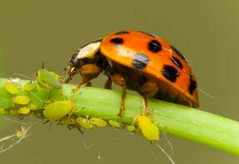
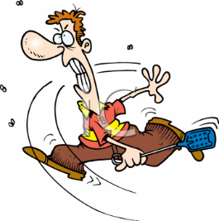
What is Biological Control?
The use of living organisms to control pest insects, weeds or diseases.
Involves some human activity.
Planet Natural
What isn’t Biological Control?
Botanical insecticides
Toxins, IGRs, pheromones
Mechanical control
Biobased pest management
Clipart Guide
Notes:
Pyrethrum, neem, vegetable oil
Bacillus thuringiensis toxins, Insect growth regulators (juvenile hormone), attractants
Is this mechanical or biological control?
Biobased- anything biological, e.g., sterile technique, trap crops

Slide 4
What Are Biological Control Agents?
Predators (kill, consume)
Parasitoids (parasitize, leave)
Pathogens (kill, compete)
Notes:
Predators, e. g. bears, carnivores
Parasitoids, specialized insect parasite that has a free-living stage
Pathogens, e. g. COVID-19! Compete- Trichoderma harzianum fungus to suppress soil pathogens

Slide 5
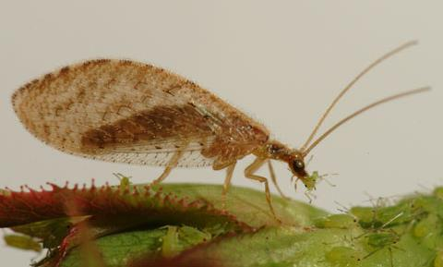
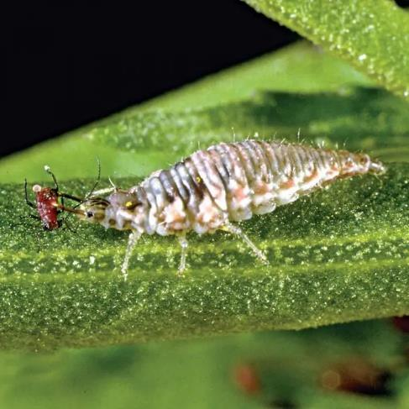
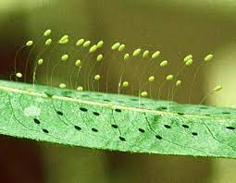
Lacewings
F. Heraux
Orange Co. CA
A.M. Leonard
mdc.mo.gov
Notes:
Grasping mouthparts
Adults and larvae predacious
Note stalks to protect eggs from predation by siblings

Slide 6
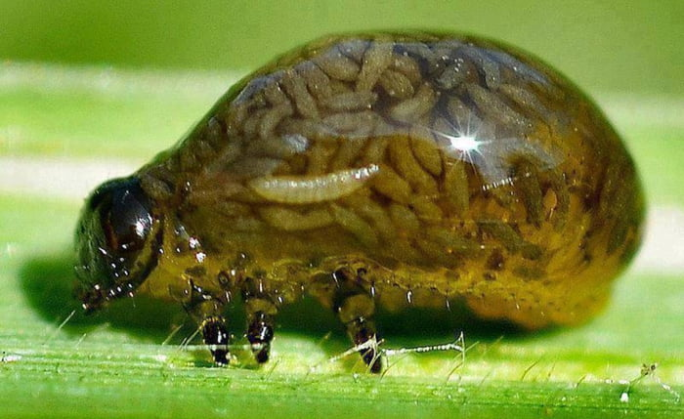
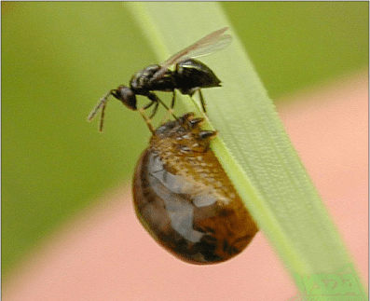
Parasitoid Larvae in a Beetle
Washington Ag. Dept.
Tetrastichus julis
9gag
Cereal leaf beetle, Oulema melanopus
Notes:
The endoparasitoids eventually kill the host but the host can continue to develop after being parasitized
Cereal leaf beetle and parasitoid wasp larvae

Slide 7
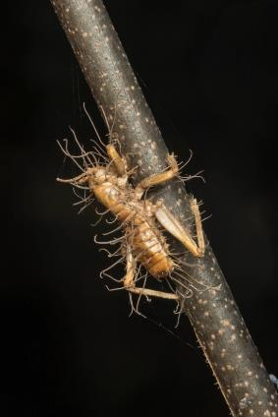
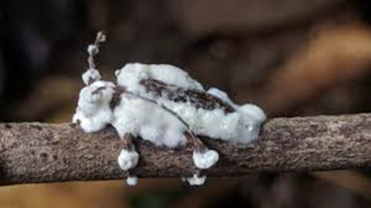
Insect Fungus
roadsendnaturalist
Drhoz.livejournal
Notes:
Cricket and longhorned beetle with fungal mycelia extending from the integument

Slide 8
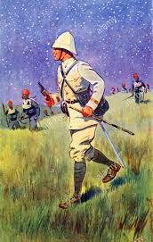
How is biological control implemented?
Biological control
Classical- Explore and import biological control agents
Augmentation- Mass-rear and release biological control agents
Conservation- Promote existing biological control agents
Alamy
Notes:
Explore regions where the invasive pest originated and is under control
Rear host and biological control agent
Preserve natural enemies and provide habitat

Slide 9
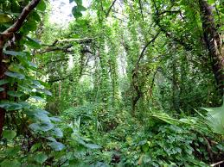
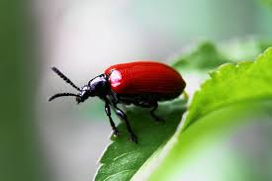
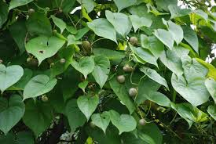
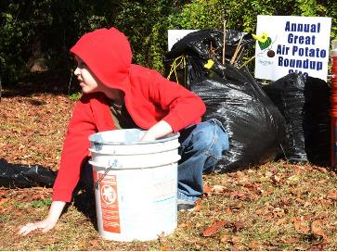
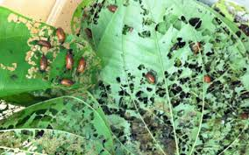
Classical (Importation) Biological Control
Mole cricket
Florida Times-Union
Orlando Sentinel
Everglades CISMA
FDACS DPI
Gainesville Sun
Notes:
https://entnemdept.ufl.edu/Creatures/BENEFICIAL/BEETLES/air_potato_leaf_beetle.htm
The native range of air potato includes much of Asia and Africa, and air potato in Florida probably originated from China.
A leaf feeding beetle, Lilioceris cheni, was introduced into Florida from China for biological control of air potato.

Slide 10
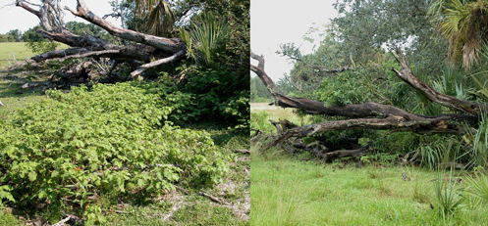
Tropical Soda Apple Biological Control
W. A. Overholt
Notes:
https://entnemdept.ufl.edu/creatures/BENEFICIAL/BEETLES/Gratiana_boliviana.htm
Successful biological control of tropical soda apple in Florida
Tropical soda apple is in the same plant family as tomato, so the biological control agent had to be host specific
Reinfestation occurs when cattle eat the soda apples and “plant” the seeds with their feces

Slide 11
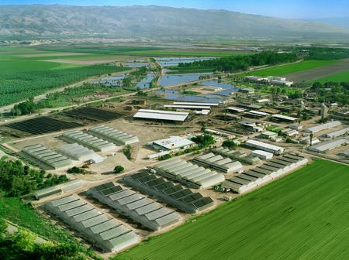
Bio-Bee Biological Systems, Israel
Augmentative Biological Control
Notes:
Bio-factories in Europe, Middle East, Mexico, South America, India, and other countries.

Slide 12
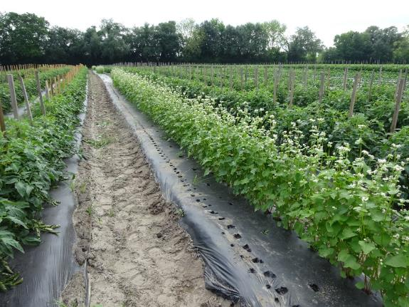
Conservation Biological Control
Abundance and diversity of beneficial and pest arthropods in buckwheat on blueberry and vegetable farms in north Florida. 2017. Cory Penca, Amanda Hodges, Lani Lei Davis, Norman Leppla, and Robert Hochmuth
Notes:
https://journals.flvc.org/flaent/article/view/88350/89312
An example of our cooperative research at Live Oak, Florida
Hoover Farm, Live Oak, Florida- buckwheat in sweet pepper
Questions about types of biological control?

Slide 13
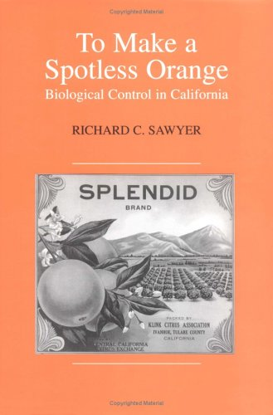
1868- Cottony cushion scale, Icerya
purchasi, invaded California.
1888- Vedalia beetle, Rodolia cardinalis,
imported from Australia and quickly controlled the pest.
1889- California growers and politicians
had a “ladybird fantasy,” a natural enemy exists for every pest.
1900- Entomologists began to understand how to conduct a successful
biological control program.
Notes:
Charles Valentine Riley sent Albert Koebele to Australia in 1888 to search for natural enemies of cottony cushion scale, Icerya purchasi.
Biological expertise was needed for foreign exploration, host-specificity testing, mass rearing, release methods, and impact evaluation.

Slide 14
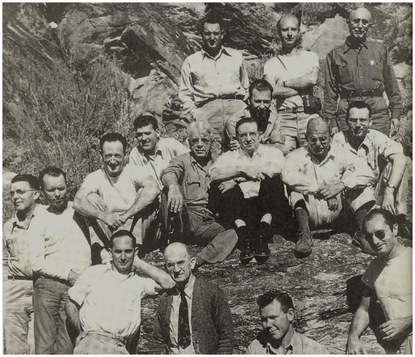
1919- 1940s- 1940s- 1947- 1952- | Harry Scott Smith formalized “biological control” as the use of predators, parasites, and pathogens Initial Florida biological control pioneers entered the field DDT widely used and created a “Magic bullet“ mindset Insect resistance to DDT 4400 pesticides, unacceptable non-target effects
1948
Carl Huffaker
Edward Steinhaus
Ken Hagen
Harry Smith
Paul DeBach
Everett Dietrick
Notes:
Harry Scott Smith, first head, beneficial insect investigations, University of California, “biological control”. (His photo on faculty desks!
Introduce IPM pioneers: Harry Scott Smith hired Carl Huffaker in 1946 to work at the Division of Biological Control, graduated Ohio State University 1942. Led the first national IPM project in the U.S.
Robert Van den Bosch “Pesticide Conspiracy” (on right with sunglasses)
I knew Hagan and Dietrick.

Slide 15
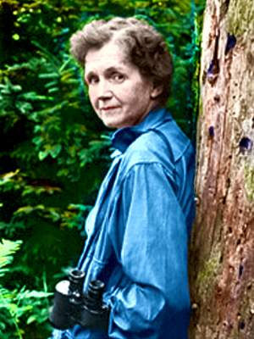
Concerns About Pesticides
1962- Rachel Carson
“Silent Spring”
1972- EPA cancels most uses of DDT
Notes:
My dept chair, a toxicologist, very unhappy, worked against cancellation of DDT.

Slide 16
Notes:
The states are in alphabetical order from the left. Seven states had 10 or more biocontrol personnel. Compare yellow, blue and green for number in state, federal and university employees (Total 340, state & federal 2/3 full time, university 1/3)(~170 FTEs). Easier to see in next slide.

Slide 17
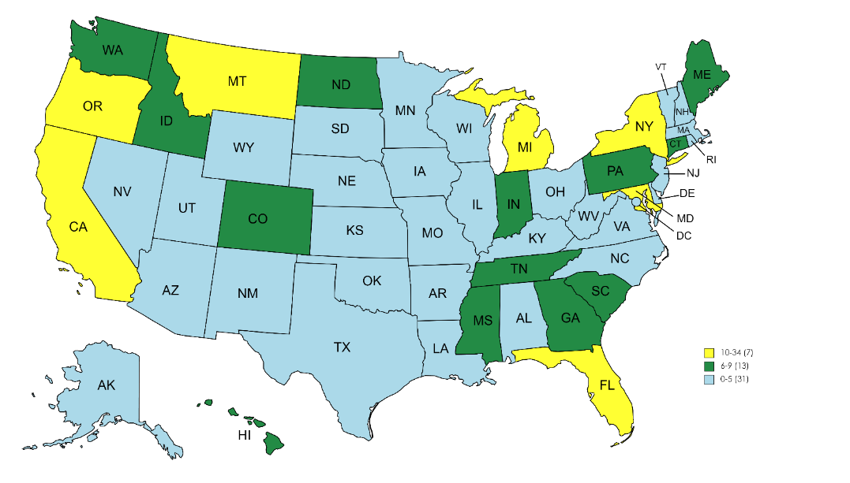
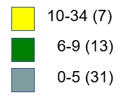
Distribution of Biocontrol Personnel
Notes:
Total biocontrol personnel (state, federal and university).

Slide 18
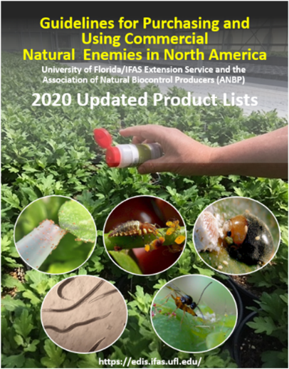
Association of Natural Biocontrol Producers
21 producers, 13 distributors, eight practitioners, and a few other contributors (scientists, extension agents, regulators, and students)
https://anbp.org

Slide 19
Production of Natural Enemies (Guide)
69 species of parasitoids and predators in North America
Parasitic nematodes (12)
Predatory mites (12)
Predatory insects (19)
Parasitic wasps (26)
Biopesticide and Organic Database (IR-4) (https://ir4app.cals.ncsu.edu/biopestPub/labelDb)
NPIRS (https://www.npirs.org/state/search-results)
CABI BioProtection portal (https://bioprotectionportal.com/)

Slide 20
339 responses, 124/340=37% responders
Notes:
Number of responses by 124 responders/total number of BC personnel who were sent the survey. Of the 11 applications for biocontrol, the top six were in yellow. Read top six.

Slide 21
Major Trends in Biological Control
Consolidation- fewer companies
New companies entering- Syngenta (traditional chemical)
Expanded production and mechanization (Koppert, Sparkbio)
Wider distribution (CABI ~35 countries)
Larger crops- row crops in addition to specialty crops
Biopesticides more than macroorganisms
Growth 10-15% per year (~1% of market)
Few new products or applications
Limited research- federal, state, university
Reduced formal education and training
Benefits and risks of biocontrol (FAO Code of Conduct)

Slide 22
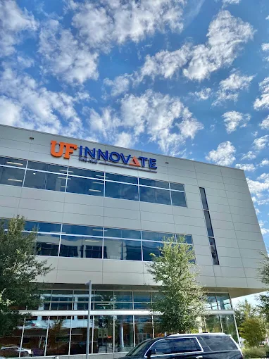
https://biofirstgroup.com/
UF Innovation Hub Gainesville, FL
Notes:
Biobest- BC, pollinators; BioWorks- biopesticides, biostimulents; Bioproducts- plant protection consultation; Biotrop- biopesticides, biostimulents

Slide 23
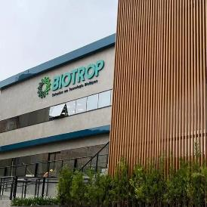
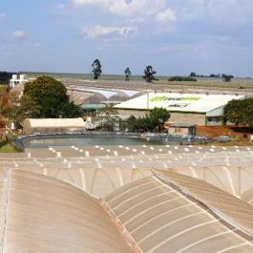
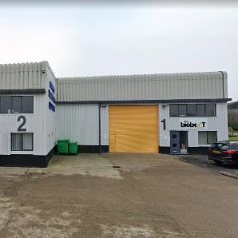
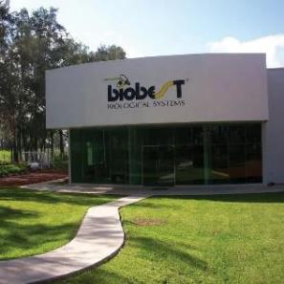
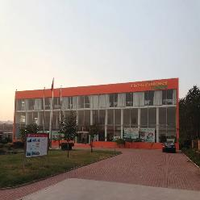
Brazil
Kenya
UK
Acquired Beneficial Insectary California
China
Mexico

Slide 24
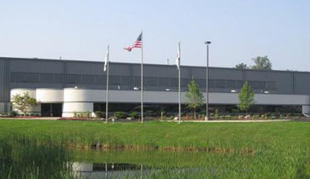
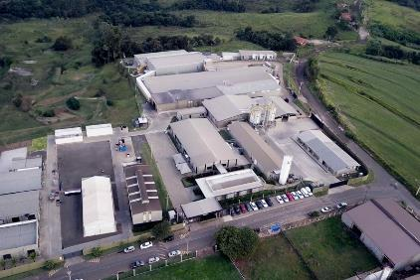
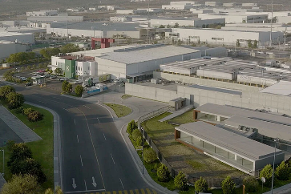
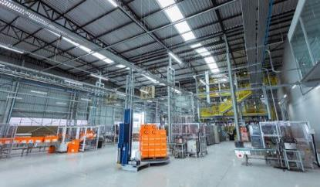
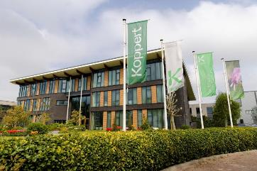
Howland, MI
Brazil
The Netherlands
Mexico

Slide 25
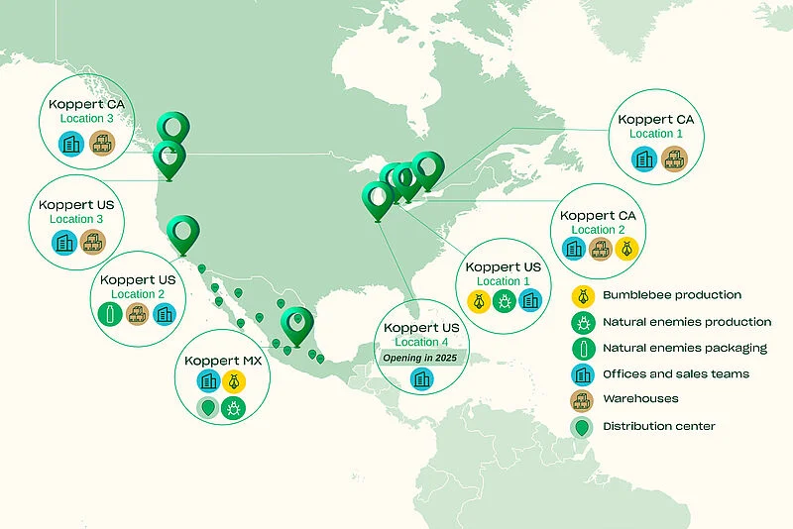
Koppert in more than 100 countries worldwide nearly 120 natural enemy solutions

Slide 26
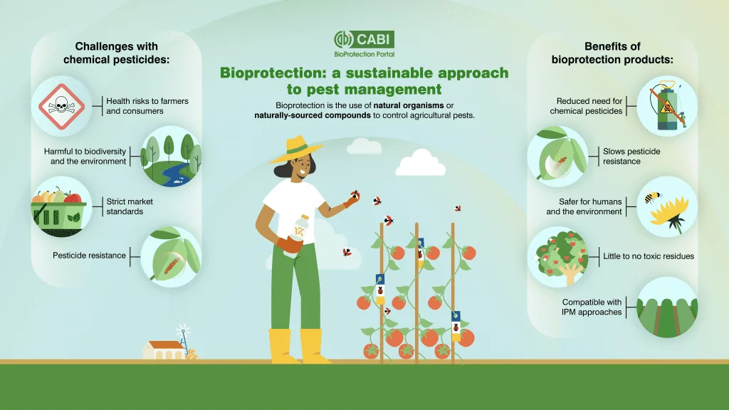
CABI

Slide 27
Needs for Advancing Biocontrol
Regulatory improvements- USDA, APHIS; USFWL; increase approved list
Research support- federal funding, USDA, SBIR, NRCS
Research- production, storage, application technology
Education and training- classroom, online
User support- Extension, private sector (as for chemical insecticides)
Marketing- customer acceptance, injury thresholds (blemished produce)
Biocontrol systems versus chemical control (effective, affordable)
National leadership- USDA, universities, SDA, private sector
Market incentives (pre- and post-harvest)- organic, ecolabels
Technology transfer- cooperative agricultural insectaries (Fillmore, DPI)
New products and services- bioinsecticides (strains, formulations), macro’s
Access- import biocontrol agents from countries
Engineering- facilities, automation, packaging, shipment
Post-release evaluation, documentation of successful systems

Slide 28
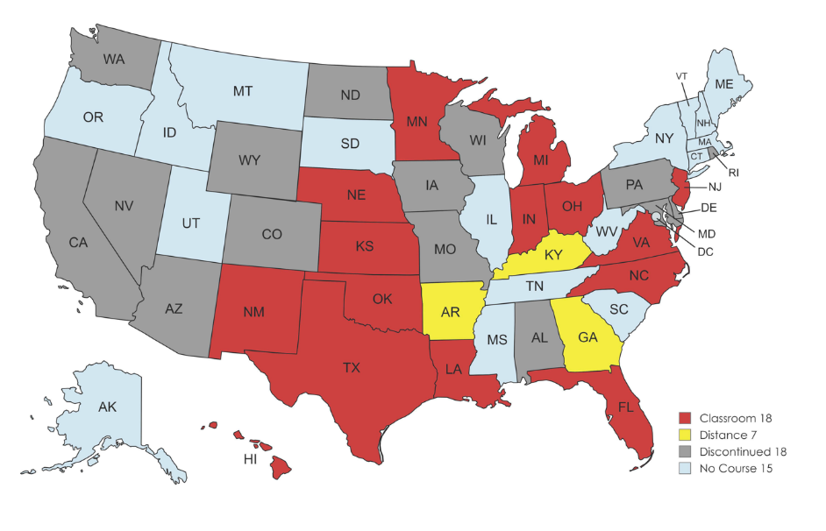
Biocontrol Education and Training
Classroom & Distance
4 universities
2 Courses
Total BC Courses
2 Universities
2 Courses
MapChart
Notes:
Classroom 18 states, Distance 7 states (4 with both classroom and distance), Florida 2 universities, California 4 universities, NM 2 courses, Hawaii 2 courses

Slide 29
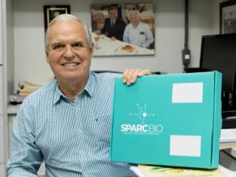
SPARCBio
Biological Control Research Center (São Paulo Advanced Research Center for Biological Control)
Esalq. Entomology and Acarology, Piracicaba, São Paulo, Brazil
Professor José Roberto Postali Parra, Center’s Director
Partnership between FAPESP (São Paulo Research Foundation), Escola Superior de Agricultura “Luiz de Queiroz” (Esalq/USP) and Koppert Biological Systems.

Slide 30
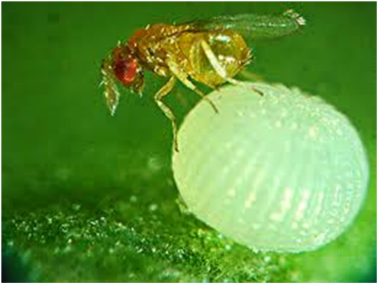
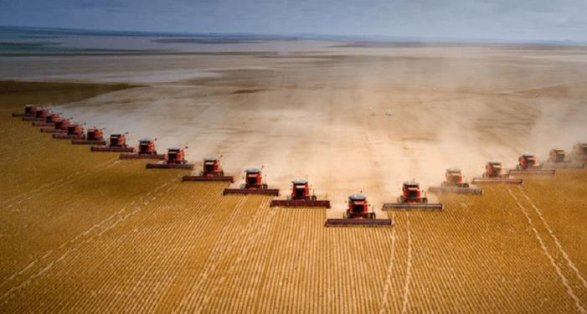
Mass Releases of Parasitoids in Field Crops
IAGRO
Trichogramma galloi
Rio Times
Harvesting soybeans in Brazil
Notes:
Trichogramma galloi for sugarcane borer, Diatraea saccharalis; Telenomus podisi for brown stink bug, Euschistus heros, in soybeans.

Slide 31
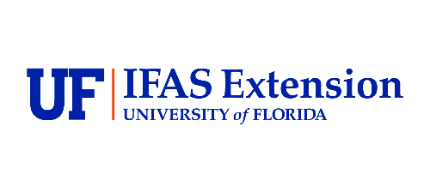
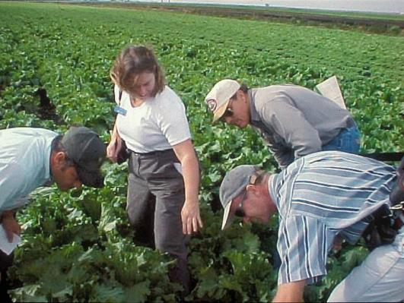
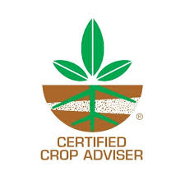
Biocontrol Delivery

Slide 32
IPM Florida provides statewide, interdisciplinary and inter-unit coordination and assistance for UF/IFAS integrated pest management research Extension and education faculty
http://ipm.ifas.ufl.edu

