Slide 1
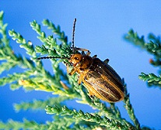
IPM3: On-line IPM Education for the Workforce
Robert M. Nowierski
National Program Leader
Bio-Based Pest Management
USDA- NIFA
Washington, DC
Rnowierski@nifa.usda.gov

Slide 2
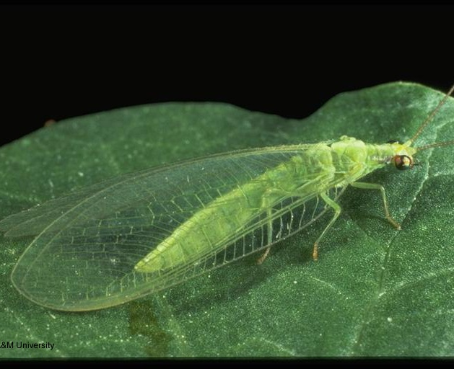
What is IPM³ ?
IPM³ stands for ‘Professional Program in Pest Management’.
The IPM³ Training Consortium was formed to meet the diverse Integrated Pest Management needs of federal agencies and beyond.
www.umn.edu/ipm3

Slide 3
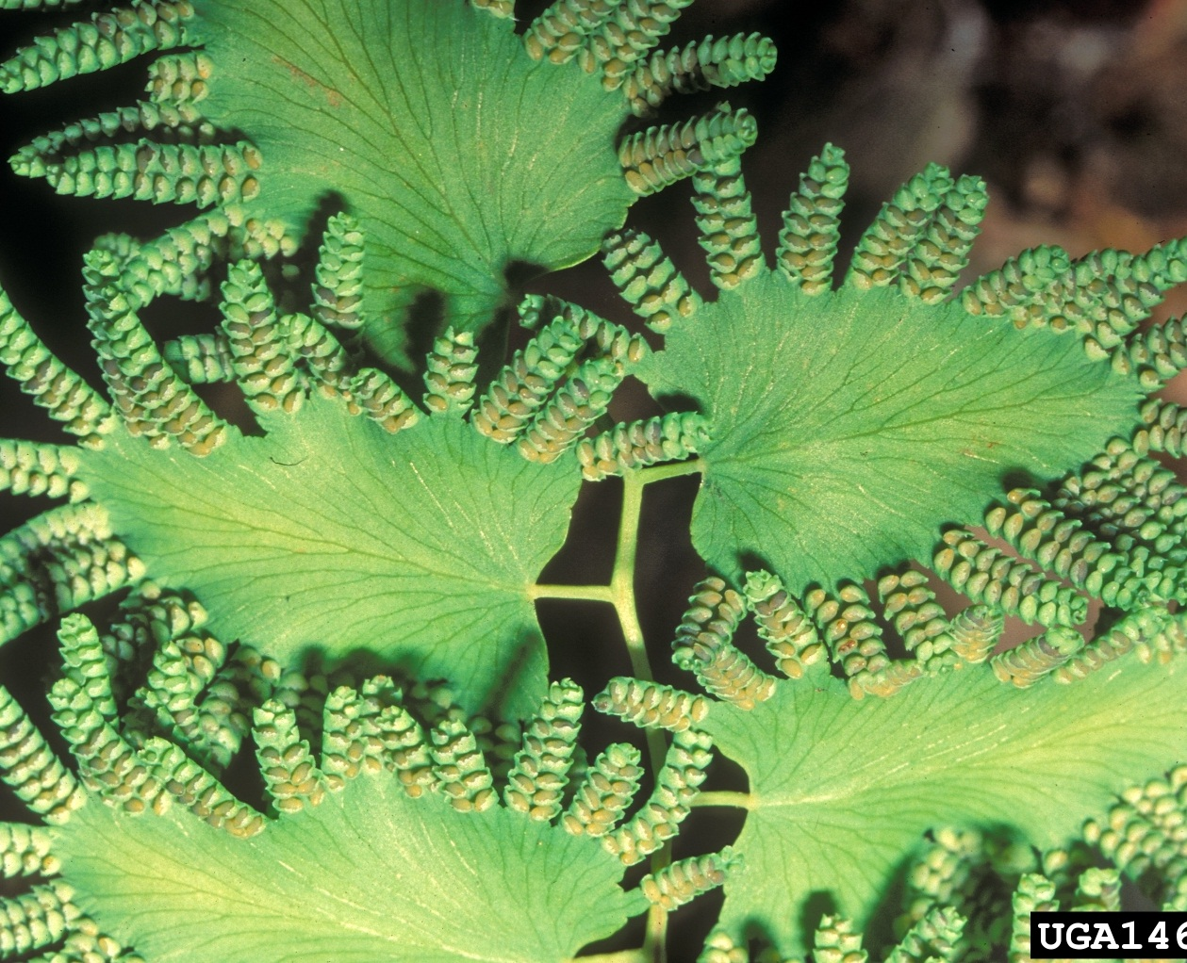
Who’s Involved in
Steering IPM³ ?
IPM practitioners from land grant institutions and from federal agencies, a number of which are under a federal mandate to implement IPM.

Slide 4
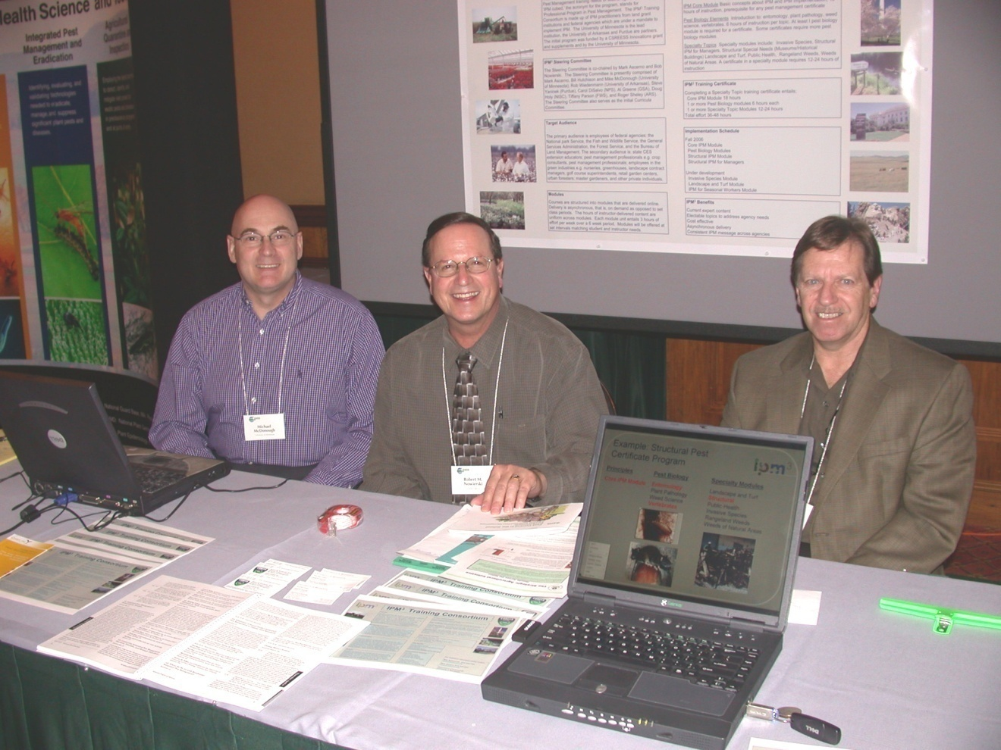
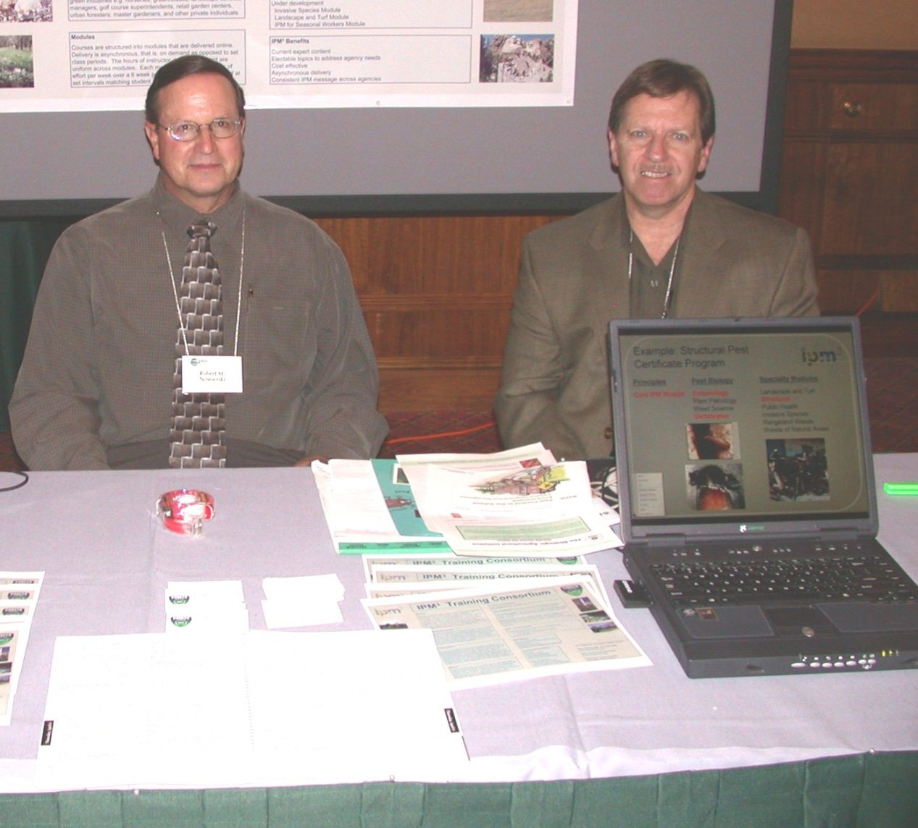
IPM³ Steering Committee Co-chairs:
Bob Nowierski USDA-NIFA (center) Mark Ascerno, University of Minnesota (right)
IPM³ Coordinator: Mike McDonough, Univ. of Minn. (left)
5th National IPM Symposium, St. Louis April 2006

Slide 5
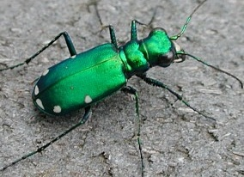
IPM³ Steering Committee
Federal Agency members:
  Carol DiSalvo, National Park Service
  Al Greene, General Services Administration
  Doug Holy, Natural Resource Conservation Service
  Bob Nowierski, National Institute of Food and Agriculture
  Tiffany Parson, Fish and Wildlife Service
  Roger Sheley, Agricultural Research Service

Slide 6
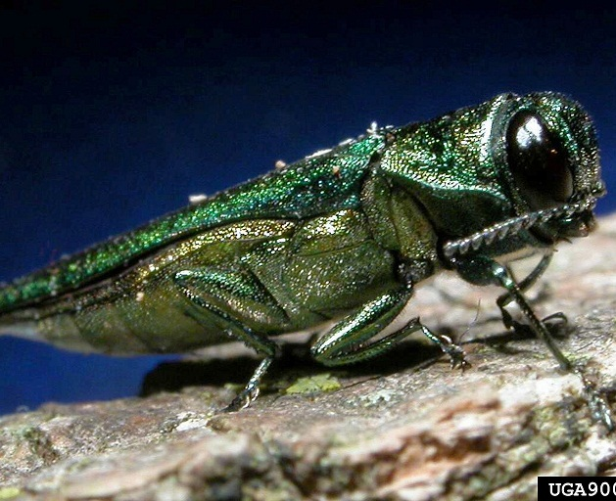
IPM³ Steering Committee
Land Grant Institution members:
  Mark Ascerno, University of Minnesota
  Ernest Delfosse, Michigan State Univ.
  Doug Jardine, Kansas State University
  Mike McDonough, University of Minnesota
  Rob Wiedenmann, University of Arkansas
  Steve Yaninek, Purdue University

Slide 7
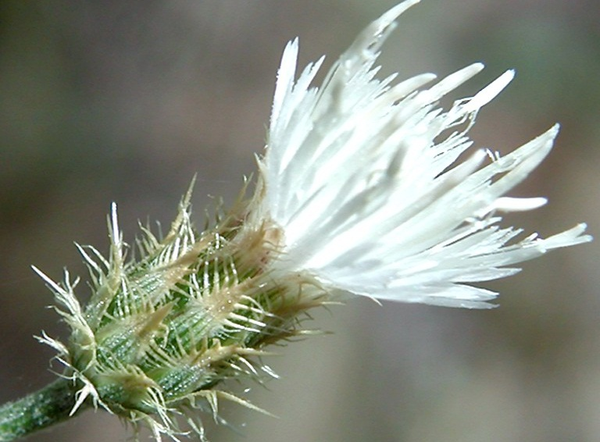
IPM³ Program Objectives
Provide easy access to distance IPM training
Provide a mechanism for individuals to become proficient in the principles and application of IPM
Provide IPM training tailored to specific pest management needs.

Slide 8

IPM³ Primary Audience
Employees of federal agencies:
DOI: NPS, FWS, BLM, BOR, USGS
USDA: NRCS, USFS, ARS, ERS, APHIS, FAS
Others: GSA, DOD, DOT, DHS, EPA, USAID

Slide 9
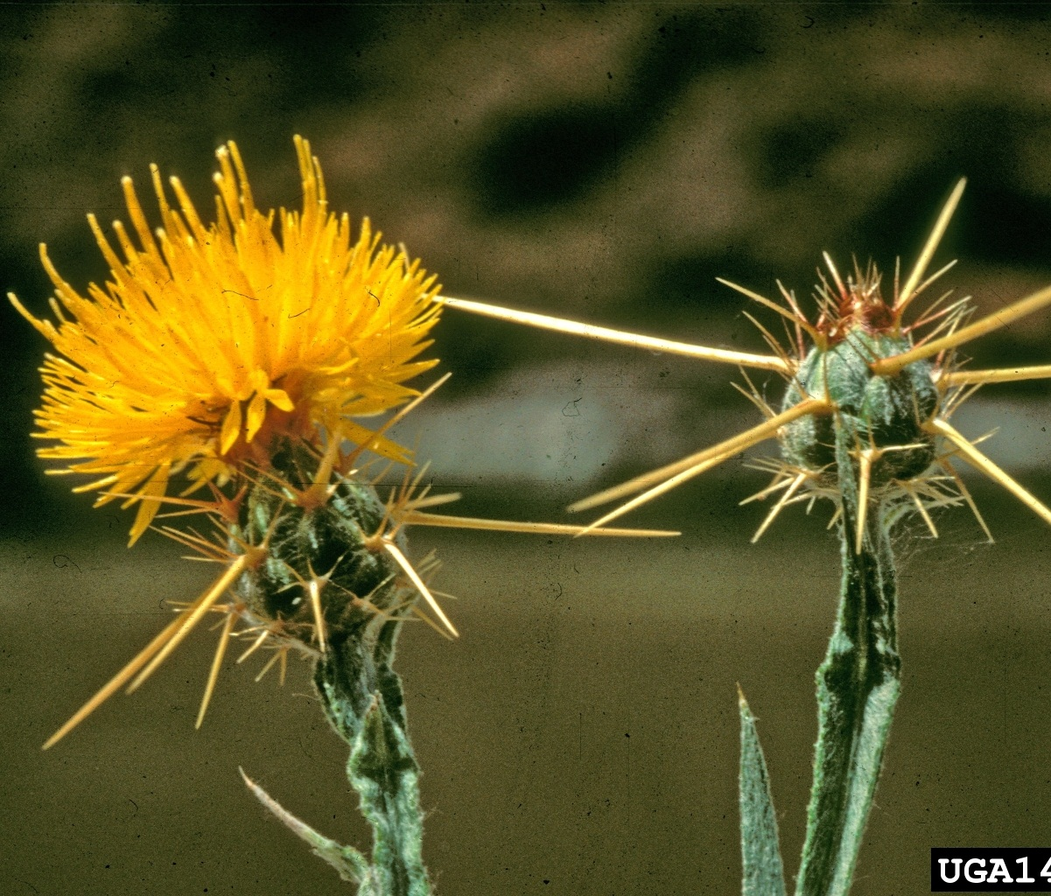
IPM³ Broader Audience
State and local government officials tasked with IPM
Co./State/Regional Extension Educators
Crop commodity groups
State Plant Health Directors
Master Gardeners
4-H staff
Crop Consultants/Pest Manag. Professionals
Green Industry Professionals.
Notes:
9

Slide 10
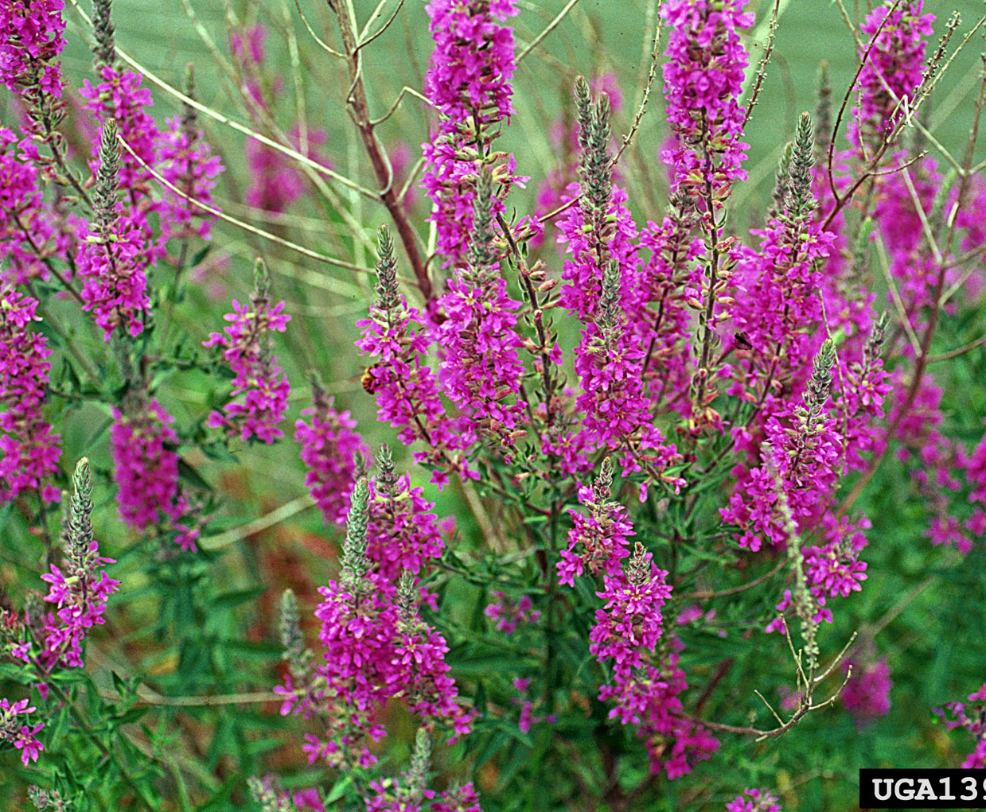
Training Modules
Scheduled at various times of the year based on demand.
Each module is typically 6 weeks long.
Content is entirely online.
Asynchronous delivery.
Continuing Education Units (CEUs) and Certificate of Completion for each module.

Slide 11


IPM³ Distance Education Platform
Training modules are delivered online via the Moodle Classroom Management System (CMS)
  Student progress is self-paced
  Modules and grades are available 24/7

Slide 12


Training Modules
The curricula emphasizes practical content.
Academic content is included to the extent necessary to support the understanding of practical content and ongoing IPM education.
Multiple learning formats and assessments are
used to maximize learning and retention of info

Slide 13
3-Tiered IPM
Training Program
Specialty Modules
Pest Biology Modules
IPM Core Concepts Module

Slide 14

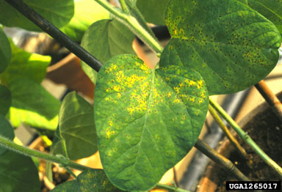
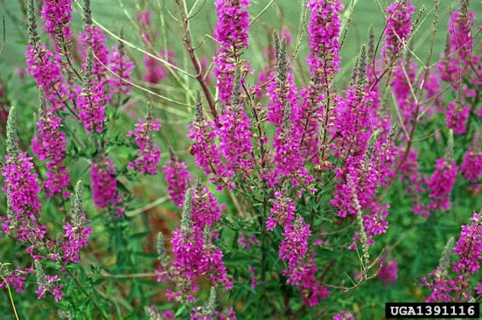
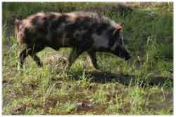
IPM Core Concepts Module
Basic concepts about IPM and IPM implementation.
15 hours of instruction.
Spanish translation available.

Slide 15
IPM Core Concepts Module
Unit 1 Introduction to IPM.
  Pests and pest impacts.
  Pest management.
  History of pesticide use.
  IPM developed in response to pesticide problems.
Unit 2 IPM Economic Concepts.
  Pest populations.
  Natural control and general equilibrium position (GEP).
  Economic thresholds (ET).
  Economic injury level (EIL).

Slide 16
IPM Core Concepts Module
Unit 3 Host Plant Resistance.
  Coevolution and selection pressure.
  Resistance mechanisms: antixenosis, antibiosis, and tolerance.
  Constitutive and induced resistance and their fitness costs.
  Resistance genetics.
Unit 4 IPM Tactics―Biological Control.
  Biological control organisms.
  Arthropod parasites and parasitoids.
  Arthropod predators.
  Behavior modification.

Slide 17
IPM Core Concepts Module
Unit 5 IPM Tactics―Chemical Control.
  Pesticide regulations.
  Pesticide classification.
  Pesticide mode of action (MOA).
  Pesticide resistance.
  Insecticide, fungicide and herbicide resistance management.
  Pesticide safety, pesticide residues and tolerances.
  Environmental fate of pesticides.
Unit 6 IPM Tactics―Physical Control.
  Physical barriers, manual weeding, mulches, pneumatic control, and thermal techniques.

Slide 18
IPM Core Concepts Module
Unit 7 IPM Tactics―Cultural Control.
  Sanitation, soil tillage, crop rotations, interplanting, trap crops, cover crops, elimination of alternate hosts.
Unit 8 IPM Tactics―Regulatory Control.
  USDA Animal Plant Health Inspection Service (APHIS) Plant Protection and Quarantine (PPQ).
  Department of Homeland Security Customs (DHS) Border Patrol agricultural inspection.

Slide 19
IPM Core Concepts Module
Unit 9 Introduction to Invasive Species.
  Definition of an invasive species, Executive Order 13112.
  National Invasive Species Council (NISC).
  Impact of invasive species.
  APHIS prevention, monitoring, control and emergency program costs― $0.9 to $1.4 billion annually.
  Crop and environmental losses of approx. $120 billion annually.
  Biological stages of invasion: arrival, establishment, integration, and spread.
    Prevention of arrival in wooden packaging and on live plants.

Slide 20
IPM Core Concepts Module
Unit 9 (cont.) Introduction to Invasive Species.
    Inspections―balancing biosecurity, trade, environmental, and volume considerations.
    Prevention of arrival. Is the inspection system adequate?
    National Park Service Exotic Plant Management Teams.
    Eradication Example: Black rat on Anacapa Island.
    Suppression/Containment Example: Emerald ash borer
    Suppression Example: Tamarisk (salt cedar)

Slide 21
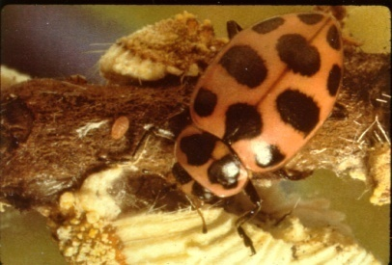
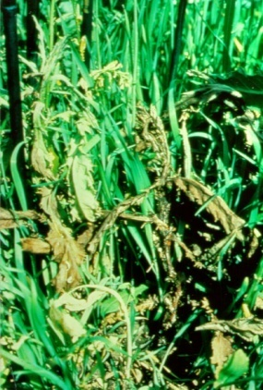
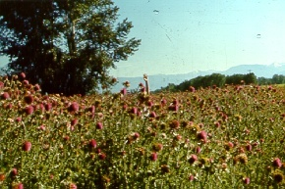
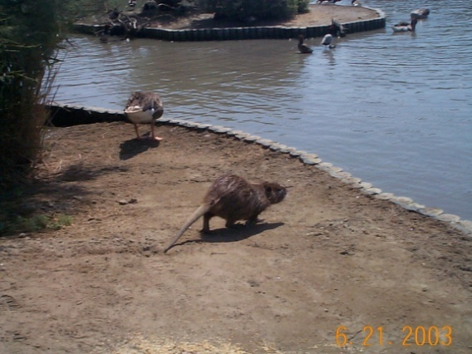
Pest Biology Modules
Introduction to:
  Plant Diseases
  Weed Science
Planned:
  Arthropods
  Vertebrates
  2.5-10.0 hours of instruction per topic.

Slide 22
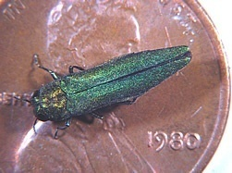
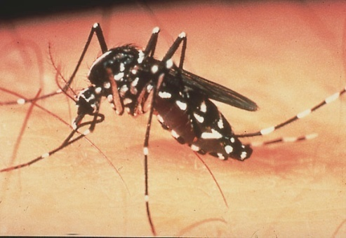
Specialty Modules
Current/Planned* Specialty Modules:
  Invasive Species
  IPM for Facility Managers
  and Supervisors
  Imported Fire Ant IPM
  Bed Bug Prevention and Control in the Hospitality Industry
  IPM for Seasonal Employees*
  IPM of Rangeland Weeds*
  IPM of Feral Pigs*
2.5-15 hours of instruction per module.

Slide 23
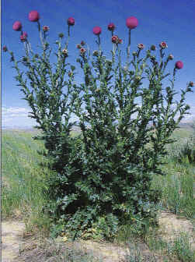
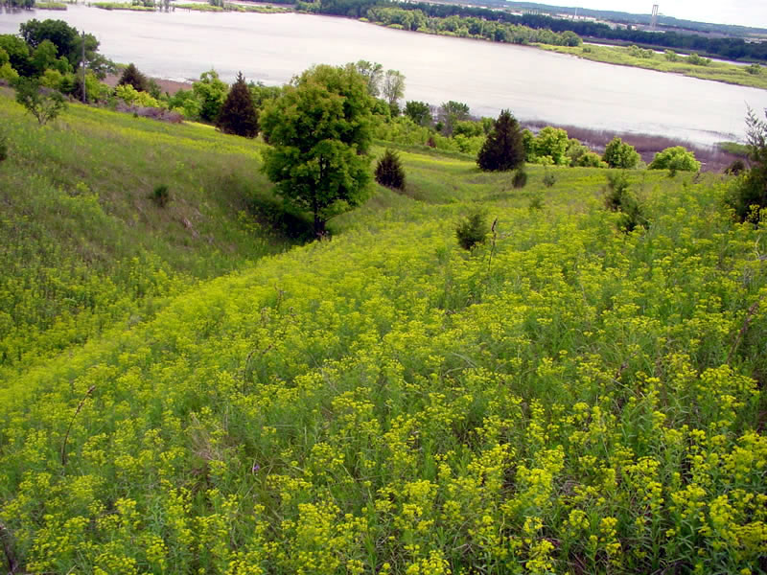
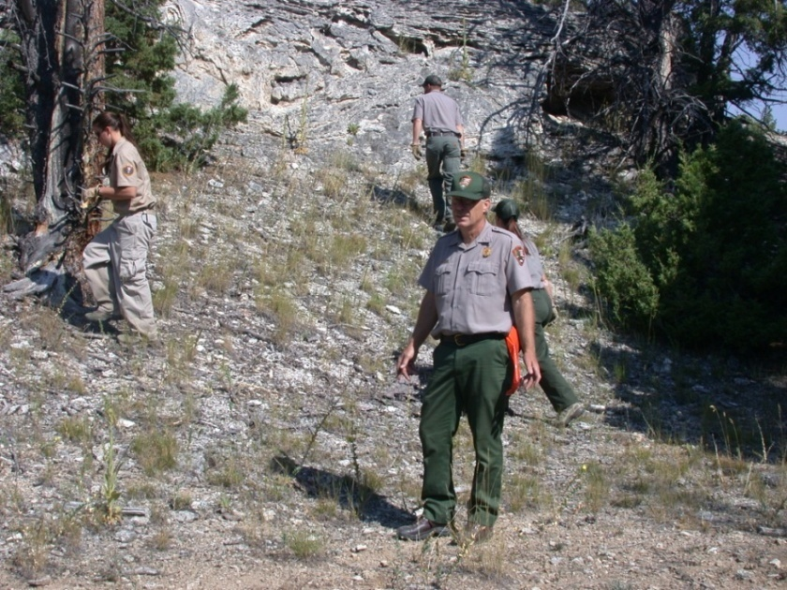
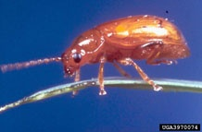
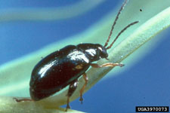
Course Certificate Example: Rangeland Weed Management
Specialty Modules
Rangeland Weeds
Weeds of Natural Areas
Invasive Species
Landscape and Turf
IPM for Facility Managers & Supervisors
Principles
Core IPM Module
Pest Biology
Arthropods
Plant Pathology
Weed Science
Vertebrates

Slide 24
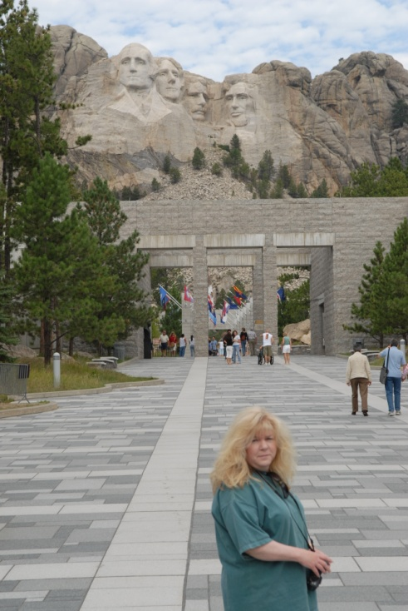
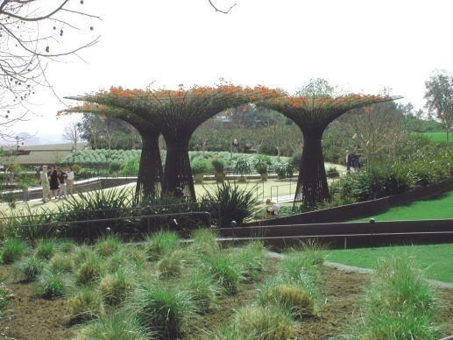

Course Certificate Example: Landscape and Turf
Principles
Core IPM Module
Pest Biology
Arthropods
Plant Pathology
Weed Science
Vertebrates
Specialty Modules
Landscape and Turf
Invasive Species
Rangeland Weeds
Weeds of Natural Areas

Slide 25

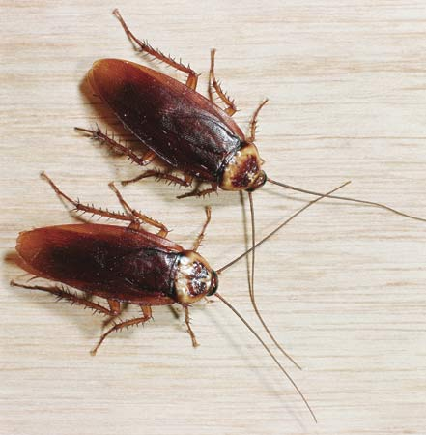
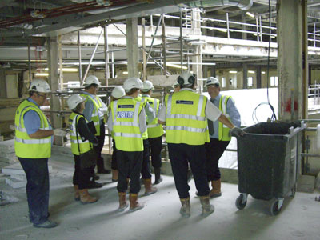
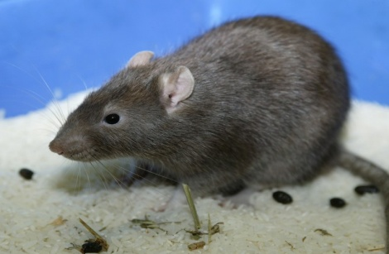
Course Certificate Example: IPM for Facility Managers and Supervisors
Principles
Core IPM Module
Pest Biology
Arthropods
Plant Pathology
Weed Science
Vertebrates
Specialty Modules
Landscape and Turf
Invasive Species
Rangeland Weeds
IPM for Facility Managers and Supervisors

Slide 26
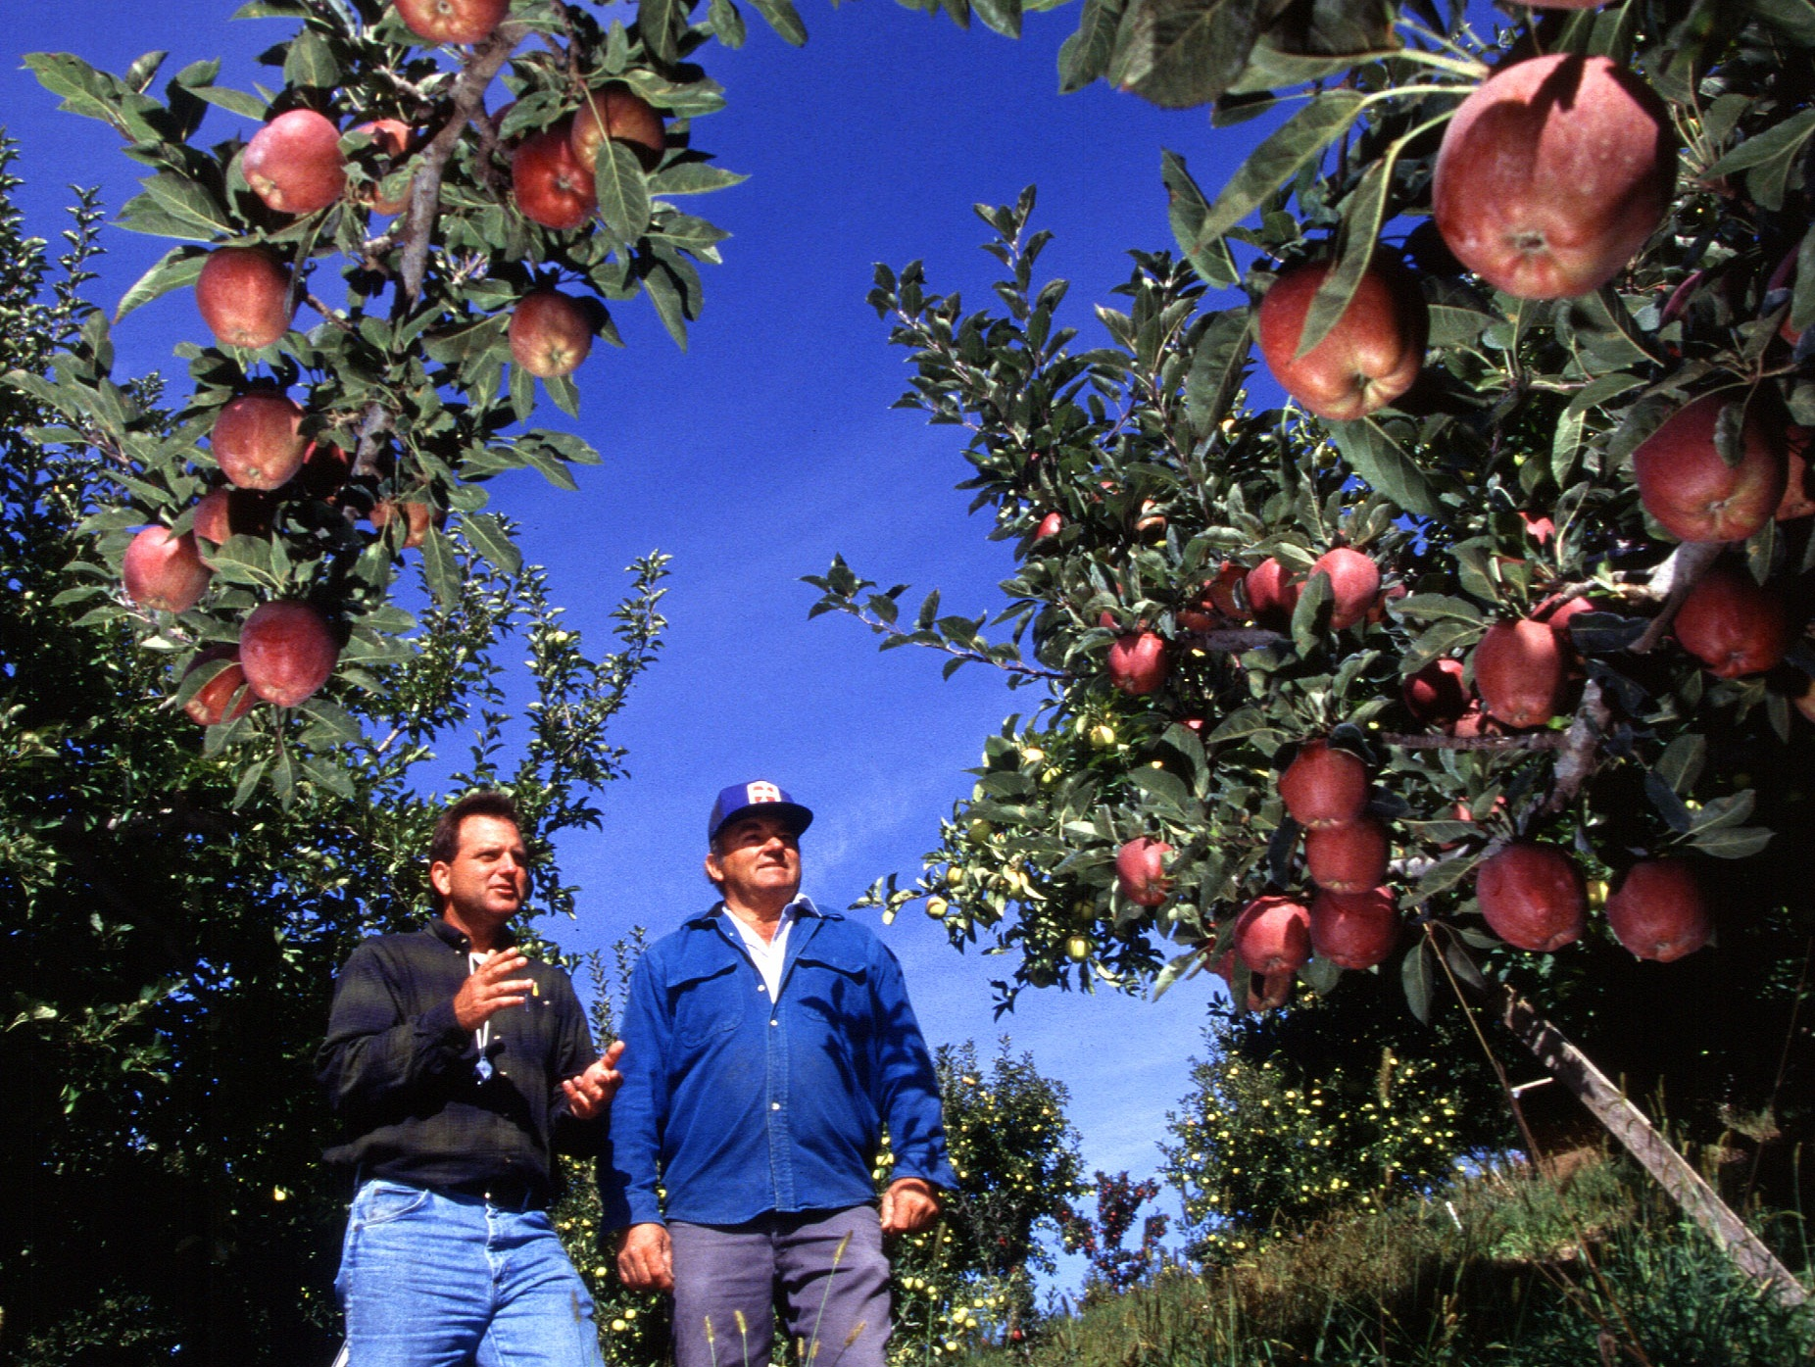
Benefits of IPM³ Training
Current expert content.
Electable topics to address agency needs.
Cost-effective.
Asynchronous online delivery.
Consistent IPM message across agencies.

Slide 27

Program Funding
Grant funds from CSREES (now NIFA), NC-RIPM, USDA Inv. Spp. Coord., Univ. of Minnesota have been used during the development phase.
Ultimately, revenue must be generated to make the program self sustaining.
Notes:
27

Slide 28
Module Fees
Per hour rates (est. $25/module hr)
  Core Module (15 hrs.): $375
  Core Module in Spanish (15 hrs.): $375
  IPM for Facility Managers and Supervisors (15 hrs): $375
  Pest Biology – Weed Science (10 hrs.): $250
  Pest Biology – Plant Diseases (6 hrs.): $150
  Invasive Species (10 hrs.): $250
  Imported Fire Ant IPM (10 hrs.): $250
  Bed Bug Prevention and Control in the Hospitality Industry (15 hrs.): $375

Slide 29
Volume Discounts for IPM Modules
Agencies and organizations can arrange block enrollments for multiple students (more than ten) using a Coupon Code system.
  15% Discount (10-19 students)
  25% Discount (20-29 students)
  35% Discount (30-50 students)

Slide 30
Program Revenue from Fees
Updating existing modules
Creation of new IPM modules
Up-front funding for the development of course content ($400 per contact hr)
Funding for instructors (1/3 of course fee)
IPM³ Training Consortium infrastructure
and administration

Slide 31

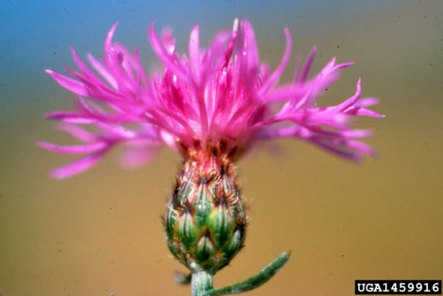
Operability Status
  IPM Core Concepts Module
    Apr 9 – May 21, 2012
    Oct-Nov 2012 (dates to be
    determined)
  Invasive Species
    Apr 9 – May 21, 2012
    Oct-Nov 2012 (dates to be
    determined)
  Biology of Weeds
    Oct-Nov 2012 (dates to be
    determined)

Slide 32
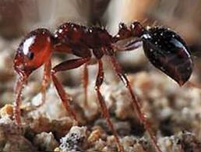
Operability Status
  Biology of Plant Diseases
    Oct-Nov 2012 (dates to be
    determined)
  IPM for Facility Managers & Supervisors
    April 9 – June 18, 2012
    Oct-Nov 2012 (dates to be
    determined)
  Imported Fire Ant IPM
    Apr 9 – May 21, 2012
    Oct-Nov 2012 (dates to be
    determined)

Slide 33
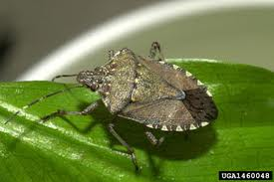

Operability Status
  IPM Core Concepts Module – Spanish
  Translation
    Apr 9 – May 21, 2012
    Oct-Nov 2012 (dates to be
    determined)
  Biology of Vertebrates
    Content developer found;
    funding being sought.
  IPM for Seasonal Workers
    In development.

Slide 34
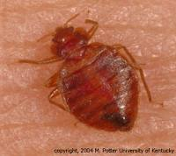
Operability Status
  Bed Bug Prevention and Control
  in the Hospitality Industry
    Oct-Nov 2012 (dates to be determined)
  IPM for Feral Pigs
    Funding and content developer being sought.
  IPM Credential for PCAs in Specialty Crops
    NRCS and IPM Working Group – ID training needs for PCAs in specialty crops.
    IPM Institute of North America, NRCS, and the IPM Credential Steering Committee developed performance objectives and exam questions for TSPs to get certified by NRCS so they can develop CAPs. (Plan is for IPM Credential to be certified through Nat. Alliance for Indep. Crop Consultants (NAICC)).

Slide 35
Contacts:
Mark Ascerno, Department of Entomology, University of Minnesota, St. Paul, MN
(612- 624-9773; mascerno@umn.edu)
Robert M. Nowierski, USDA-NIFA, Washington, DC (202-401-4900; rnowierski@nifa.usda.gov)
Copyright 2012

Slide 36
Thank You!

