Slide 1

Biological Control
In-Service Training - IPM Academy Lorena Lopez

Slide 2

Biological Control
The use of natural enemies to control pests.
Natural enemies include predators, parasitoids, and
pathogens.
Advantages and Disadvantages?
Biological control agents (BCAs)
can be already established around
the crop
No human health and environmental hazards
Can be compatible with some
pesticides
Can be cheap
May need to release multiple times
Detailed knowledge about plant- pest-BCA interactions
Time consuming and labor
intensive
Can be expensive

Slide 3
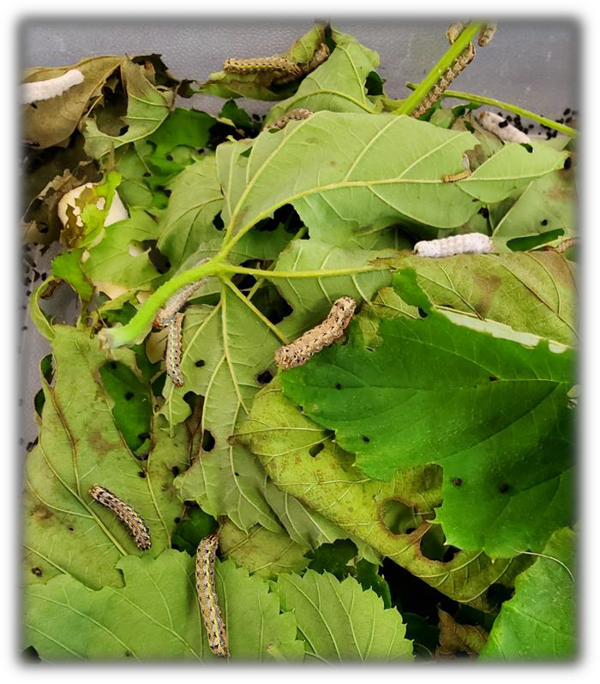
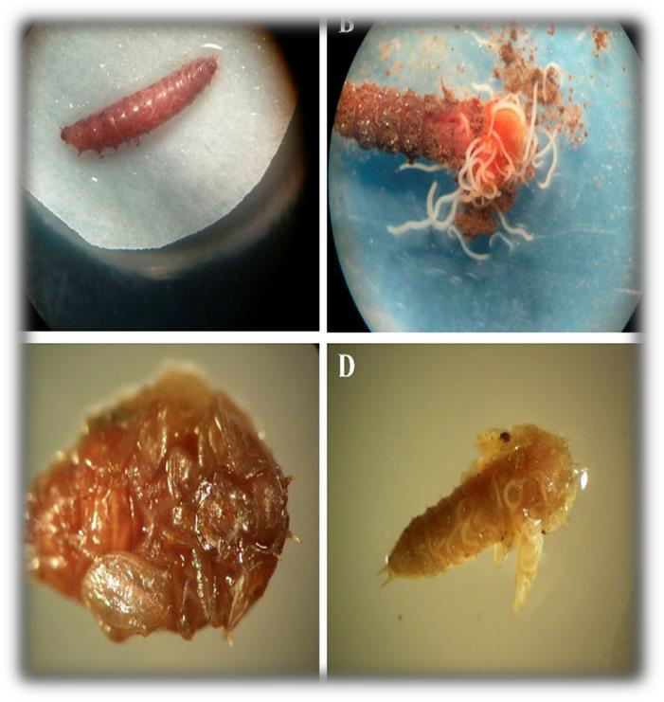
Entomopathogenic Nematodes and Fungi
Entomopathogenic nematodes attacking sap beetles in
strawberries. Eliceche et al., 2017.
Entomopathogenic fungi attacking armyworms in hops. Photo by H. Smith.

Slide 4


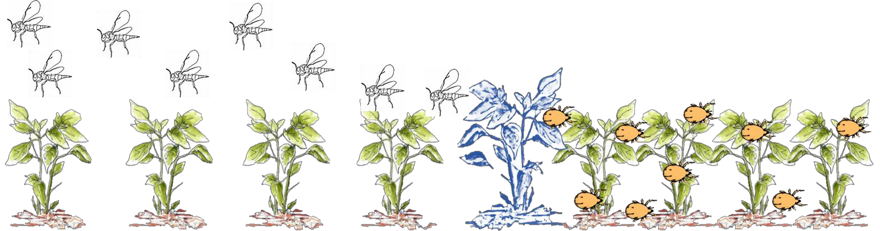



Parasitoids
Predators
Generalists
One or more life stages are
predaceous
vs.
Host specific
Target one life stage
Only immature stages are parasitic
Dispersal capacity
Feed on multiple life stages of the pest
Alternative food resources
Ambulatory and aerial dispersal

Slide 5
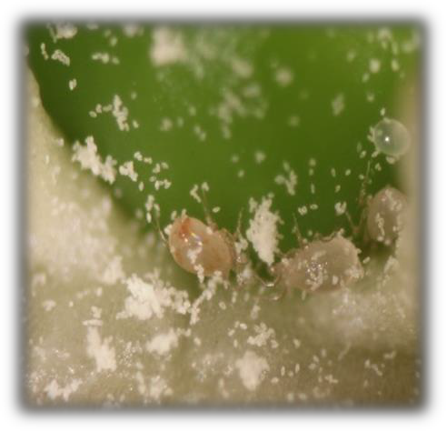
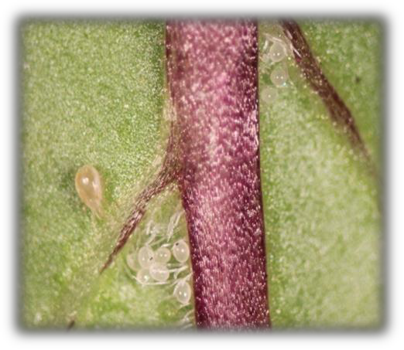
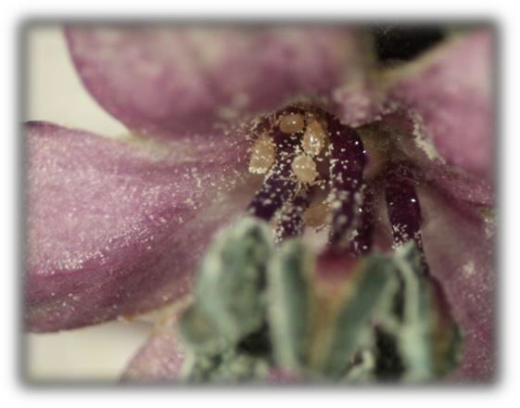
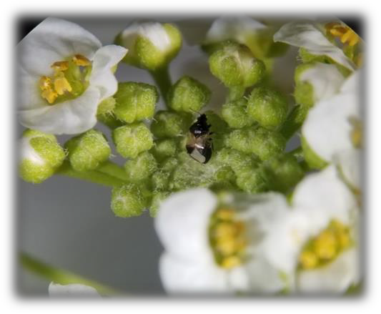
Swirskii egg clusters in
leaf domatia
Swirskii mite females in bell
pepper
A. swirskii females in ornamental pepper
Minute pirate bug on sweet alyssum
Photos by L. Lopez

Slide 6
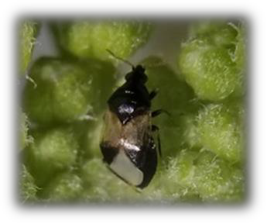
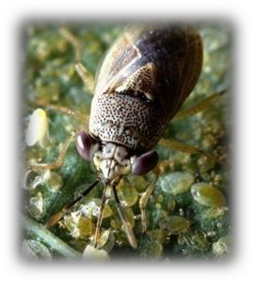
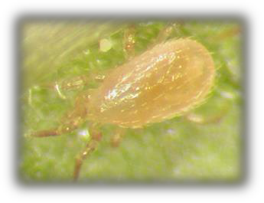
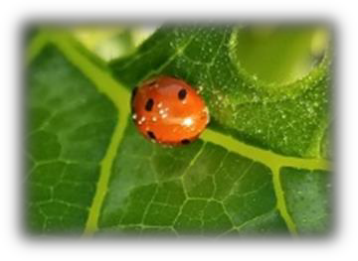
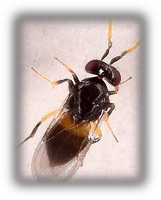
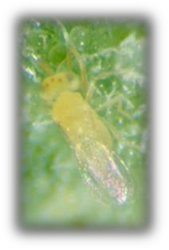
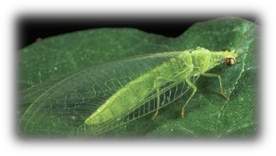
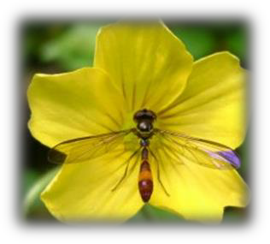
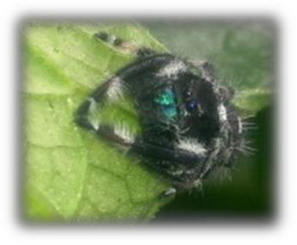
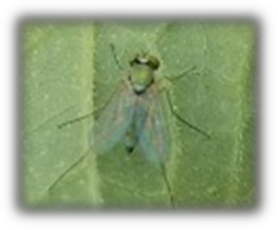
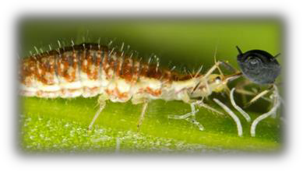
Naturally Occurring BCAs
Minute pirate bugs
Predatory mites
Ladybugs
Big-eyed bugs
Whitefly and aphid parasitoids
Long-legged flies
Hoverflies
Spiders
Lacewings
Photos by L. Lopez, https://www.fugleognatur.dk/gallery.asp?mode=ShowLarge&ID=623148, https://www.dragonfli.co.uk/products/lacewing-larvae-chrysoperla-carnea, and
http://greenhouseipm.org/biocontrol-agent/neoseiulus-cucumeris/

Slide 7
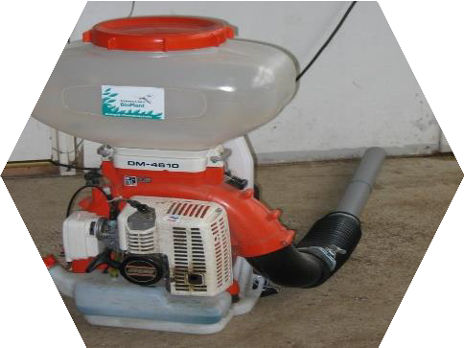
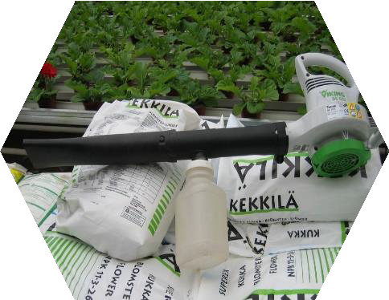
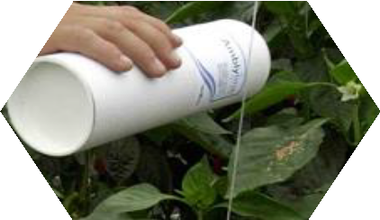
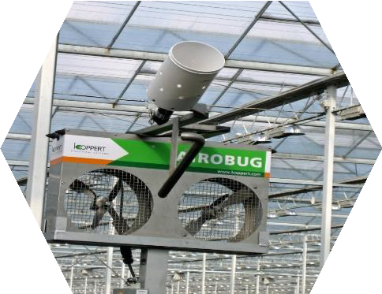
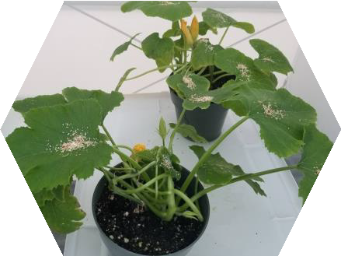
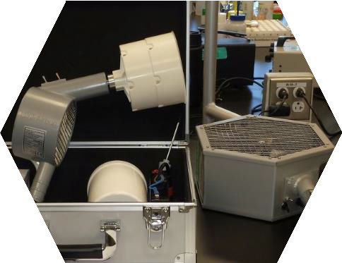
Application Methods
Wide variety of release and delivery methods
Application technology
Variety of carriers
Bottles for manual release
Photos by L. Lopez and http://greenhouseipm.org/biocontrol-agent/neoseiulus-cucumeris/

Slide 8
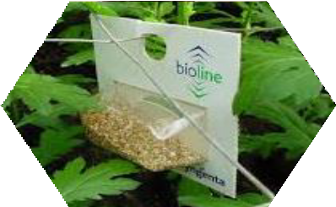
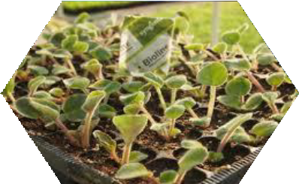
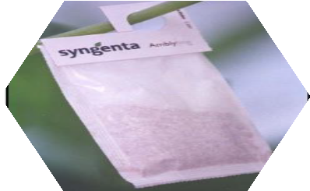
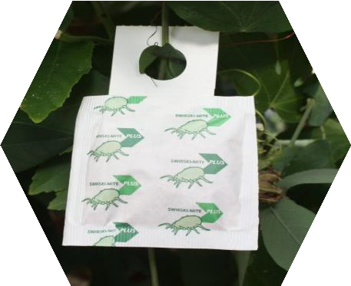
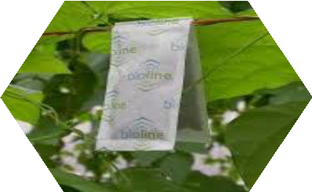
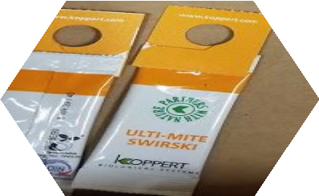
Application Methods
Target pest
Cropping conditions
Food and shelter availability
Sachets for long-term release
Photos by L. Lopez and http://greenhouseipm.org/biocontrol-agent/neoseiulus-cucumeris/

Slide 9
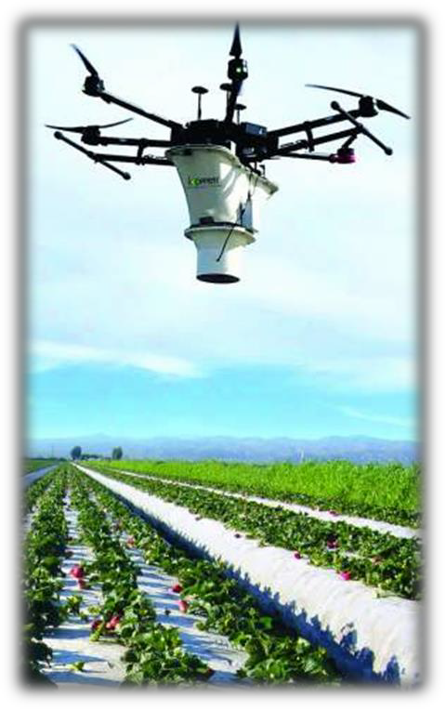
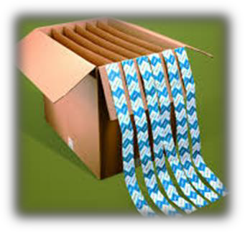
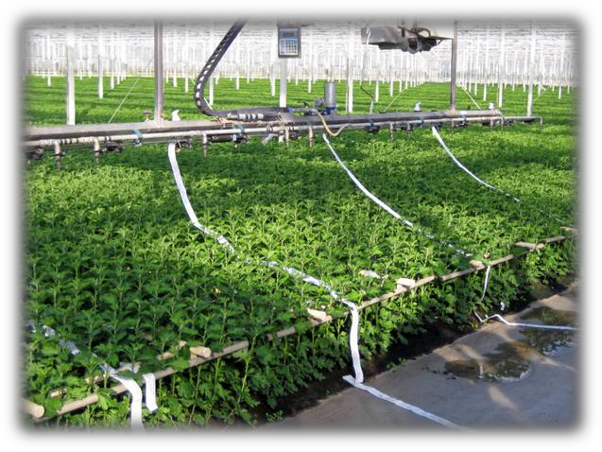
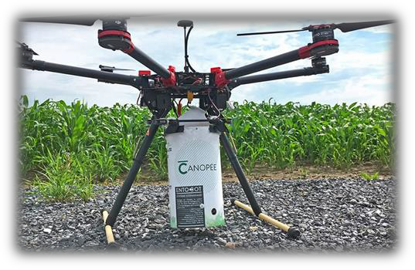
Application Methods
Large scale application
Crop value
SSPM or PIPM
Drones for BCA release
in open fields
Bugline for greenhouse ornamentals
https://youtu.be/KeY_o2muhcI
Photos by L. Lopez, https://www.biolineagrosciences.com/, https://www.uaviq.com/en/biocontrol/, and http://greenhouseipm.org/biocontrol-agent/neoseiulus-cucumeris/

Slide 10
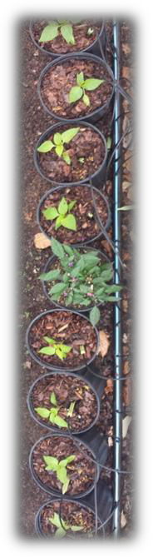
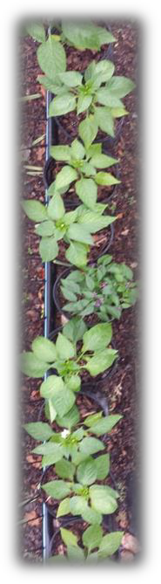
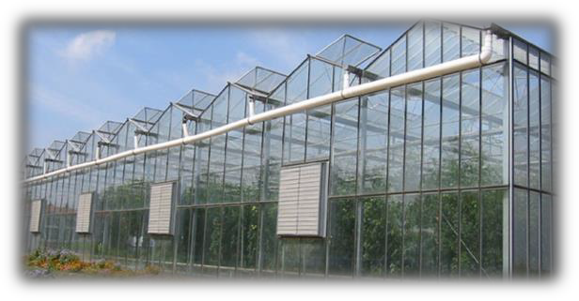

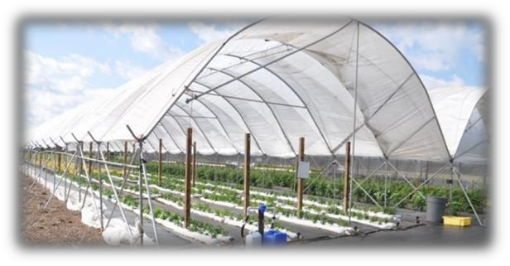


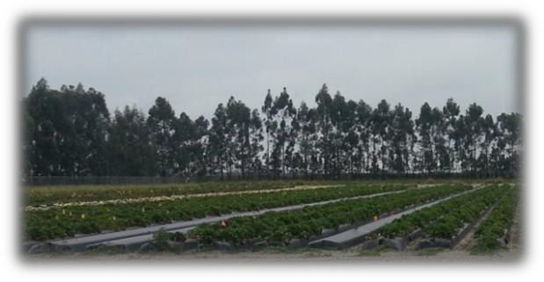

Temperature
Solar radiation
Rainfall Humidity
Cropping system
Open
canopy
Closed
canopy
Irrigation
Preventive vs.
curative methods
Plant density
Photos by L. Lopez.

Slide 11
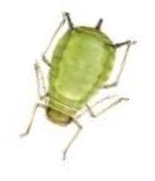
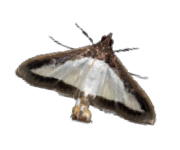
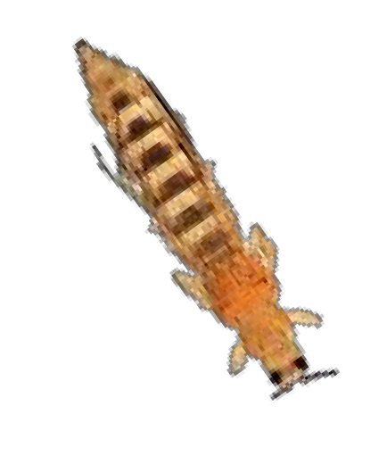


3 weeks
4 weeks
5 weeks
6 weeks
7 weeks
8 weeks
Azera | Entrust | Swirskii mite | Dipel | Total
$50 | $128 | $210 | $40 | $428
Biocontrol
1 acre
~15k plants/a Rate = 25 mites/m²
Azera | Entrust | M-Pede | Entrust+ Pyganic | Azera | Total
$50 | $128 | $80 | $177 | $50 | $485
Pesticides only
**Labor costs are not included. Only the product cost for 1 application per acre are shown.

Slide 12
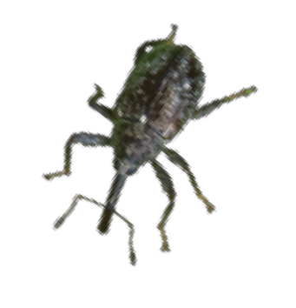

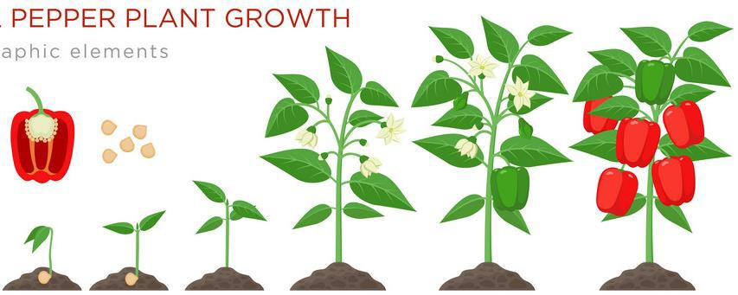

Biological control can reduce pesticide applications and negative impacts in the field
3 weeks
4 weeks
5 weeks
6 weeks
7 weeks
8 weeks
9 weeks
10 weeks
Pyganic | Agri- Mek | Swirskii mite | M-Pede | Assail | Total
$49 | $9 | $210 | $80 | $5 | $353
Biocontrol
1 acre
~15k plants/a Rate = 25 mites/m²
Pesticides
only
Pyganic | Agri- Mek | Oberon | Aza- Direct | Admire- Pro | Brigade | Assail | Vydate*
$49 | $9 | $35 | $127 | $24 | $7 | $5 | $30 | $286
**Labor costs are not included. Only the product cost for 1 application per acre are shown.

Slide 13
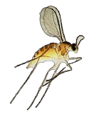
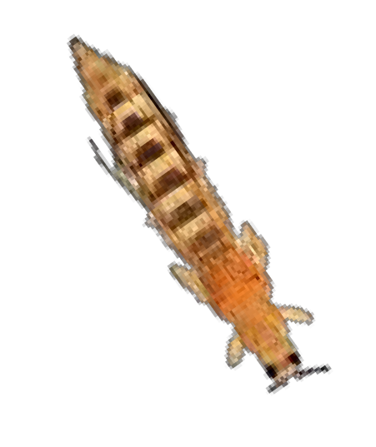


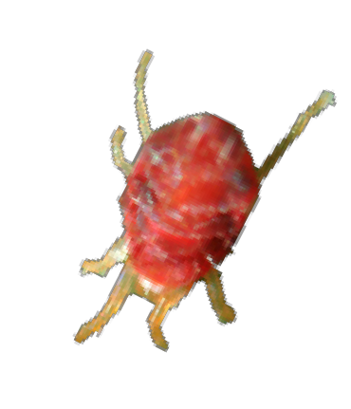
Perennial crops may facilitate BCA’s establishment when
alternative prey/food items are present
Year-round

Slide 14
Economic Thresholds
Management activity
EIL
ET (pesticides)
ET (biocontrol)
Number of insects
Time
BCAs take longer to lower pest populations under non- damaging levels compared to pesticides

Slide 15
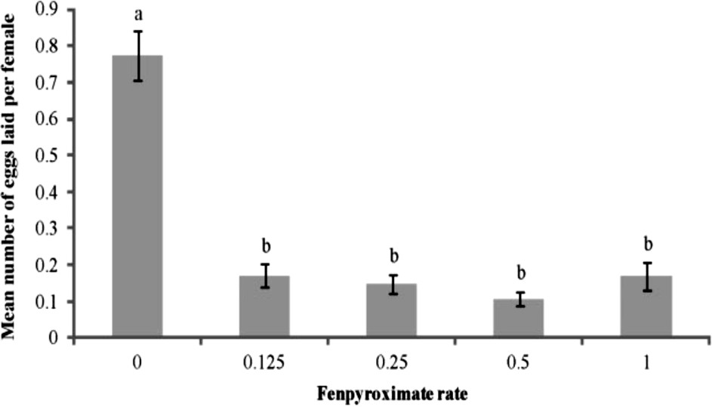
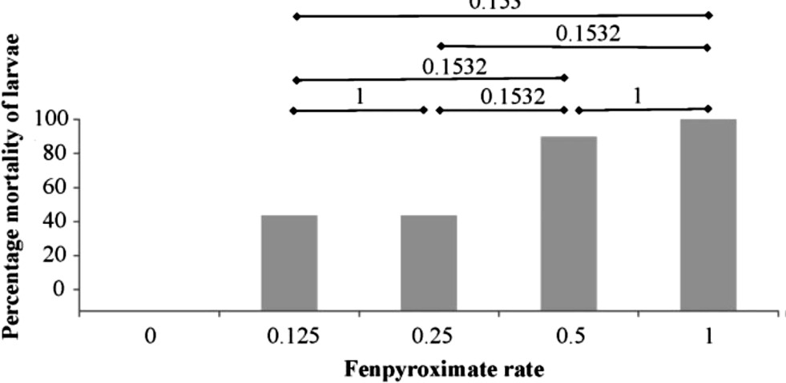
5
A
Females
Nymps
Larvae
4
a
Pesticide Compatibility
Mean number of dead mites
ns
3
ns
ns
2
b
b B
1
C
0
Azera
Control
Insecticide
M-Pede
Swirskii mite populations can be resilient when low-risk pesticides are applied
*
Lopez et al., 2015

Slide 16

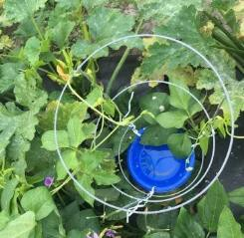

Pesticide Compatibility
Azera® (Azadirachtin+Pyrethrins) – thrips, aphids, whiteflies
Entrust® (spinosad) - thrips, lepidopteran pests
Bacillus thuringiensis (Bt) – lepidopteran pests
M-Pede® (soap concentrate) – insecticide, miticide,
fungicide
MilStop® - fungicide
Monitoring
Naturally-occurring natural enemies?
Organic vs. conventional pesticides?
The principles of IPM are the same for all cropping
systems
Photos by L. Lopez.

Slide 17
Key Points About Biological Control
Detailed knowledge about biotic and abiotic factors within the cropping system is vital for the success of biological control
Annual and perennial crops have different characteristics that may facilitate the establishment of BCAs
Application technology is moving towards improving biological control implementation
Each biological control program is unique
Biological control does not eradicate pests nor replace the use of pesticides, but it reduces pest populations by complementing the use of biorational pesticides

Slide 18
Additional Information
EDIS, UF/IFAS Extension. https://edis.ifas.ufl.edu/topic_biological_co ntrol
FDACS. https://www.freshfromflorida.com/Division s-Offices/Plant-Industry/Bureaus-and- Services/Bureau-Of-Methods-Development- Biological-Control/Biological-Control
SARE. https://www.sare.org/Project- Reports
ATTRA, NCAT. https://attra.ncat.org/pest/
UC, IPM. http://ipm.ucanr.edu/PMG/NE/index.html
Xerces Society for Invertebrate Conservation. https://xerces.org/conservationbiocontrol/
International Organization for Biological Control (IOBC). http://www.iobc- global.org/publications.html
Natural Enemies Handbook:
The Illustrated Guide to Biological Pest Control. http://ipm.ucanr.edu/IPMPROJECT/ADS/ manual_naturalenemies.html
Prospects for Biological Control of Plant Feeding Mites and Other Harmful Organisms. https://play.google.com/store/books/details
?id=g-39CAAAQBAJ&rdid=book-g- 39CAAAQBAJ&rdot=1&source=gbs_vpt_rea d
IPM in Practice: Principles and Methods of Integrated Pest Management. http://ipm.ucanr.edu/IPMPROJECT/ADS/ manual_ipminpractice.html

Slide 19



@lorelopez257
Thank you!
lorelopezq.257@ufl.edu

Slide 20

Trash bug eating two-spotted spider mite eggs

Slide 21

Predatory mites feeding on two-spotted spider mites

