Slide 1


Vegetable Diagnostics 101:
Insects and Diseases
Resources for Pest Identification
Norm Leppla, Director
UF/IFAS Statewide IPM Program

Slide 2
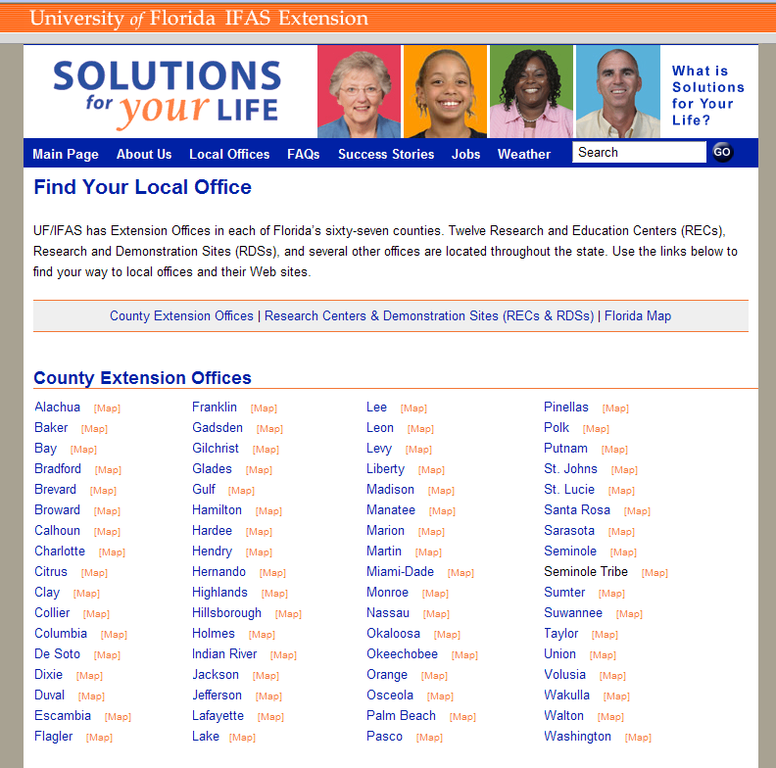
University of Florida
Cooperative Extension Service
http://ifas.ufl.edu
Notes:
All plant-related samples of interest in Florida should first be sent to your local University of Florida/IFAS Extension, Cooperative Extension County Office. Visit the University of Florida’s new Solutions for Your Life website for the latest links and information to your local county agent.

Slide 3
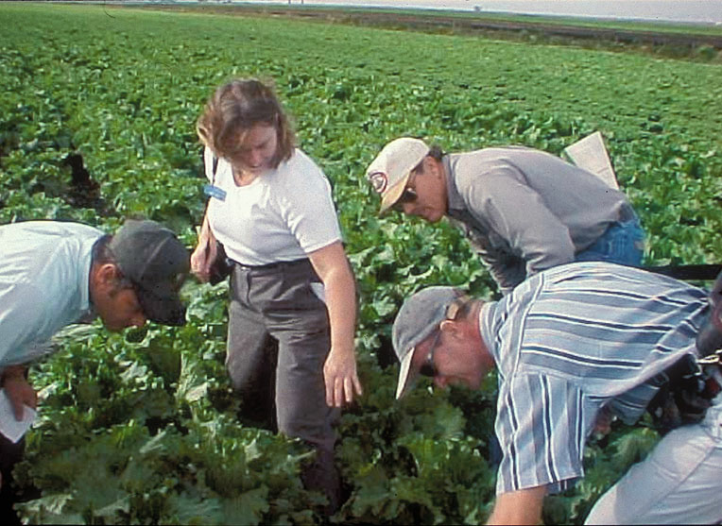
Cooperative Extension Service
Agent consultation
Pest diagnostics
Training programs
Plant clinics
Master gardeners
Access to Extension specialists
Local and UF library (literature searches)
Pesticide applicator licensing
Information dissemination (newsletters)

Slide 4
How to Send a Sample to Gainesville and Receive the Results?
Maybe if I put enough stuff in this box, put a stamp on it, and send it to Gainesville someone will tell me what’s wrong with my plant?
I can’t determine your problem here, but I can get your sample to the right laboratory for an accurate and timely diagnosis.

Slide 5
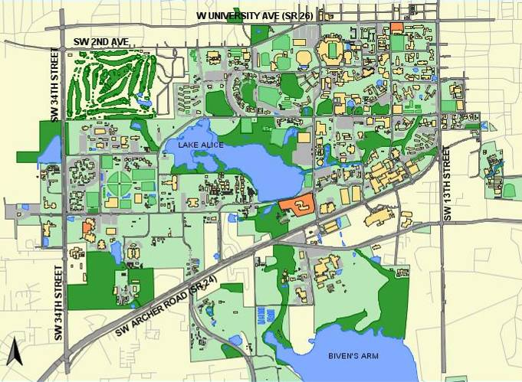
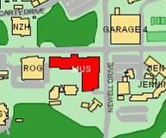
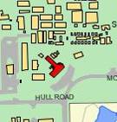
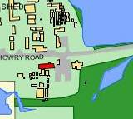
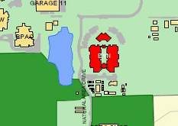
Plant Identification
Extension Soil Testing
Plant Disease Clinic & Nematode Assay
Insect Identification
A. Camerino

Slide 6
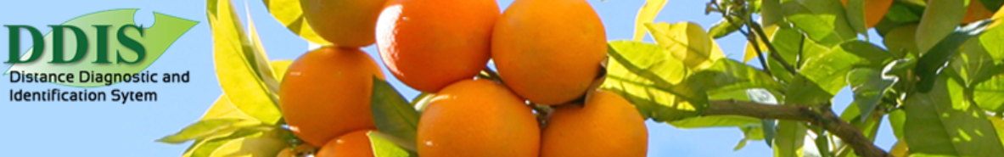
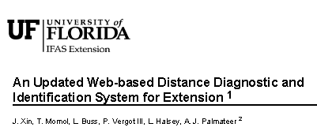



Florida Plant Diagnostic Network (FPDN) (http://fpdn.ifas.ufl.edu)
Southern Plant Diagnostic Network (SPDN) (http://spdn.ifas.ufl.edu)
International Plant Diagnostic Network (IPDN) (http://www.intpdn.org)
National Plant Diagnostic Network (NPDN) (http://www.npdn.org)

Slide 7
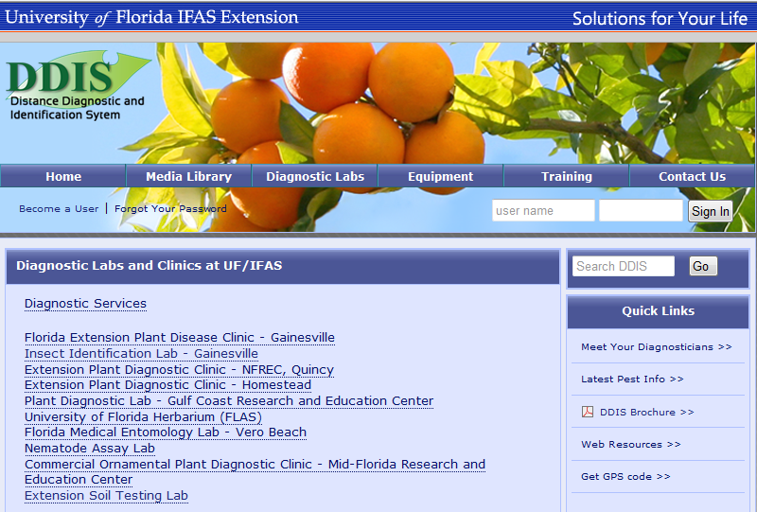
DDIS and Diagnostic Laboratories
http://ddis.ifas.ufl.edu

Slide 8
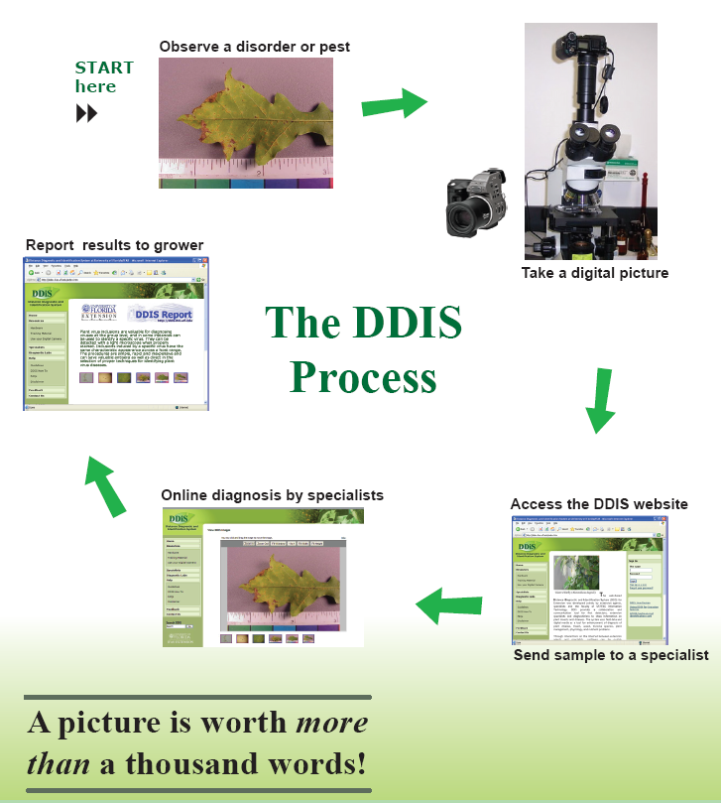
Submitting DDIS Samples
Amanda Hodges, Ph.D. & Jiannong Xin, Ph.D.
UF/IFAS Extension
Notes:
This is a simplified view of the process. There has been quite a bit of success with diagnosing common problems using DDIS. In particular, many of your everyday insect and week problems can be readily identified in this fashion. Plant pathogens can be a bit more difficult, but symptom pictures are very helpful if a physical sample is being submitted to a diagnostic lab.

Slide 9

IPM Florida provides statewide, interdisciplinary and inter-unit coordination and assistance for UF/IFAS integrated pest management research, Extension and education faculty
http://ipm.ifas.ufl.edu

Slide 10
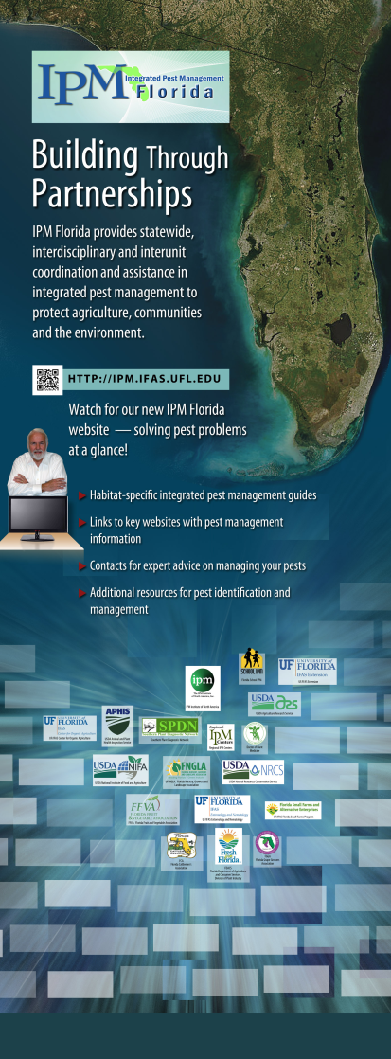
Direct Access to IPM Information
Habitat-specific IPM guides, fact sheets.
EDIS articles, Featured Creatures, etc.
Links to specialized websites with IPM
management information specific to
a crop or situation.
Key contacts for expert advice on
managing pests.
Additional resources for pest
identification and management,
e.g., diagnostic services.

Slide 11
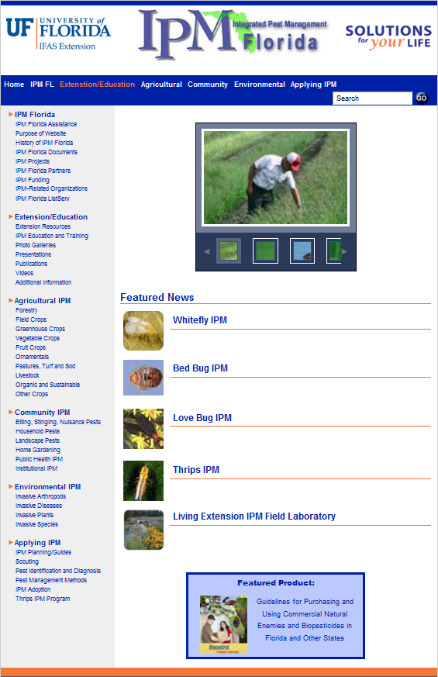
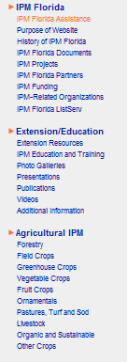
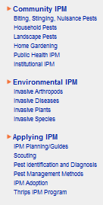

Slide 12

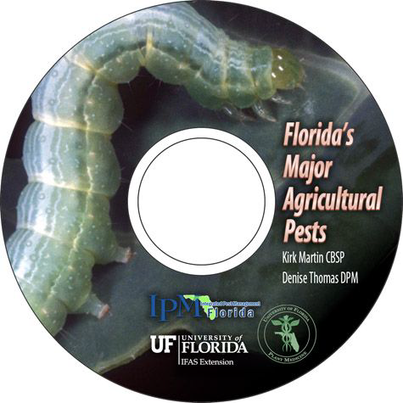
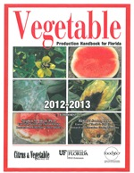
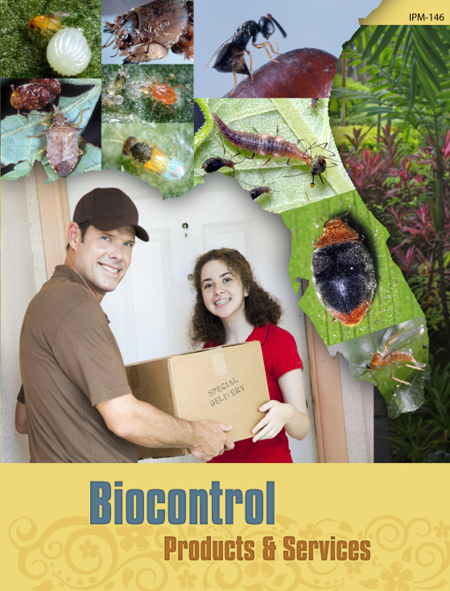


Extension Guides
http://nfrec.ifas.ufl.edu/vegetable_handbook.shtml
EDIS

Slide 13
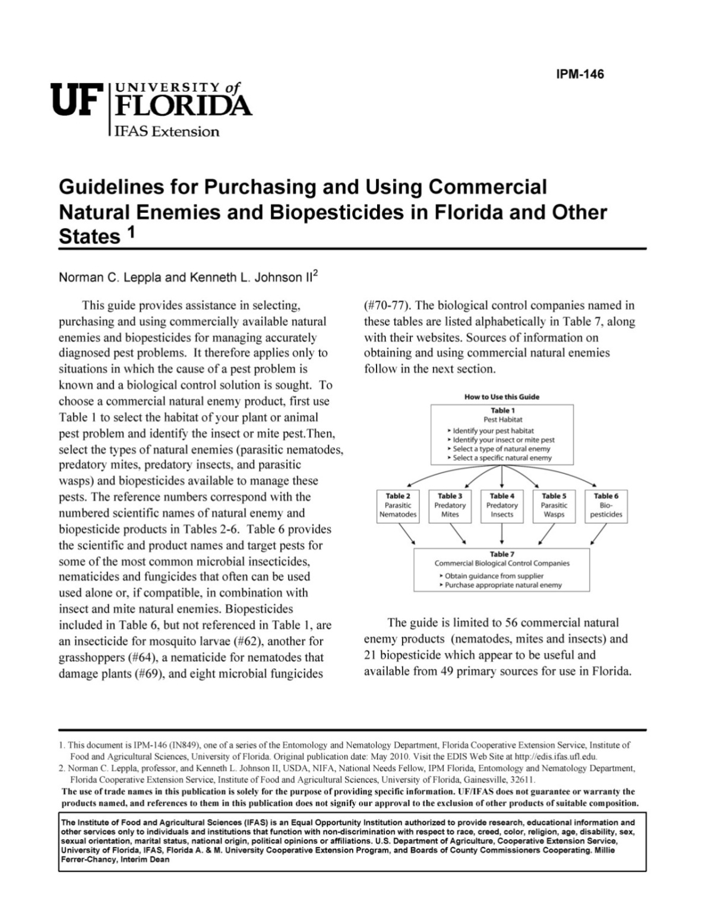

Slide 14
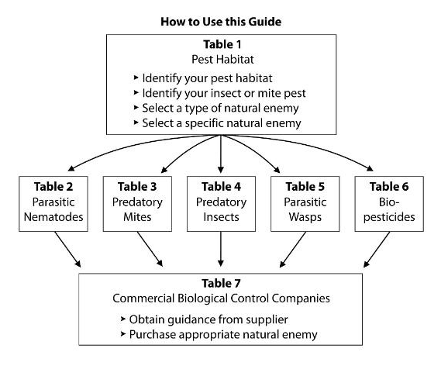

Slide 15
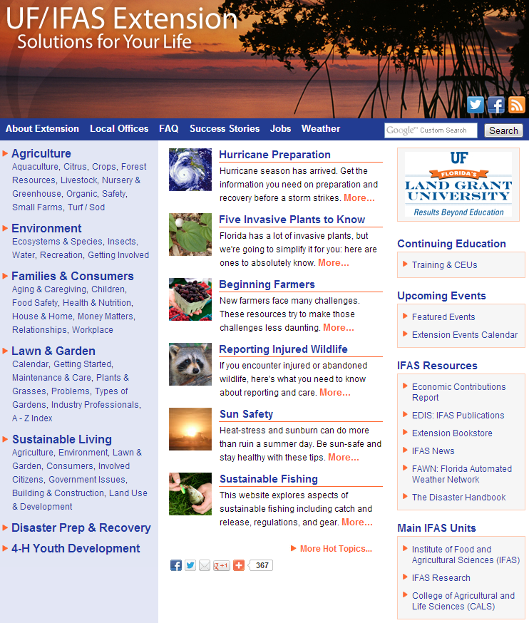
http://solutionsforyourlife.ufl.edu/

Slide 16
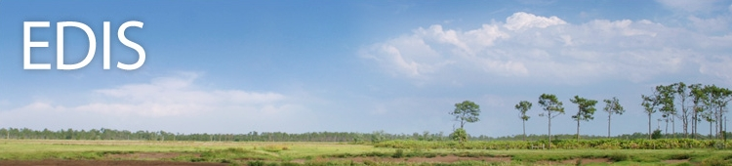
Electronic Data Information Source (EDIS)
The EDIS website is a comprehensive, single-source repository of all current UF/IFAS peer-reviewed publications (about 7,500).
http://edis.ifas.ufl.edu

Slide 17
Electronic Data Information Source (EDIS)
Agriculture
Community Development
Environment
Families & Consumers
4H Youth development
Lawn & Garden
Aquaculture
Crops
Livestock
Nursery & GH
Organic farming
Agricultural safety
Small farms
Turf & sod

Slide 18
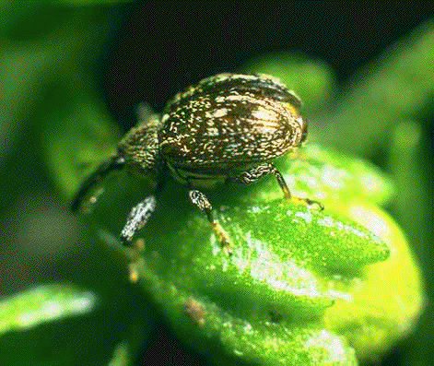
EDIS Agriculture Crops
Subtopics:
Commercial Vegetable Production- Subtopics
Vegetable Gardening
Specific Vegetables A-Z
Vegetables by Type
Vegetable Industry
Cultural Practices for Vegetables
Economics of Vegetables
Vegetable Irrigation
Nutrition and Fertilizers for Vegetables
Vegetable Pest Management
Vegetable Post-harvest and Processing
Vegetable Production Handbook
Florida Greenhouse Vegetable Production Handbook
Vegetable Production -- Miami Dade Vegetable Production (en)

Slide 19
Vegetable Pest Management
Subtopics:
Greenhouse Pest Management
Vegetable Diseases
Vegetable Garden Pest Management
Vegetable Pest Insects
Vegetable Pest Nematodes
Vegetable Pest Management by crop
Vegetable Pesticides
Vegetable Weeds
Vegetable Diseases- Subtopics
Vegetable Diseases by crop
Alternaria
Anthracnose
Plant Disease Management Guide- Vegetable Crops
Rhizoctonia and Brown Patch
Tospovirus
Vegetable
Publications

Slide 20

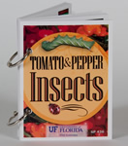
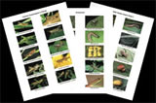
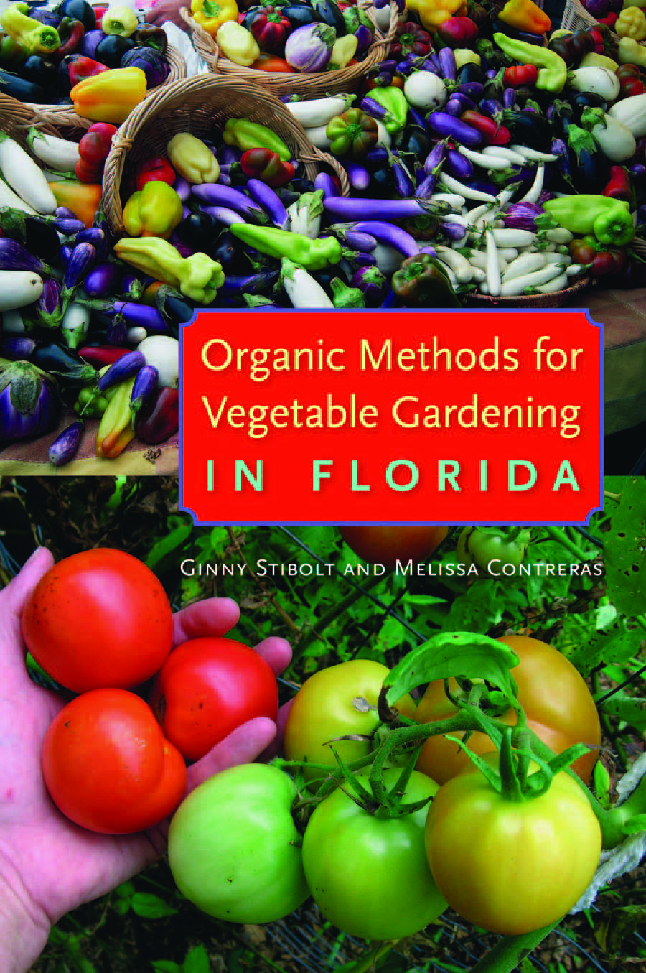

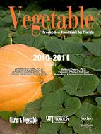

Slide 21






http://entnemdept.ufl.edu/creatures/
Featured Creatures provides in-depth profiles of insects, nematodes, arachnids and other organisms. The site is a cooperative venture of the University of Florida's Department of Entomology and Nematology and the Florida Department of Agriculture and Consumer Services' Division of Plant Industry. All articles are official publications of the University of Florida's Institute of Food and Agricultural Sciences.

Slide 22
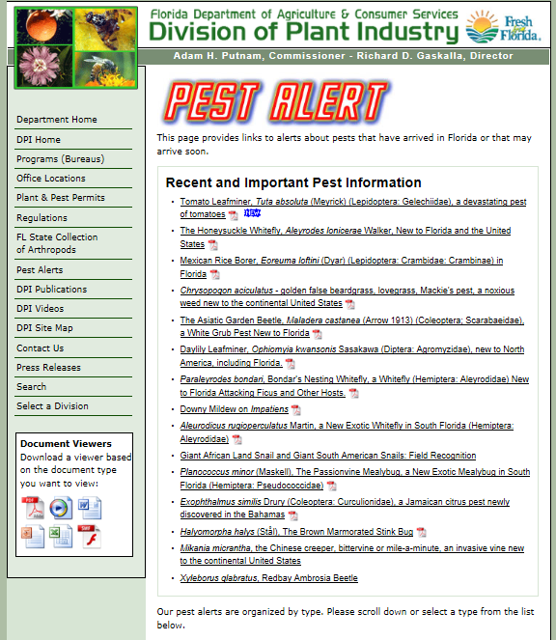

Slide 23

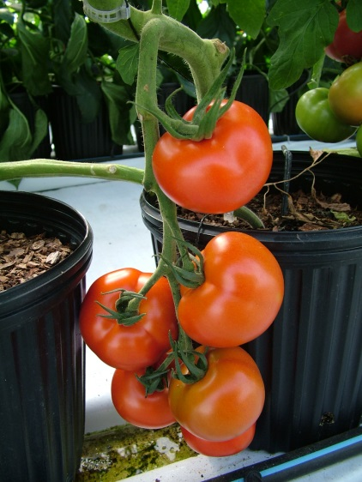
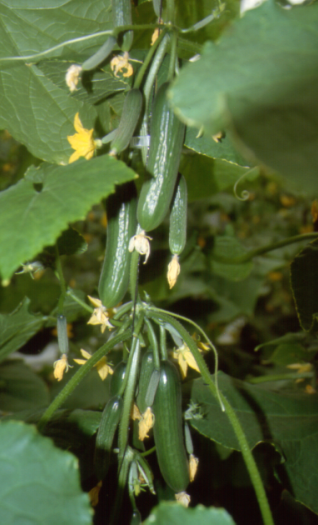

http://ipm.ifas.ufl.edu

