Slide 1
Increasing Production of Trichogramma by Substituting Artificial Diets for Factitious Host Eggs
S. M. Greenberg¹ and N. C. Leppla²
¹USDA, ARS Beneficial Insects Research Unit, Weslaco, Texas 78596 and ²University of Florida, Entomology and Nematology Department Gainesville, Florida 32611

Slide 2
Mass Rearing Trichogramma on Factitious Hosts
Trichogramma research accelerated the development of “industrial entomology. “
Before the USSR ended, about 32 million hectares of agricultural and forest land were treated with Trichogramma annually.
Daily, 4-5 million Trichogramma were produced in eggs of Sitotroga cerealella.
Currently, 15 million ha are treated in more than 40 countries.
Trichogramma spp. parasitize more than 400 harmful insect species.

Slide 3
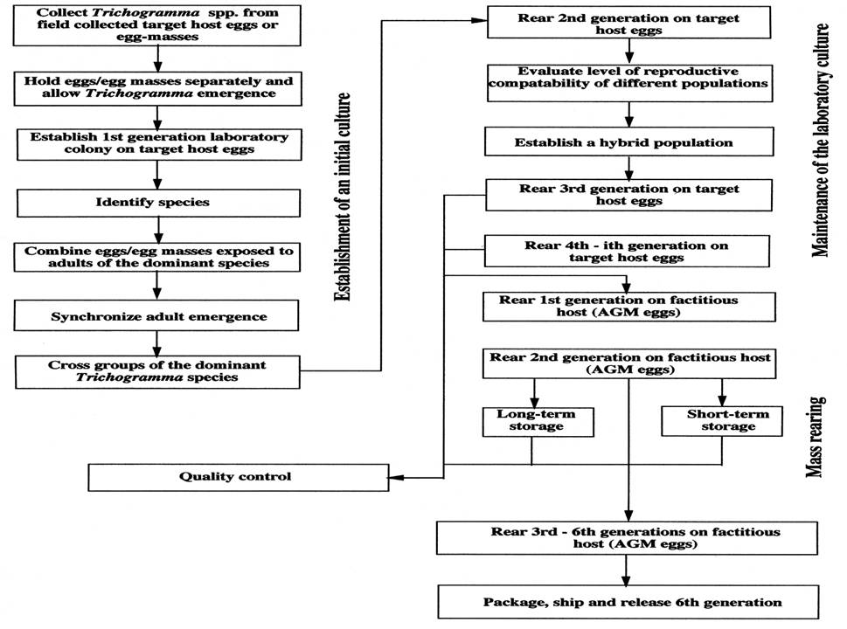
The process for mass rearing Trichogramma spp. used in the former USSR

Slide 4
Alternative Factitious Hosts
Host Species | Common Name | Primary Countries
Sitotroga cerealella | Angoumois grain moth | Former USSR, E. Europe, North and South America
Ephestia kuehniella | Mediterranean flour moth | Western Europe
Corcyra cephalonica | Rice moth | China, Southest Asia
Galleria mellonella | Greater wax moth | Research
Helicoverpa zea | Cotton bollworm | Research
Manduca sexta | Tobacco hornworm | Research
Samia cynthia ricini | Eri silkworm | China
Antheraea. pernyi | Oak silkworm | China

Slide 5
Trichogramma Body Length Classes
The body length of a Trichogramma adult is dependent on the size of host egg on which it developed.
Adult female Trichogramma body length is positively correlated with fecundity.
We measured the body length of adult female Trichogramma from the frons to the tip of the abdomen and divided the insects into four quality classes.
Class 1 | >0.421 mm
Class 2 | 0.290 – 0.420 mm
Class 3 | 0.188 – 0.289 mm
Non-standard | <0.187 mm

Slide 6
Trichogramma spp. | Host | Host Egg (mm³) | Trichogramma/ Host Egg | Trichogramma Length
evanescens, pintoi, maidis, pretiosum, minutum | S. cerealella | 0.02 | 1.0 | 0.181-0.275 Aver. 0.236 (Class 3)
T. brassicae, evanescens | E. kuehniella | 0.029 | 1.0-2.0 | 0.187-0.357 Aver. 0.311 (Class 2)
evanescens, pretiosum, minutum | G. mellonella | 0.034 | 2.0 | 0.239-0.357 Aver. 0.319
ostriniae, chilonis, japonicum, evanescens | C. cephlonica |  | 2.0-3.0 | 0.290-0.405 Aver. 0.332 (Class 1)
T.evanescens, pretiosum, minutum, brassicae | H. zea | 0.09 | 2.0-4.0 | 0.310-0.425 Aver. 0.393
evanescens, pretiosum, minutum | M. sexta | 1.32 | 10.0-15.0 | 0.400-0.561 Aver. 0.525
T.ostriniae, evanescens, pretiosum, cacoeciae | Samia cynthia ricini |  | 27.0-60.0; Optimal 25.0
dendrolimi, chilonis, closterae | Antheraea. pernyi |  | 50.0-260.0; Optimal 60.0-80.0.

Slide 7
Size and Fecundity of T. minutum Females Reared on Two Hosts
Body Length (mm) | Eggs/Female
Sitotroga cerealella
0.199±0.005a | 18.4±9.0a
0.291±0.005b | 25.0±0.7b
Helicoverpa zea
0.313±0.004a | 26.2±0.7a
0.461±0.005b | 35.2±1.1b

Slide 8
Cost of Producing Trichogramma on Different Factitous Hosts
Host | Production | Costs
S. cerealella (in former USSR) | Increased from 4.5 to 9.4 g eggs S. c./kg of barley kernels; 4-5 millionn Trichogramma/day | Labor to produce 100,000 S. cerealella eggs ranged 0.14-0.27 man-h
S. cerealella (in the USA) | Increased from 6.0 to 12.0 g eggs S. c./kg of wheat kernels; 5 million Trichogramma/day | Labor required per production 100,000 S. cerealella eggs 0.239 man-h
E. Kuehniella on mixture of 40% wheat & 60% corn flour | Increased from 3.1 to 7.6 g eggs E. k./kg of diet; about 3.5 million Trichogramma/day | Reduced labor from 0.44 to 0.1 man-h/ 100,000 E. k. eggs.

Slide 9
Cost of Producing Trichogramma on Different Factitous Hosts
Host | Production | Costs
C. cephalonica on 90% wheat bran, 5% soybean, and 5% corn flour | Increased to 10 g eggs C.c./kg of diet; 3.0 million Trichogramma/day
A. pernyi | A newly developed extractor can squeeze about 20,000 females/day and yield 120-130 kg of A. p. eggs/280 million Trichogramma/day | This device replaces more than 20 workers

Slide 10
Rearing Host | % Wax Artificial Eggs Parasitized | No. Parasitoid eggs/ Female/Wax Artificial Egg
S. Cerealella | 49.5 ± 11.5b | 6.5 ± 1.6b
E. kuehniella | 78.0 ± 5.4a | 13.3 ± 1.6b
G. mellonella | 76.7 ± 10.6a | 9.4 ± 1.4b
H.zea | 80.0 ± 4.7a | 16.5 ± 2.9a
M. sexta | 83.3 ± 5.0a | 19.6 ± 2.1a
G. mellonella | 76.7 ± 10.6a | 9.4 ± 1.4b

Slide 11
Artificial Diet and Automated In Vitro Rearing of Trichogramma
The Chinese first developed in vitro rearing of Trichogramma for commercial production.
They used oligidic diets containing 27-50% silkworm haemolymph plus other ingredients.
They reared T. dendrolimi, T. chilonis, T. cacoeciae, T. evanescens, T. ostriniae, and T. japonicum.
Biological Control units of USDA, ARS at Mississippi and Texas (Nordlund D. A., WuZ. X., Cohen A. C., and Greenberg S. M.) developed in vitro rearing of T. minutum and T. pretiosum.

Slide 12
The Diet for Trichogramma In Vitro Rearing
Component | Percentage
7% Yeast Extract solution | 10.0
Free Amine III | 5.0
10% suspension of nonfat dry milk | 15.0
Chicken egg yolk | 25.0
Chicken embryo extract | 15.0
Manduca sexta egg liquid | 30.0

Slide 13
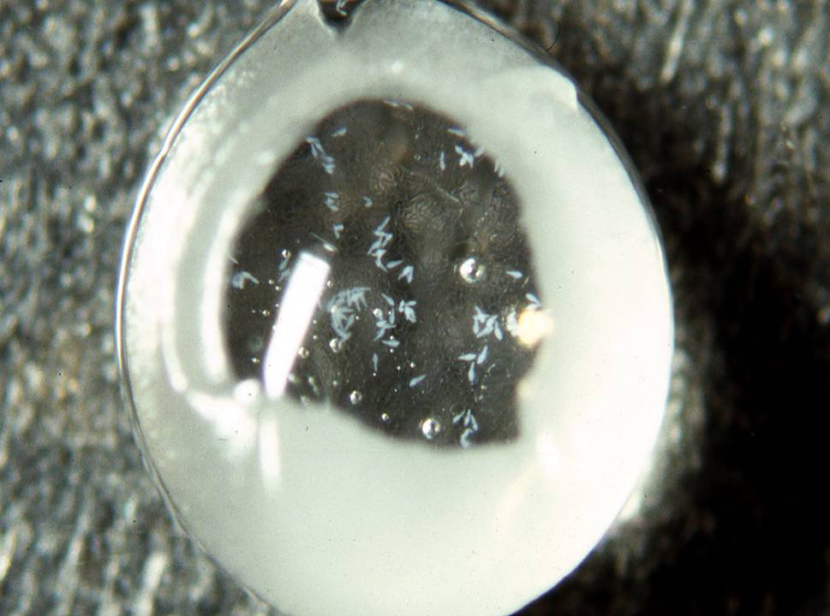

Slide 14
Mass Production of Artificial Host Egg Cards
A computer controlled machine automatically completes all five egg production processes: 1. setting-up the synthetic membrane, 2. forming the “egg shells,” 3. injecting the artificial medium into the shells, 4. sealing the double-layered membrane, and 5. separating the egg cards.
The production capacity of the machine is 1,200 egg-cards/ hour, which can be used to produce 6-7 x 10⁶ Trichogramma.
About 5x10⁶ Trichogramma can be reared on one liter of the oligidic diet (At $2.84/liter, diet cost is $0.06/100,000 adults).

Slide 15
T. minutum and T. pretiosum Reared In Vivo and In Vitro for 10 Generations
In vitro-reared larvae required one day longer to reach the adult stage than did insects reared on Helicoverpa zea eggs.
Adult longevity, number of H. zea eggs parasitized, and Trichogramma adult female body length was greater for insects reared in vitro.
Trichogramma spp. | Host | Host Egg (mm³) | Trichogramma/ Host Egg | Trichogramma Length
evanescens, pretiosum, minutum | Artificial diet in WAXe | 8.8 | 18.0-33.0 | 0.430-0.588 Aver. 0.489 (Class 1)

Slide 16
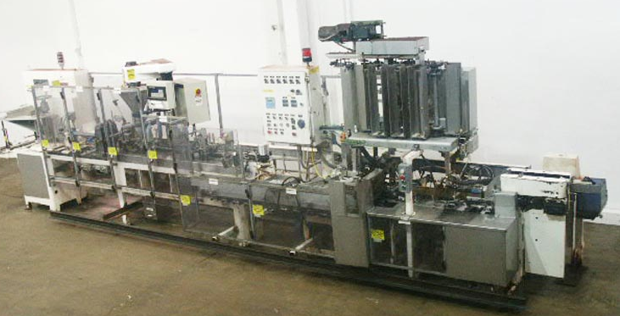
Assuming that we can rear Trichogramma in a cell similar in size to the one used for Lepidoptera (4000/cell), with the existing form-fill-seal machine operating for six hours per day and seven days per week, the weekly production would be 4.2 billion. A more modern machine with five times that capacity would increase production to 21.0 billion per week.

Slide 17
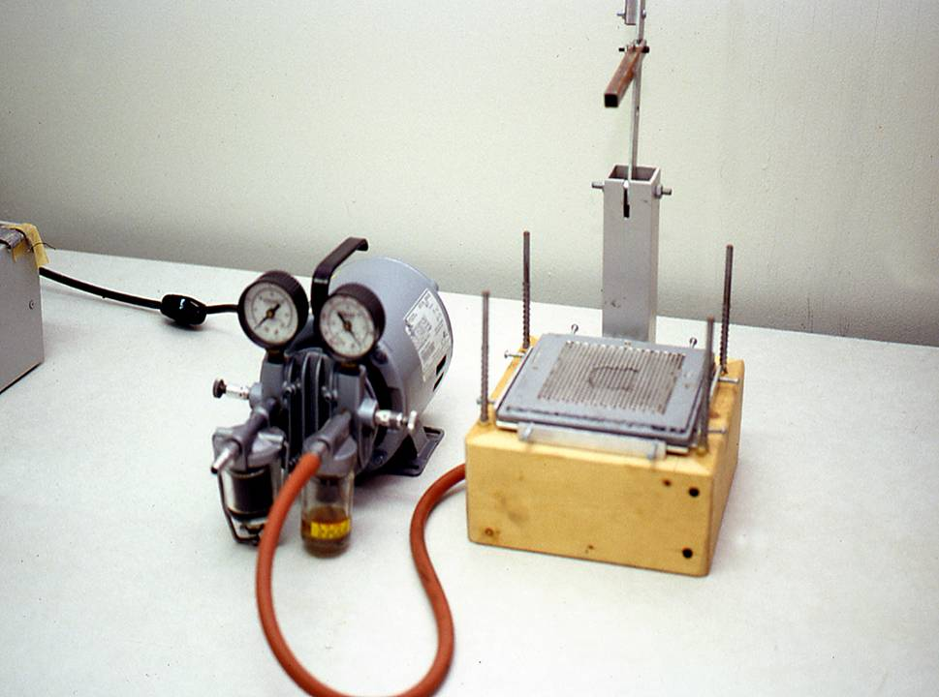
In vitro rearing of Trichogramma requires artificial “chorions” for oviposition- polypropylene or polyethylene films with thickness 32-36 µm and 10-18 µm, respectively, for species with short ovipositors; and 55-65 µm thick films for species with long ovipositors.

Slide 18
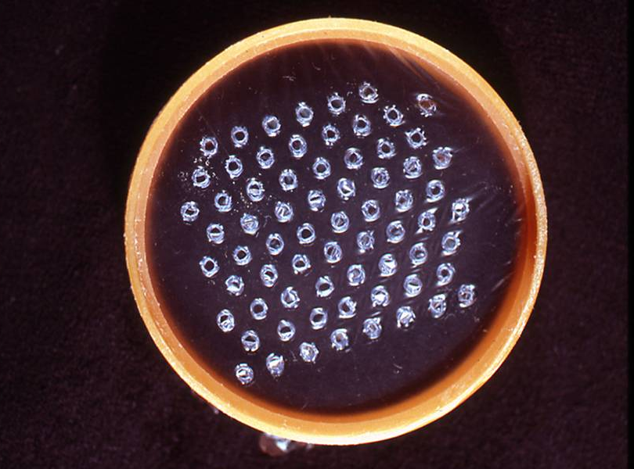
Streached Plastic Artificial Eggs (SPAEs)
Oviposition is stimulated by 5% FreAmine III, 30% chicken egg yolk, 20% TNM-FH Insect Medium, and 45% Rinaldini salt solution inside the SPAEs.
Eggs are removed from the SPAEs by filtering the oviposition solution and then mixed with the diet.
About 70% of the eggs hatch within two days of oviposition.

Slide 19
Materials Applied to Exterior of SPAEs and Oviposition by T. pretiosum
Materials | % of SPAEs with Trichogramma eggs | Parasitoid eggs/ oviposition arena
Untreated Control | 16.2 ± 2.9c | 80 ±12 c
School Glue | 40.0 ± 1.6b | 252 ± 12b
Moth Scale Extract | 58.1 ± 4.2a | 518 ± 14a
Gelatin | 45.2 ± 1.3b | 330 ± 18b
Polyvinyl Alcohol | 42.9 ± 2.2b | 268 ± 25b
Water | 15.7 ± 3.0c | 93 ± 24
Hexane | 33.3 ± 2.1b | 202 ± 5b
Streached plastic artificial eggs (SPAEs) contain FreAmine III or 0.01% bisylfite solution to stimulate oviposition.

Slide 20
Oviposition in SPAEs by T. minutum Females Reared on Different Hosts
Host | SPAEs containing eggs (%) | Trichogramma eggs/oviposition arena (70 SPAE per 16 cm² area)
Sitotroga cerealella | 30.9 ± 1.2c | 380.3 ± 21.4c
Helicoverpa zea | 76.2 ± 1.3b | 1,383.7 ± 95.7b
Wax artificial eggs | 89.3 ± 0.7a | 2,051.0 ± 53.0a

Slide 21
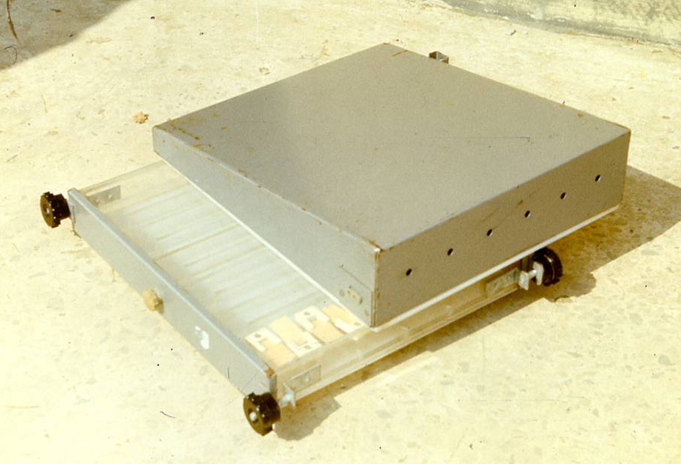
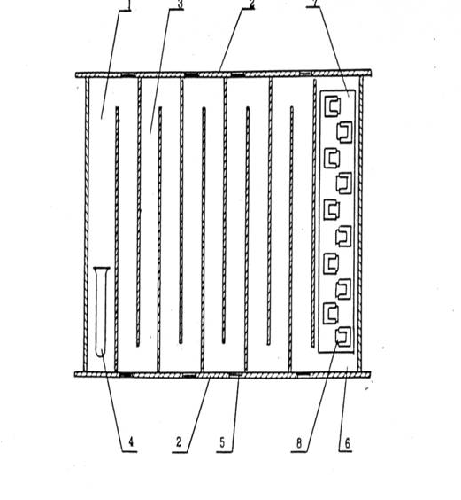
Quality Control Device for Trichogramma
1
3
2
7
Section for parasitoid release
Cover
Twisting canal
4. Vial with Trichogramma
5. Ventilation window
6. Section for parasitism
7. Tray
8. Cards with host eggs
4
2
5
8
6

Slide 22
Quality Control Characteristics for Stock and Marketable Trichogramma
Characteristic | Stock Culture | Marketable Product
Parasitized eggs/gram | >60,000 | 80,000
Percent parasitism | 60% | 80%
Percent emergence | 80% | 90%
Percent females | 65% | 50%
Eggs /female | 35.0 | 20.0
Percent deformed | <3% | 5%

Slide 23
Future Advancements in Artificial Diets for Mass Rearing Trichogramma
The current diet is impractical because it requires liquid from Manduca sexta eggs.
A high percentage of larvae reared in vitro are deformed.
Larvae feed principally on solid, highly concentrated foods so their diet should be semi-solid, not liquid.
Improvements in artificial diets can be made by studying the feeding behavior of Trichogramma larvae.
Artificial diets for mass rearing high quality Trichogramma will enable development of automated mass rearing systems.

