Slide 1
Learning About IPM and its Role in Pesticide Resistance Management
Norm Leppla, Director
UF/IFAS Statewide IPM Program

Slide 2
Pesticide Resistance Topics
What is integrated pest management (IPM)?
Role of IPM in pesticide resistance management
IPM instruction materials available in Florida

Slide 3
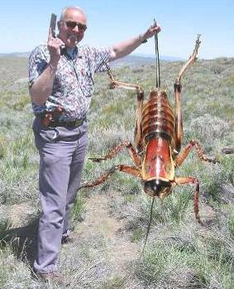
What is IPM?
It coordinates the use of pest biology, environmental information, and available technology to prevent unacceptable levels of pest damage by the most economical means, while posing the least possible risk to people, property, resources, and the environment (USDA).

Slide 4
IPM System
Pest outbreaks & disease epidemics
Environmental contamination
Human health hazards
Pest mgmt. costs
Reduce risks
INCREASE…
Reliability
Sustainability
Chem
Biological Control
Cultural Methods

Slide 5
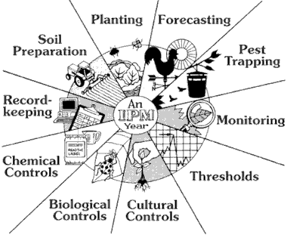
IPM Tactics

Slide 6
Complete IPM System
Biological knowledge
Monitoring and inspection
Act to control pests when necessary
Choose least-risk options
Long-term, preventative practices
Evaluation and recordkeeping
Pesticide management
Continual improvement

Slide 7
PesticidesVersus IPM
Invasive Pest
Resistant Crop
Competitors
Natural enemies
Resistant varieties
Vulnerable Crop
Integrated pest management program
Cultural practices
Scouting, ID of pests & NEs
Conservation of Comp. & NEs
Augmentation of NEs
Reduced-risk insecticides
Resistance management
Pesticide program
New insecticides
New formulations
Application methods
Resistance management

Slide 8
Role of IPM in Pesticide Resistance Management
Pesticide resistance management is part of IPM- resistant crop varieties, competitors and natural enemies, monitoring, sanitation, crop rotation, adjacent crops and weeds, pesticides, and avoiding continuous year-round cultivation of a single crop.
Determine the presence and status of pests in the crop- ID, population dynamics (stages), abundance, thresholds.
Apply pesticides- selection, rates, application coverage, timing, frequency, rotation, mixtures, resistance monitoring, biopesticides.
Develop and refine a resistance management plan with stakeholders (growers, crop advisors, pesticide suppliers).

Slide 9
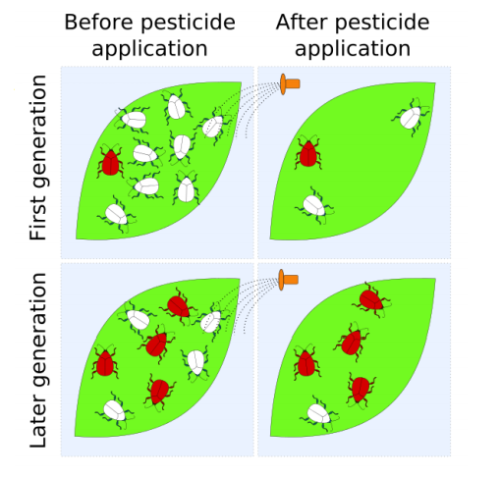
Pesticide Resistance Management
Pesticide resistance is a genetic change in an organism in response to selection by the toxicant.

Slide 10
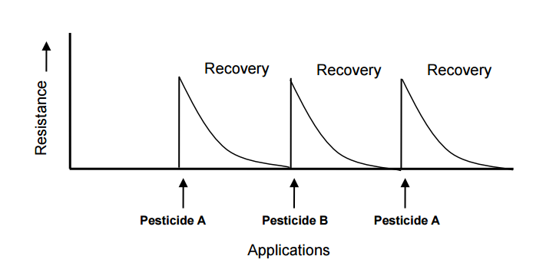
Resistance Levels and Pesticide Rotation
Guidelines on Prevention and Management of Pesticide Resistance
http://www.eppo.int/PPPRODUCTS/resistance/FAO_RMG_Sept_12.pdf

Slide 11
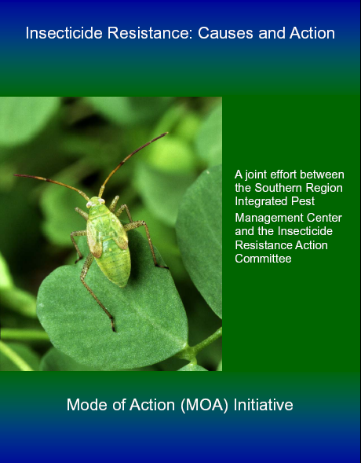
Pesticide Resistance
IRAC
HRAC
FRAC
Fred Fishel (University of Florida)
EDIS- http://edis.ifas.ufl.edu/pdffiles/PI/PI12100.pdf
Principles of Pesticides- http://agronomy.ifas.ufl.edu /pdfs/syllabi/ipm5305.pdf
Alan Roe (Utah State University)
http://utahpests.usu.edu/ipm/files/uploads/pptdocs/05sh-pesticides-new.pdf

Slide 12
IRAC Insecticide Classification
Acetylcholine esterase inhibitor (Carbamates, Carbaryl; Organophosphates, Malathion)
GABA-gated chloride channel antagonists (Cyclodiene organochlorines, chlordane; Phenylpyrazoles, Fipronil)
Sodium channel modulators (Pyrethroids, Pyrethrins, Bifenthrin; DDT, Methoxychlor, DDT)
Nicotinic Acetylcholine receptor agonists (Neonicotinoids, Imidacloprid; Nicotine Nicotine; Sulfoxaflor, Sulfoxaflor
Nicotinic Acetylcholine receptor allosteric activators (Spinosyns, Spinosad)
Chloride channel activators (Avermectins, Abamectin; Milbemycins)
Juvenile hormone mimics (Juvenile hormone analogues, Methoprene, Fenoxycarb, Pyriproxyfen)
Miscellaneous nonspecific (multi-site) inhibitors (Alky halides, Methyl bromide, Chloropicrin, Sulfuryl fluoride)
Selective homopteran feeding blockers (Pymetrozine, Flonicamid)
Mite growth inhibitors (Clofentezine)
Microbial disruptor of insect midgut membranes (Bacillus thuringiensis and the insecticidal proteins they produce; Bacillus sphaericus)
Inhibitors of mitochondrial ATP synthase (Diafenthiuron; Organotin miticides, Azocyclotin)
Uncouplers of oxidative phosphorylation via disruption of proton gradient (Chlorfenapyr; Sulfuramid)
Nicotinic acetylcholine receptor channel blockers (Nereistoxin analogues, Bensultap)
Inhibitors of chitin biosynthesis, type 0 (Benzoylureas, Diflubenzuron)
Inhibitors of chitin biosynthesis, type 1 (Buprofezin)
Moulting disruptor, Dipteran (Cyromazine)
Ecdysone receptor agonists (Diacylhydrazines, Tebufenozide)
Octopaminergic receptor agonists (Amitraz)
Mitochondrial complex III electron transport inhibitors (Hydramethylnon)
Mitochondrial complex I electron transport inhibitors (METI acaricides and insecticides, Fenpyroximate, Rotenone)
Voltage-dependent sodium channel blockers (Indoxacarb)
Inhibitors of acetyl CoA carboxylase - Lipid synthesis, growth regulation (Tetronic and Tetramic acid derivatives, Spirotetramat)
Mitochondrial complex IV electron transport inhibitors (Zinc phosphide, Cyanide)
Mitochondrial complex II electron transport inhibitors (Beta-ketonitrile derivatives, Cyenopyrafen)
Vacant
Vacant
Ryanodine receptor modulators (Diamides, Chlorantraniliprole)
(UN) Compounds of unknown or uncertain mode of action (Azadirachtin, Azadirachtin; Cryolite, Cryolite)

Slide 15
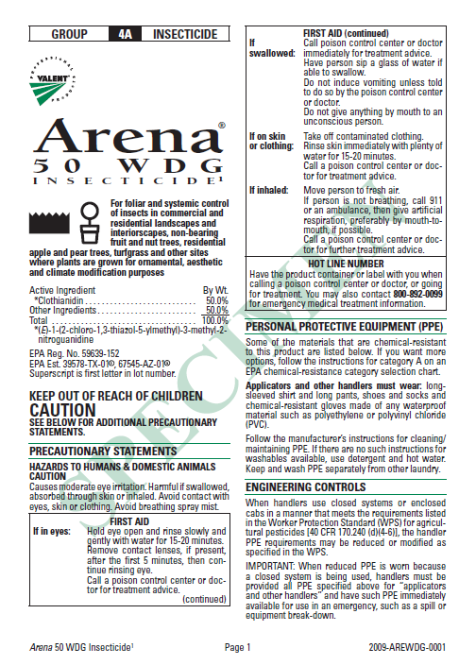
Pesticide Label
USER SAFETY RECOMMENDATIONS
Environmental Hazards
Directions for Use
AGRICULTURAL USE REQUIREMENTS
NON-AG USE REQUIREMENTS
LIMITED WARRANTY AND LIABILITY
RISKS OF USING THIS PRODUCT
RESISTANCE MANAGEMENT
RESTRICTIONS AND LIMITATIONS
Plant tolerance
Mixing instructions
Spray drift management
APPLICATION PROCEDURES
RESTRICTIONS AND LIMITATIONS
APPLICATION ON PLANTS FOR PESTS
STORAGE AND DISPOSAL

Slide 16
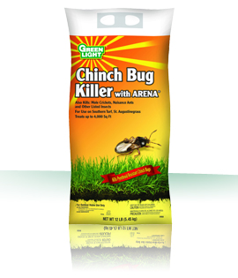
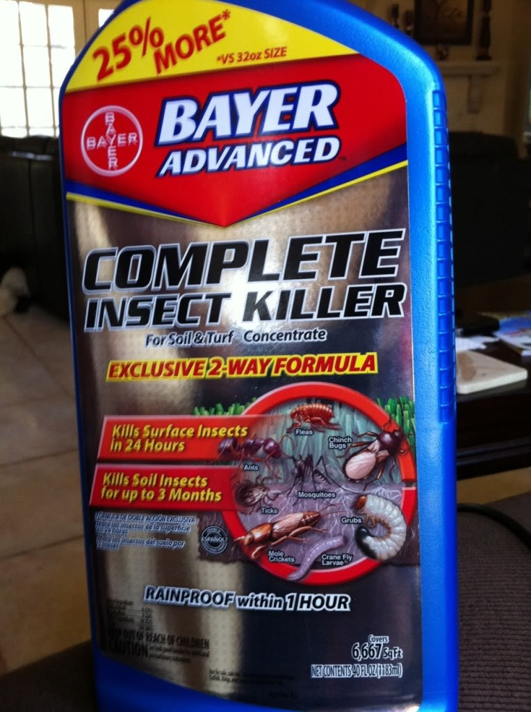
Southern Chinch Bug Insecticides
Clothianidin 50%, other by weight 50%
Imidacloprid 0.72%, beta-cyfluthrin 0.36%, other by weight 98.92%.

Slide 17
Insecticides Registered for Use on Southern Chinch Bug in Florida
Active ingredient | Chemical class | Retail/homeowner product examples | Professional product examples
Bifenthrin | Pyrethroid IRAC #3 | Scotts Lawn Pro Insect Control w/Fertilizer Scotts Turf Builder w/SummerGuard | Bifen XTS Onyx, OnyxPro Talstar EZ, PL granular Wisdom
Bifenthrin + clothianidin | Pyrethroid + neonicotinoid IRAC #3, 4A | None | Aloft
Bifenthrin + imidacloprid | Pyrethroid + neonicotinoid IRAC #3, 4A | None | Allectus
Bifenthrin + zeta-cypermethrin | Pyrethroid IRAC #3 | None | Talstar XTRA
Carbaryl | Carbamate IRAC #1 | Garden,Tech Sevin Gordons Liquid Dura-Spray | Sevin SL Sevin 80 WSP
Clothianidin | Neonicotinoid IRAC #4A | Arena 50 WDG | Arena 0.5 G
Cyfluthrin | Pyrethroid IRAC #3 | Bayer Advanced Power Force Multi-Insect Killer | Tempo
Cypermethrin | Pyrethroid IRAC #3 | None | Demon Max Demon WP
Deltamethrin | Pyrethroid IRAC #3 | Southern Ag Mole Cricket & Chinch Bug Lawn Insect Control | DeltaGard G DeltaGard T&O 5 SC
Imidacloprid | Neonicotinoid IRAC #4A | Bayer Advanced Season Long Grub Control | Merit
Lambda-cyhalothrin | Pyrethroid IRAC #3 | Spectracide Triazicide Once & Done Insect Killer | Demand CS Demand G Scimitar CS
Permethrin | Pyrethroid IRAC #3 | Spectracide Bug Stop Insect Control Granules | Astro Permethrin Pro Termite-Turf Ornamental
Thiamethoxam | Neonicotinoid IRAC #4A | None | Meridian 0.33G, 25WG
Trichlorfon | Organphosphate IRAC #1 | Bayer Advanced 24-Hour Grub Control | Dylox 80 T&O

Slide 18
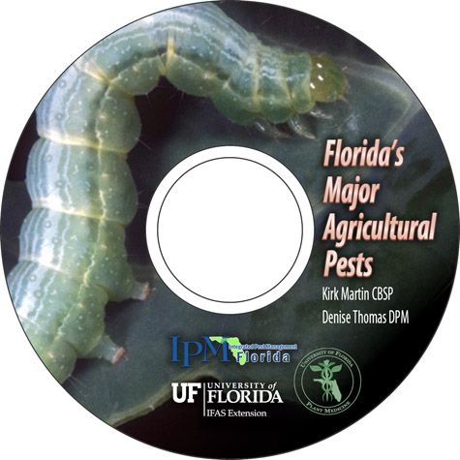
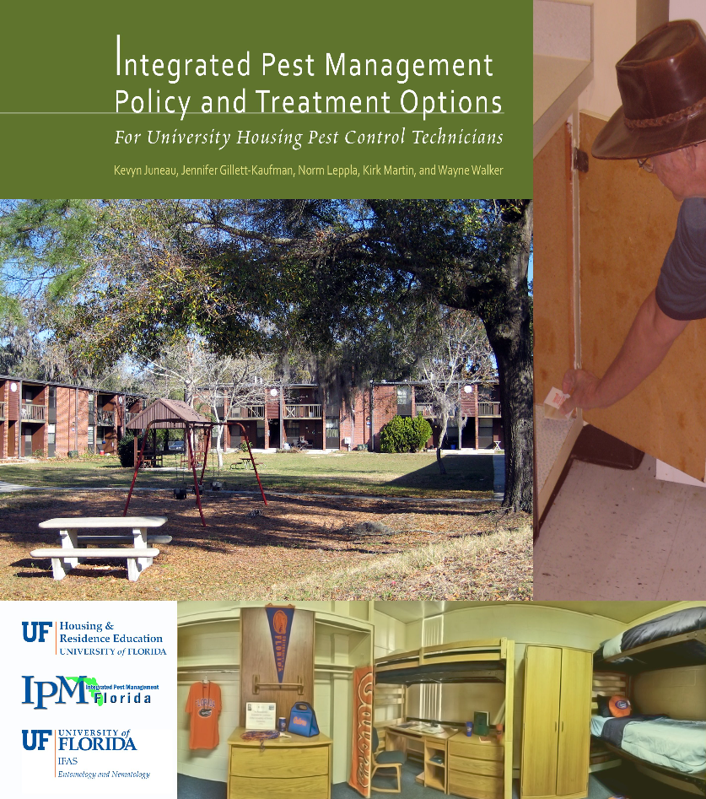
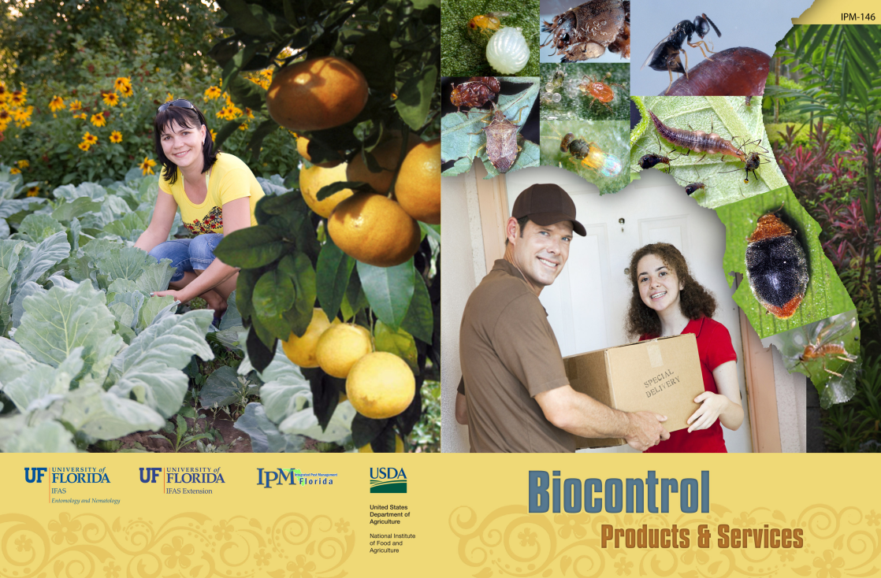
Extension Guides

Slide 19
IPM Instruction Materials Available in Florida
Capinera- ENY 5231 Insect Pest and Vector Mgmt.
Cave- PMA 3010 Fundamentals of Pest Management
Crow- NEM 6708 Field Plant Nematology
Liburd- PMA 4570C, PMA 6228 Field Techniques in IPM
Weeks- ALS 3153, ALS 5136 Agricultural Ecology
Kern- ENY 3228, ENY 5228 Urban Vertebrate Pest Mgmt.
Koehler- ENY 4228 Pesticide Application, ENY 5222C Biology and ID of Urban Pests, ENY 5226C Principles of Urban Pest Management

Slide 20
Electronic Data Information Source (EDIS)
Agriculture
Community Development
Environment
Families & Consumers
4H Youth development
Lawn & Garden
Aquaculture
Crops
Livestock
Nursery & GH
Organic farming
Agricultural safety
Small farms
Turf & sod
http://edis.ifas.ufl.edu/

Slide 21
Featured Creatures provides in-depth profiles of insects, nematodes, arachnids and other organisms. The site is a cooperative venture of the University of Florida's Department of Entomology and Nematology and the Florida Department of Agriculture and Consumer Services' Division of Plant Industry. All articles are official publications of the University of Florida's Institute of Food and Agricultural Sciences.
 |  | or

Slide 22
Pesticide Information
UF/IFAS Pesticide Information Office- Fred Fishel
NPIRS- National Pesticide
Retrieval System
CDMS- ChemSearch
CDMS- http://www.cdms.net/
LabelsMsds/LMDefault.aspx
EPA- http://www.epa.gov/ opp00001/regulating/
registering/data_sources.htm
Extension Pesticide Applicator Training

Slide 23
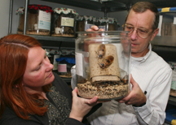
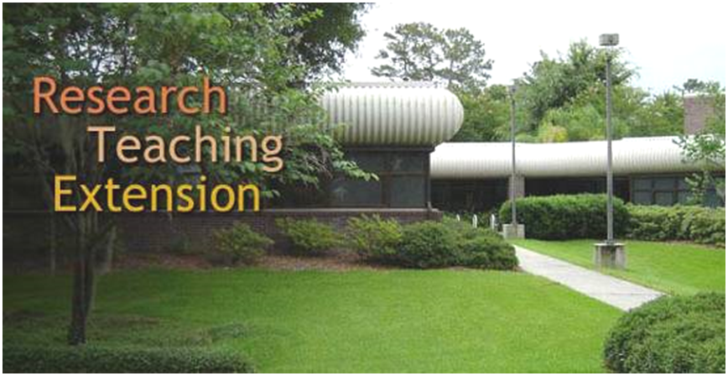
Urban Pest Management
(Urban IPM)- Phil Koehler
Certificate in Urban
Pest Management
15 Credits
Certificate in Landscape Pest Management
15 Credits

Slide 24
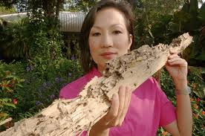
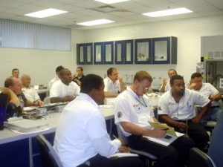
Faith Oi
Termite Training
General Household Pest (GHP) Training
Landscape & Ornamental (L&O) Pesticide Training
http://pmu.ifas.ufl.edu/

Slide 25
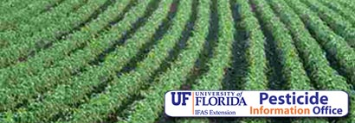
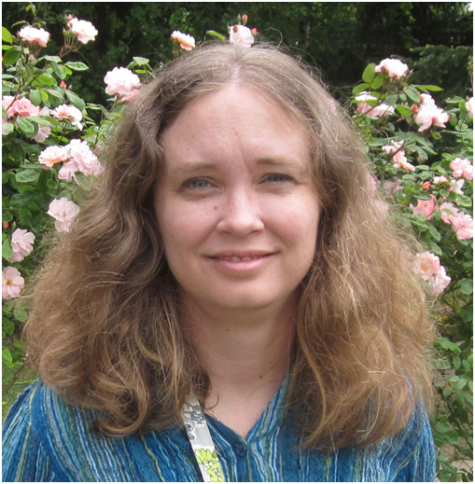
University of Florida
Plant Medicine Program
Teaching IPM to Future
Plant Doctors
Amanda Hodges, Director

Slide 26
IPM Education and Training
Identify key pests and beneficials
Understand organism’s ecology and adaptability
Master scouting and other monitoring techniques
Apply economic and other action thresholds
Prevent pest outbreaks through habitat manipulation
Design systems of mitigation that minimize environmental impact
Have experience with the habitat, e.g., crops
Understand laws and regulations pertinent to IPM
Be familiar with the safe and appropriate use of pesticides
Access pest management information and organizations

Slide 27
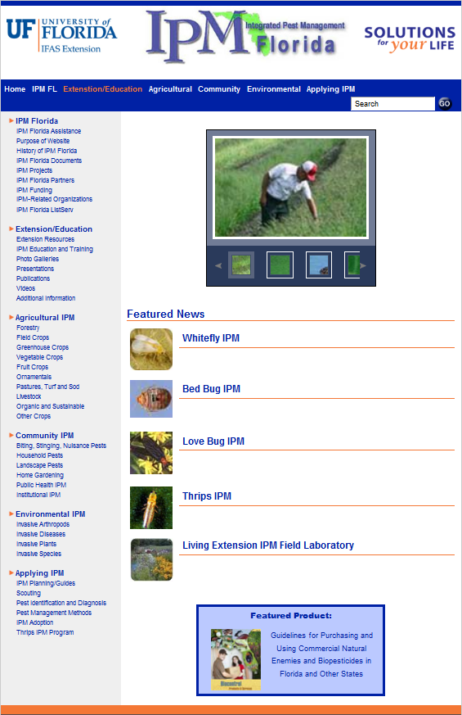
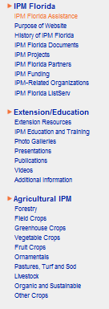
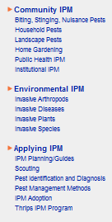

Slide 28
IPM Florida provides statewide, interdisciplinary and inter-unit coordination and assistance for UF/IFAS integrated pest management research Extension and education faculty
http://ipm.ifas.ufl.edu

