Slide 1
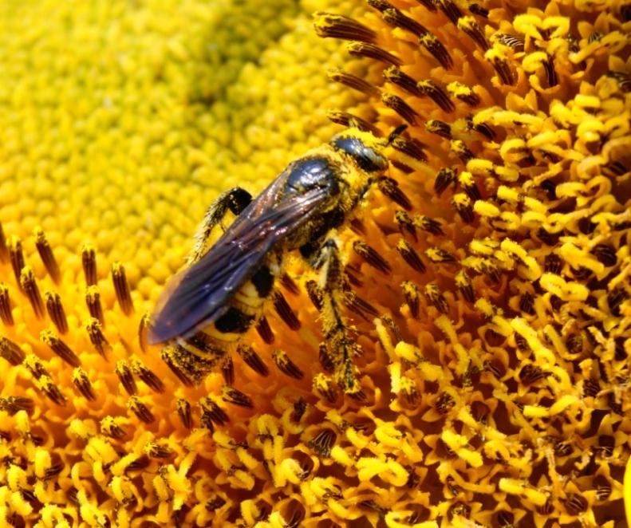
Hands-on IPM Training Through University of Florida Living Extension IPM Field Laboratory
Bob Hochmuth, Multi-County Extension Agent
Suwannee Valley Agricultural Extension Center

Slide 2
Project Objectives
1)Create a field laboratory by transforming an existing farm into a model that can be used to teach IPM principles and techniques beyond the classroom.
2) Teach clientele whole farm IPM approaches.
3) Build a sustainable IPM education infrastructure at this location and develop networking capacity for audiences with similar IPM interests.

Slide 4
IPM Project Focus Teams
Farmscaping (whole farm approach)
Fruit Orchard
Vegetable Crops
Agronomic Crops
Protected Ag and Greenhouses

Slide 5
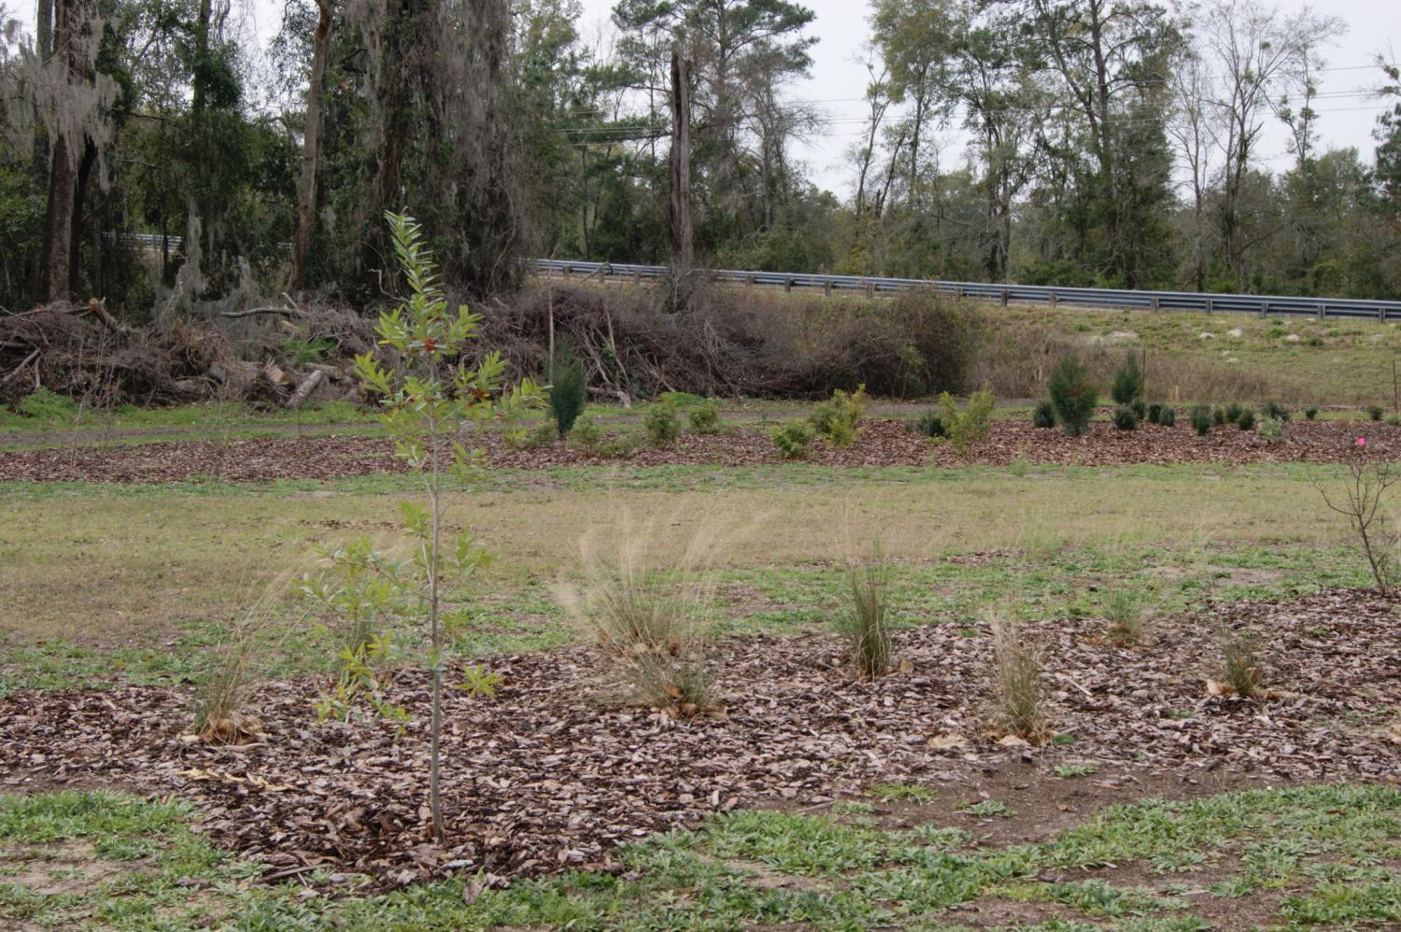
Creating Habitat for Wildlife & Beneficials

Slide 6
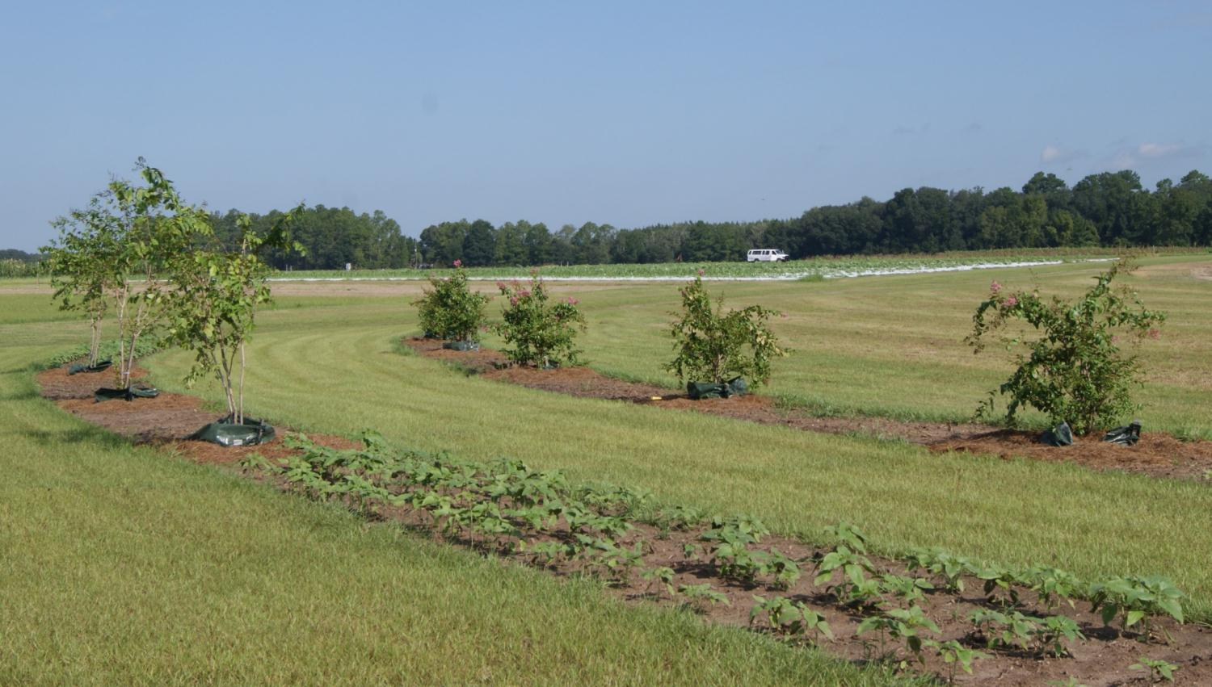
Banker Plants in a Farmscaping System

Slide 7
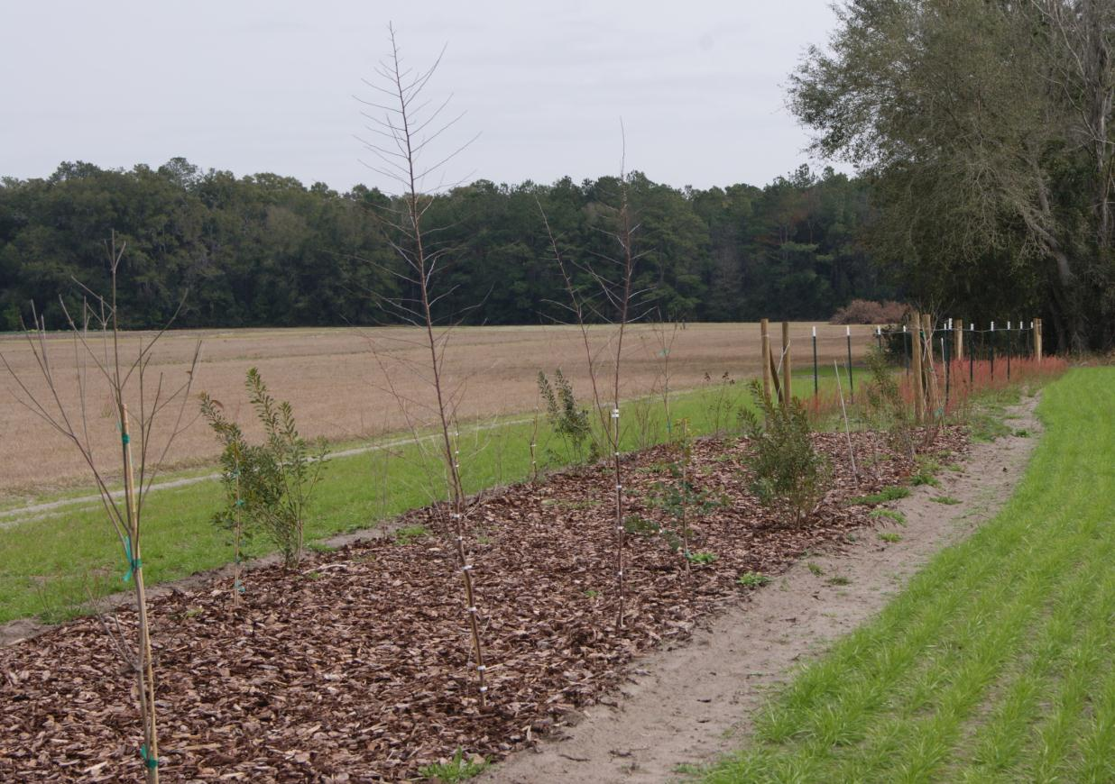
Naturally Established vs. Planted Fence Lines and Hedge Rows

Slide 8
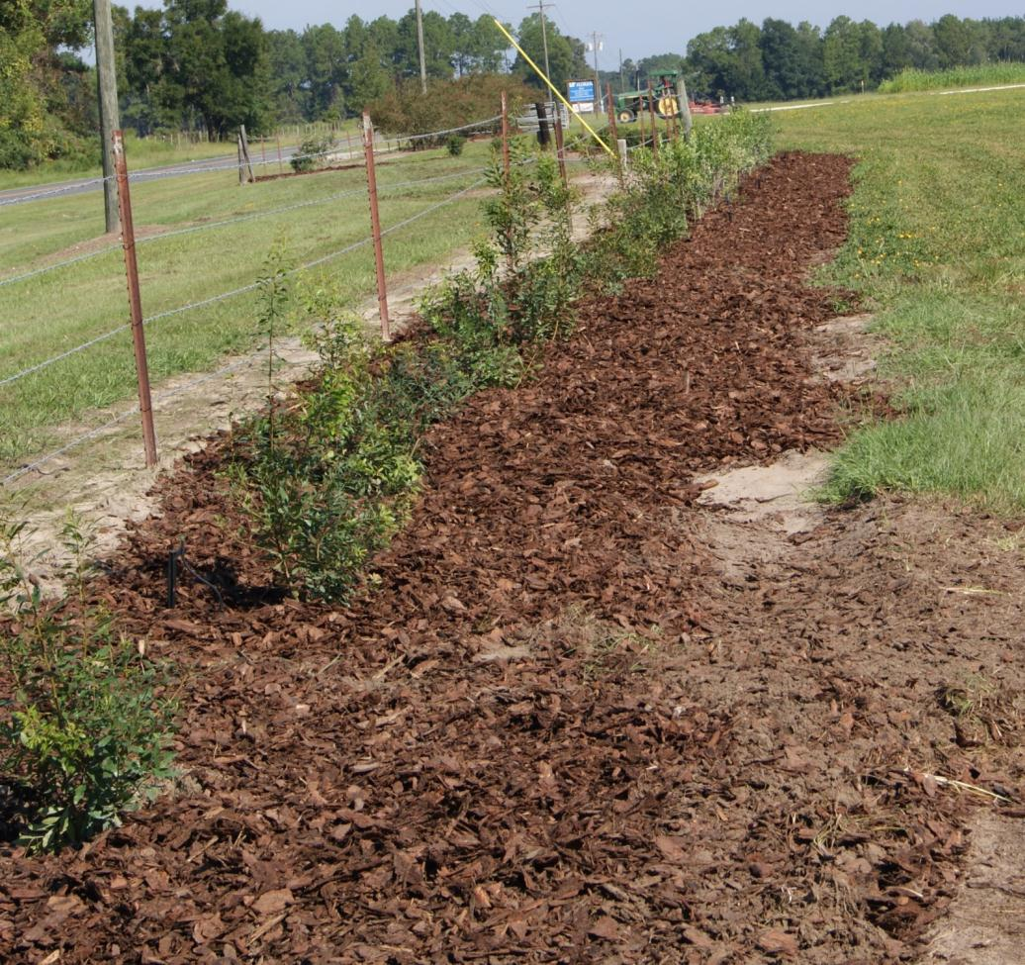
Naturalizing Existing Fence Lines

Slide 9
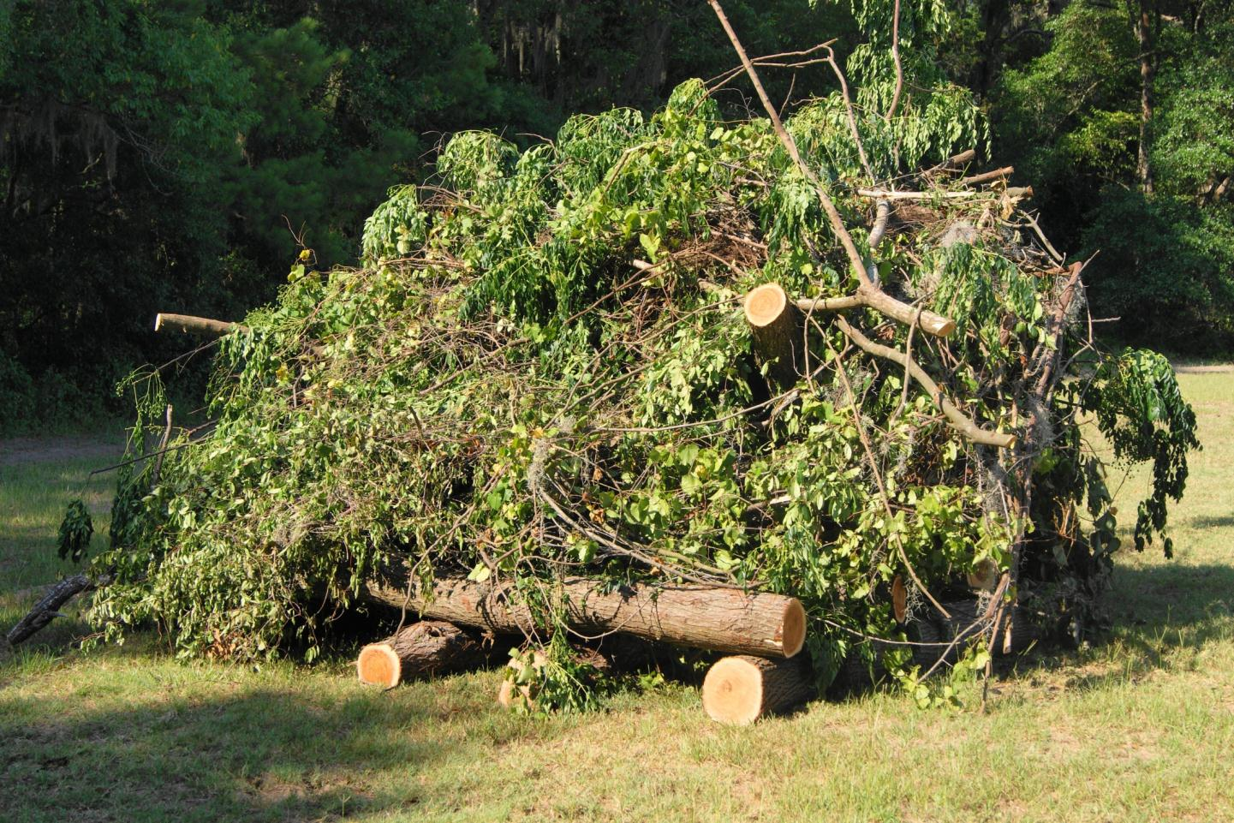
Brush Piles for Wildlife Habitat

Slide 10
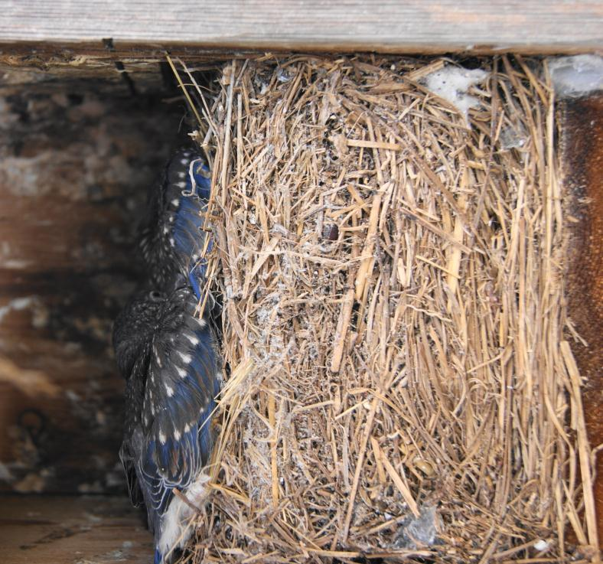
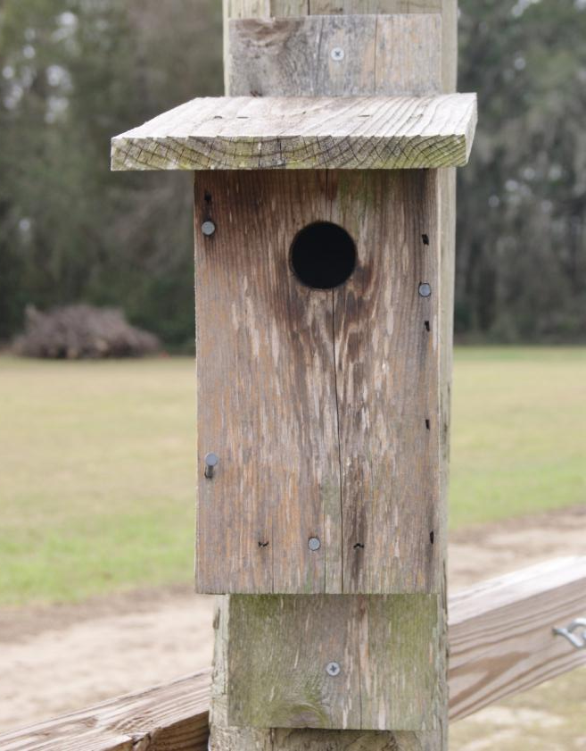
Bluebird Boxes

Slide 11
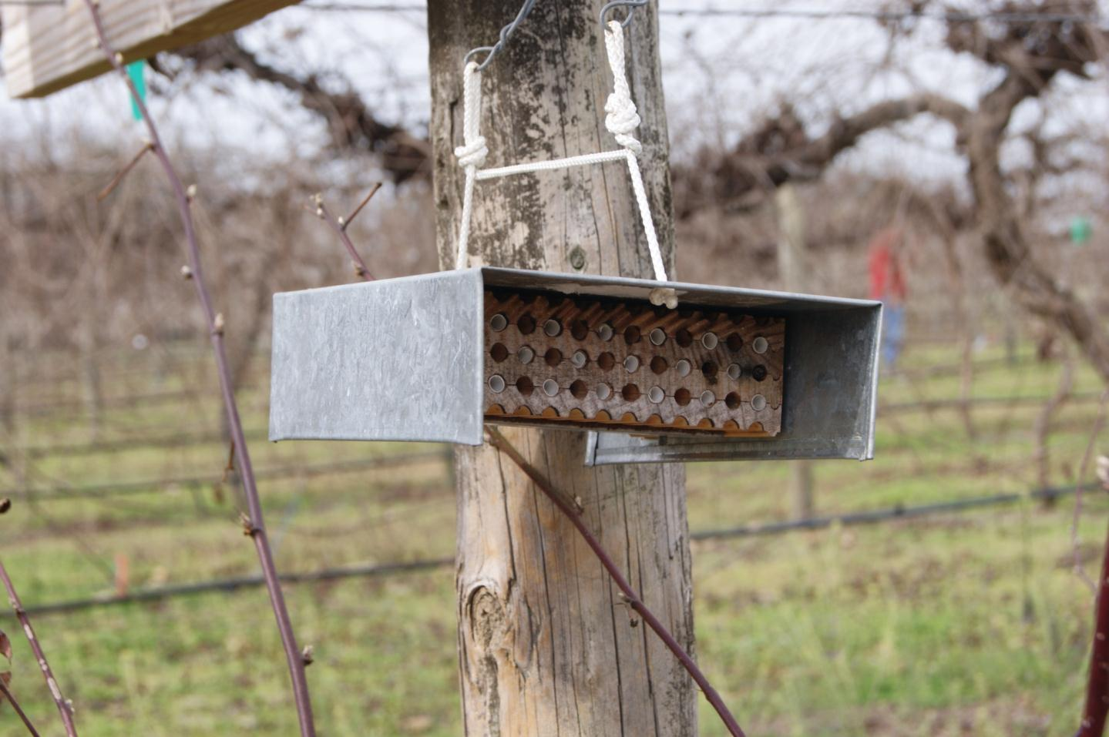
Predator (Bee) Boxes

Slide 12
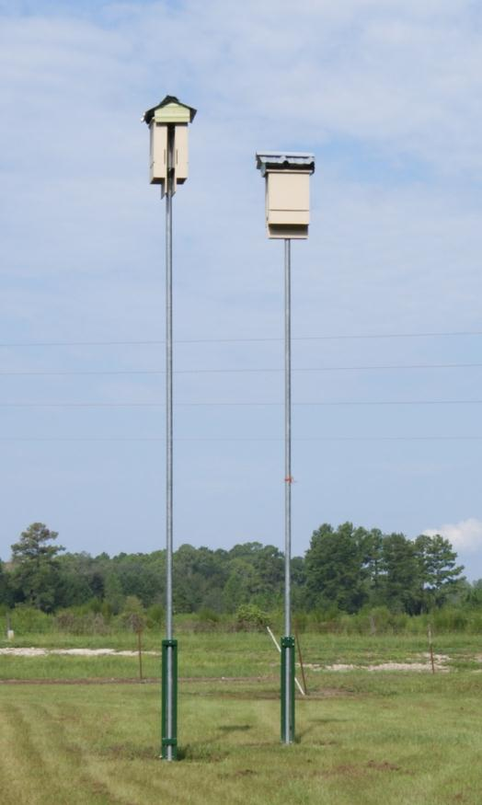
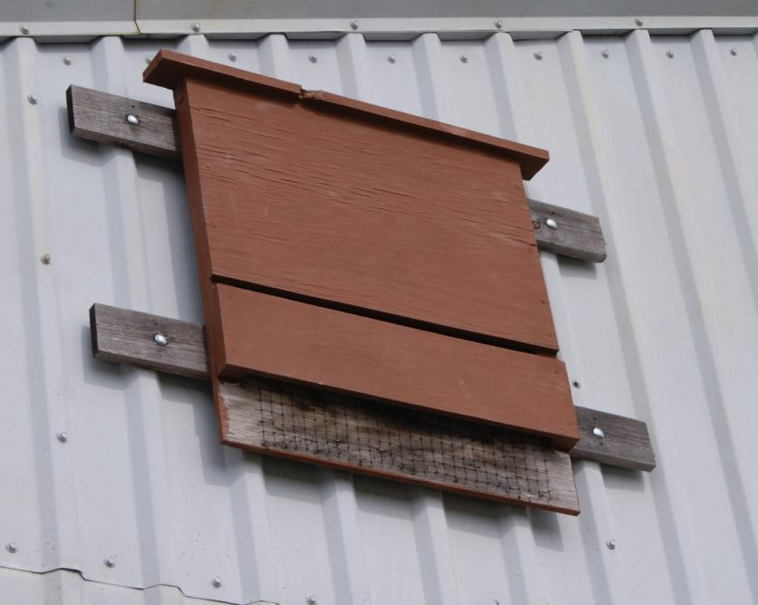
Bat Houses

Slide 13
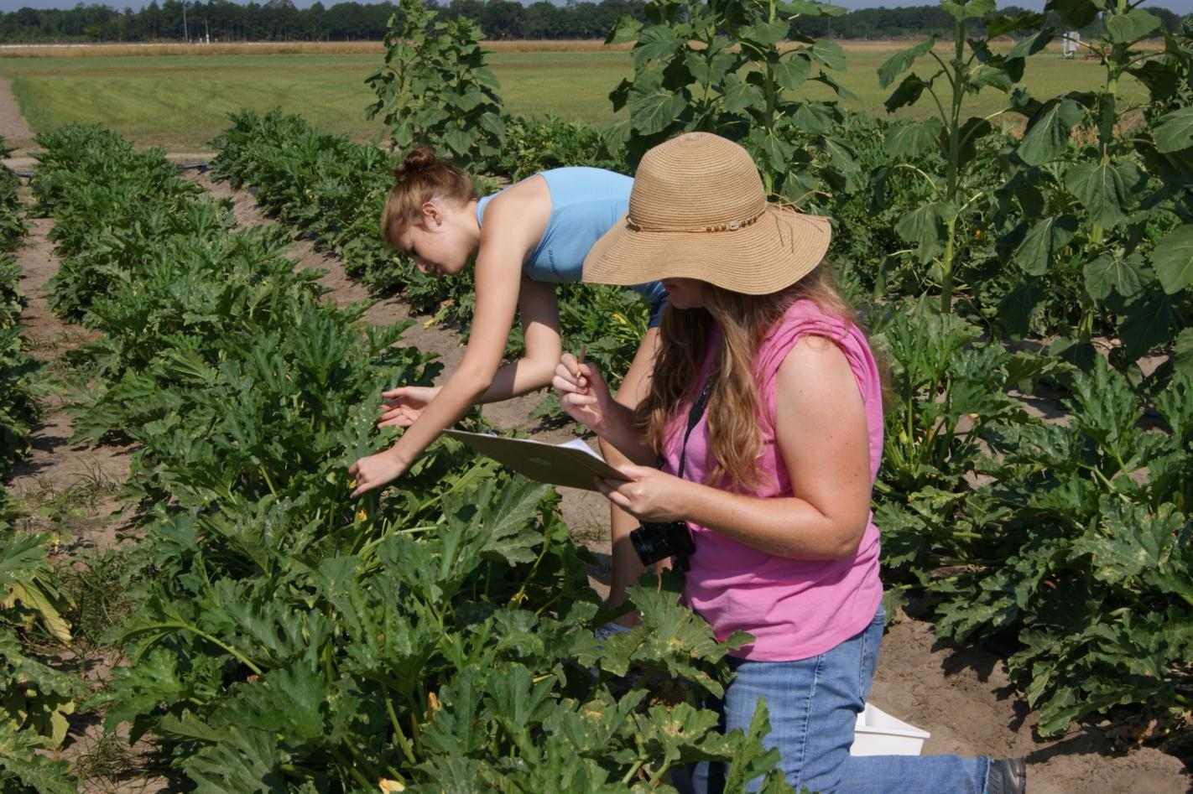
Monitoring and Scouting Fields

Slide 14
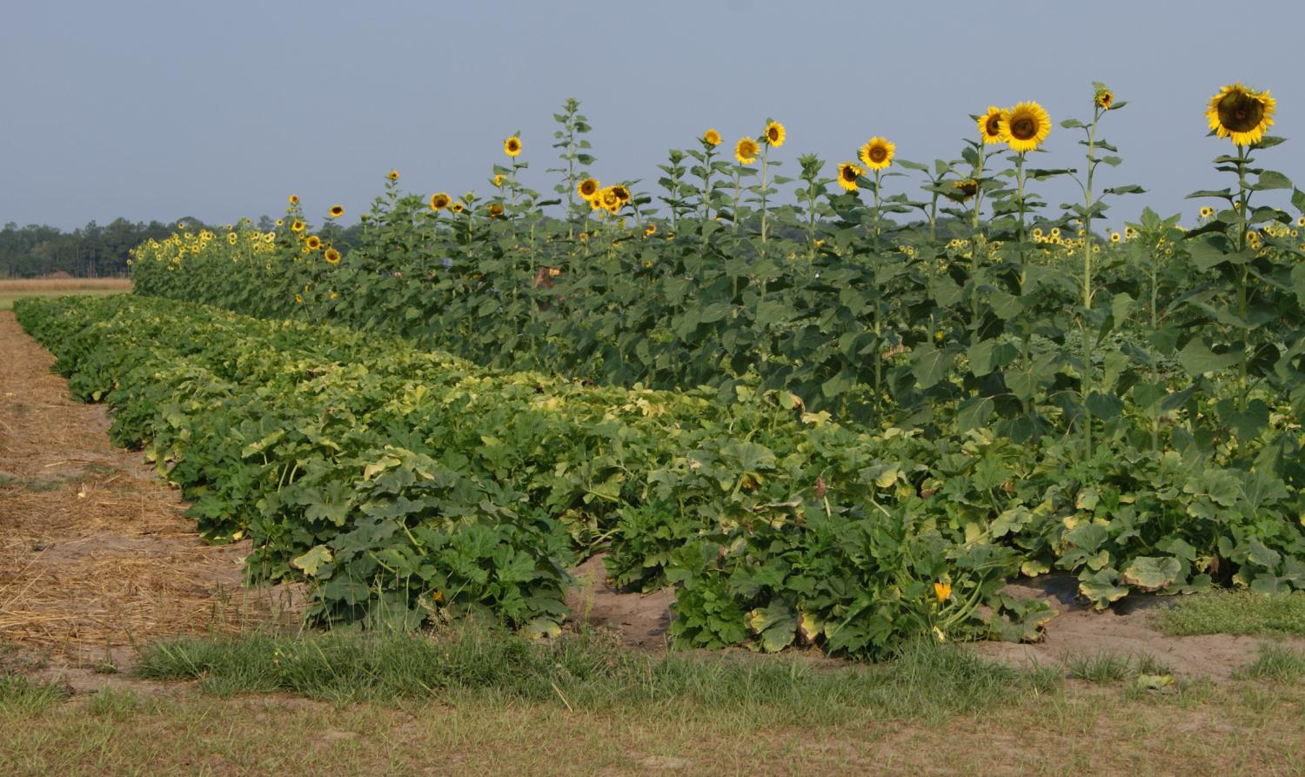
Attracting Beneficial Insects

Slide 15
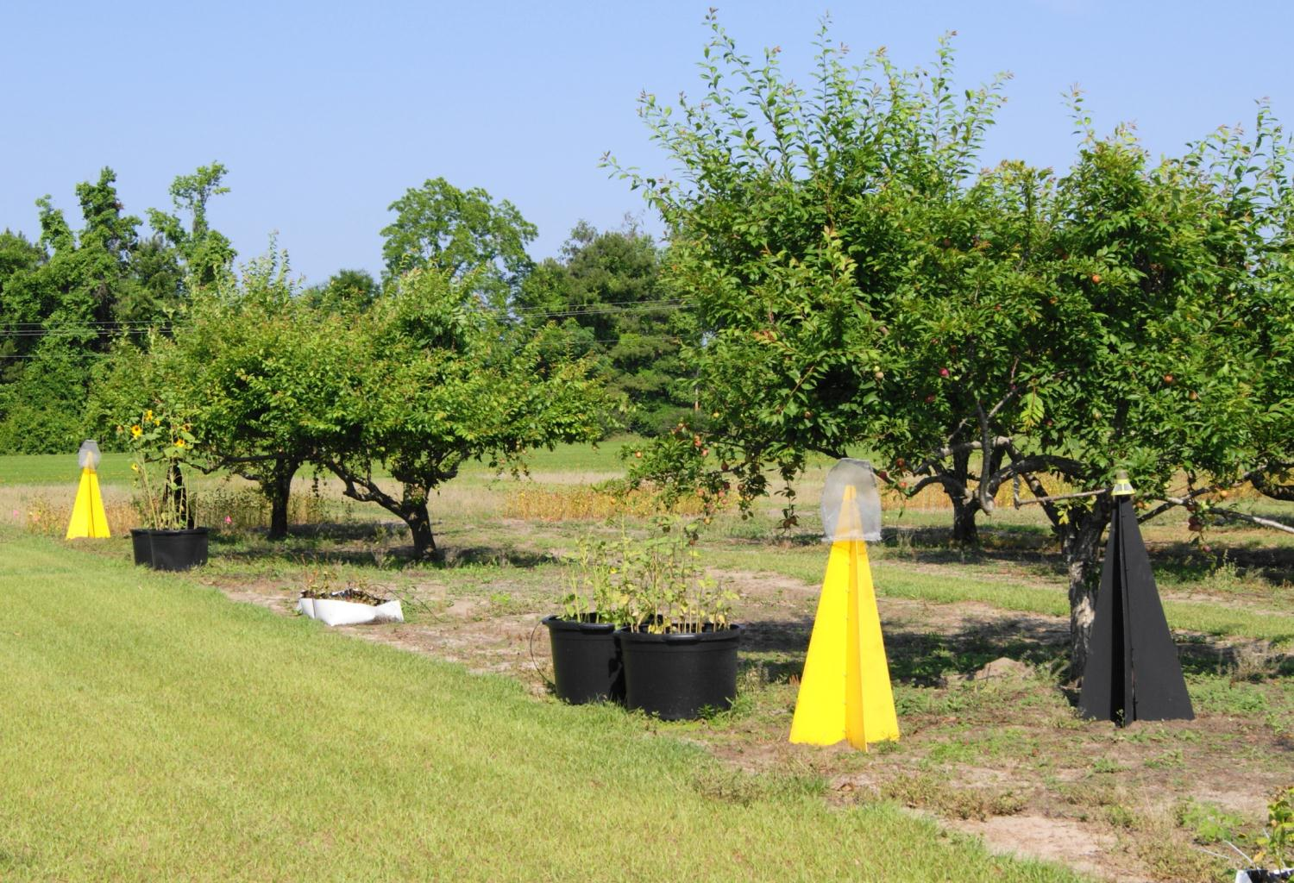
Trapping Insect Pests in Fruit Orchards

Slide 16
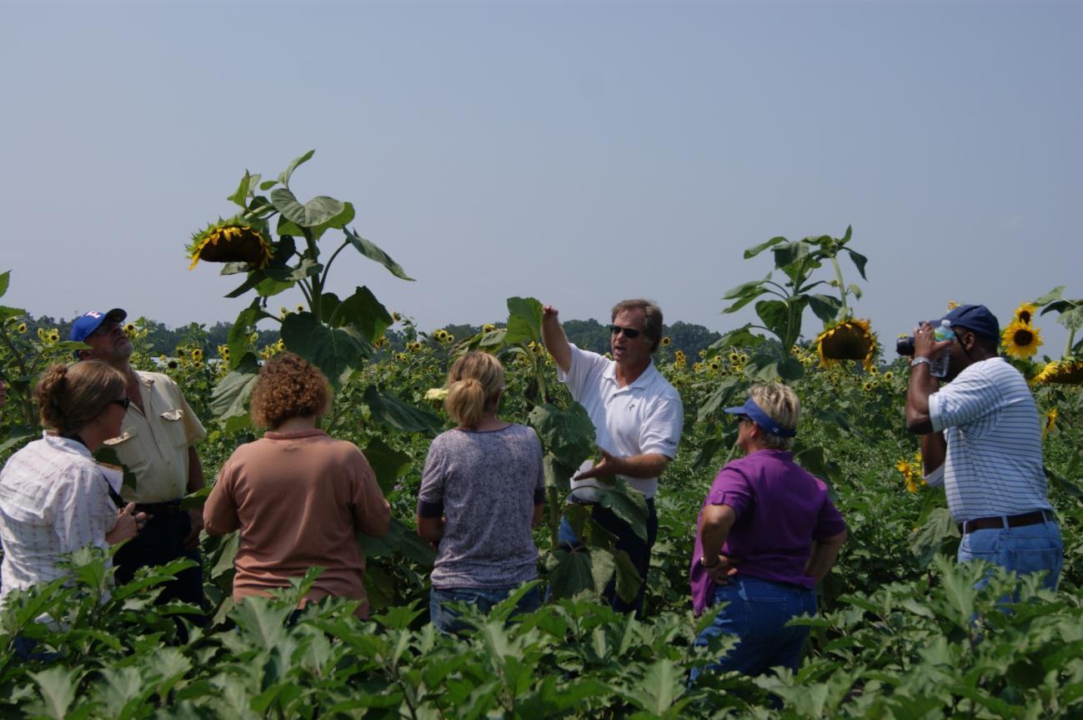
Vegetable Crop IPM – Sunflowers as a Trap Crop

Slide 17
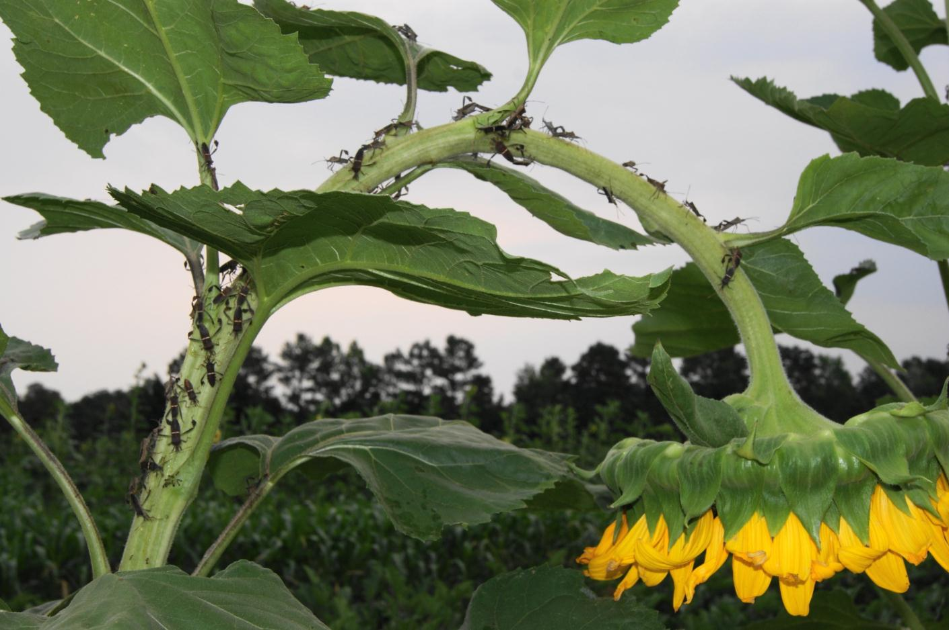
Leaf-footed Stink Bug on ‘Giganteus’ Sunflower

Slide 18
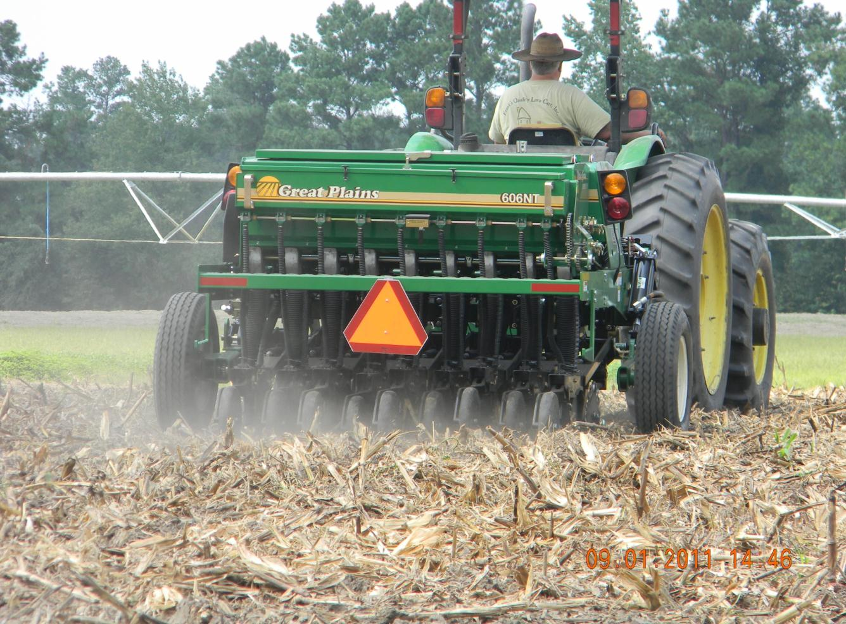
Conservation Practices and Cover Crops for Agronomic Crops

Slide 19
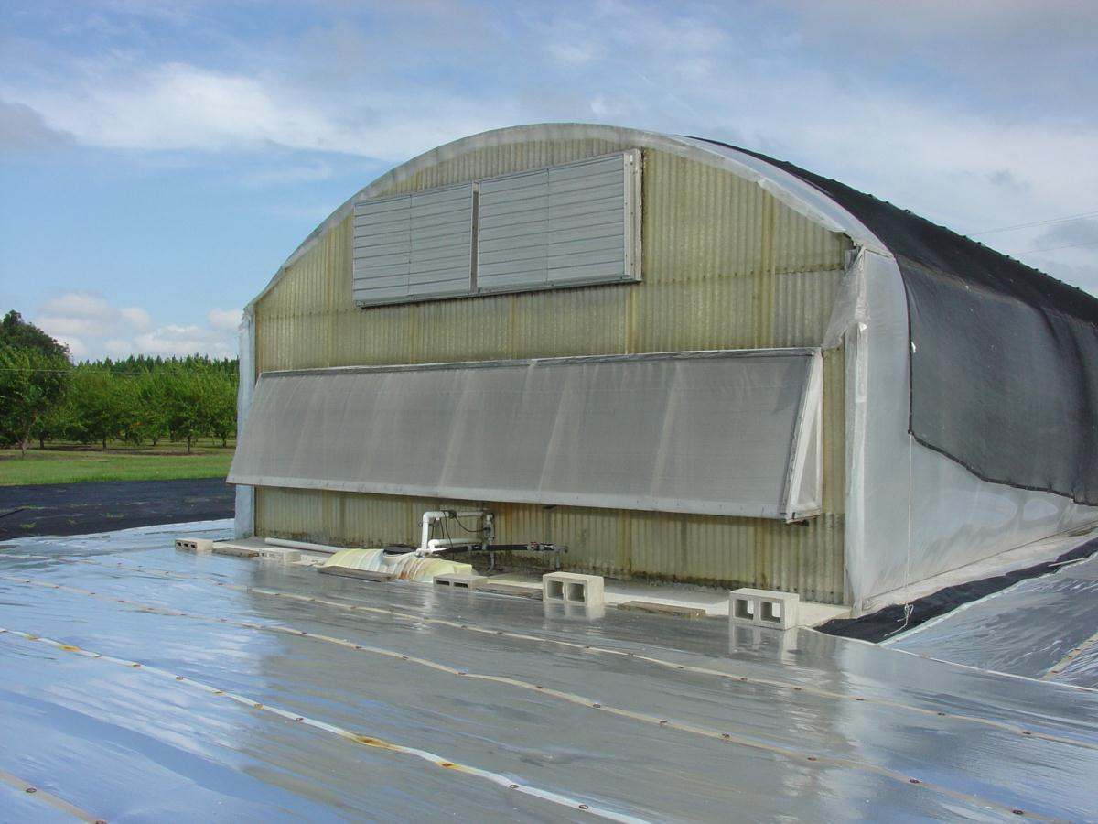
Pest Exclusion Practices for Protected Agriculture

Slide 20
Living Extension IPM Lab Programs- Spring, 2012
Greenhouse Hydroponics (IPM session) March 12-13
Greenhouse Hydroponics (IPM session) March 16-17
Master Gardener Greenhouse IPM March 23
Fruit Orchard IPM Workshop April 18
NRCS Field Staff IPM Training April 30- May 1 Extension Agent Farmscaping Training May 14-15
Small Farmer Vegetable IPM Workshop May 23
Master Gardener Field IPM Workshop May 30
4-H and Youth IPM Day Camps June 19-21

Slide 21
Statewide Venues for IPM Outreach at Statewide Conference’s Greenhouse, Organic, and Horticulture Tracks
July 27-29, 2012
Florida Small Farms Website: http://smallfarms.ifas.ufl.edu

Slide 22
Meeting the Challenges in Implementation
Choosing workshop topics to target specific audiences
Designing the farm site to facilitate specialized IPM workshops
Forming the team to design and establish training areas and provide training
Getting commitment and support from all staff at facility
Obtaining financial support to sustain the program
Making IPM meaningful to farmers and landowners

Slide 23
Potential Future Funding and Support Partners
USDA, NIFA
Extension IPM
UF, IFAS faculty, staff and students
USDA, Natural Resources Conservation Service
Florida Dept of Ag and Consumer Services
EPA and FL Dept of Environmental Protection
Farm Bureau
USDA, Beginning Farmer and Rancher, SARE, etc.
Others????

Slide 24
Leaf-footed Stink Bug on ‘Giganteus’ Sunflower

