Slide 1
American Society of Agronomy International Certified Crop Adviser Program

Slide 2
American Society of Agronomy (ASA)
Started in 1907
11,000 members
Membership comprises:
Academia
Government
Industry or private sector

Slide 3
American Society of Agronomy (ASA)
Products and Services:
Scientific Publications - Agronomy Journal
Monthly Magazine – CSA News
Quarterly Magazine – Crops and Soils
World Class meetings
Latest research updates
Educational programs
Advocacy
Certification:
Certified Crop Adviser (CCA)
Certified Professional Agronomist (CPAg)

Slide 4
American Society of Agronomy (ASA)
Certifications:
protects the public and the profession
helps establish the profession through standards
enhances professional development
Certified Crop Adviser (CCA)
Certified Professional Agronomist (CPAg)

Slide 5
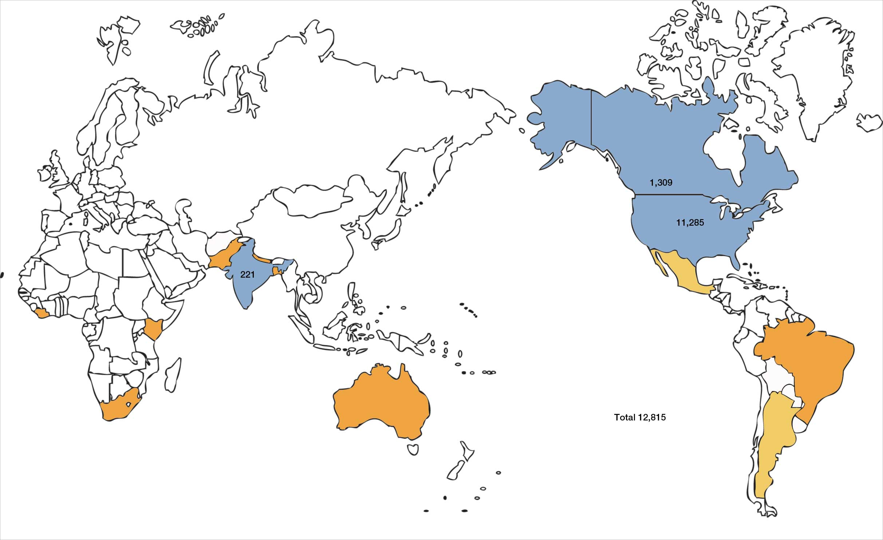

Slide 6
Certified Crop Adviser (CCA) Certified Professional Agronomist (CPAg)
CCA
CPAg
Exams
Education/Experience
BS – 2 yrs
Associate – 3 yrs
HS – 4 yrs
2 references
Ethics
CCA
BS minimum
5 years experience
5 references
Ethics

Slide 7
Continuing Education
CCA
CPAg
40 total CEUs/2 yrs
Nutrient management
Soil and water management
IPM
Crop management
Professional Development
50 total CEUs/2 yrs
Nutrient management
Soil and water management
IPM
Crop management
Professional Development
Professional Service
Professional Study

Slide 8
IPM Performance Objectives
COMPETENCY AREAS:
1. Basic Concepts of Pest Management
2. Sampling and Monitoring
3. Identification
4. Decision-Making Guidelines
5. Pest Management Strategies
6. Environmental Stewardship
7. Health and Safety
Pest Management Glossary

Slide 9
IPM Exam POs
https://www.certifiedcropadviser.org/exams/icca-performance-objectives
77 competencies in IPM
Not only IPM also NM, SW, CM

Slide 10
IPM Continuing Education
https://www.certifiedcropadviser.org/continuing-education

Slide 11
CE – IPM - Examples
a. Pesticide modes of action and pesticide interactions
b. Proper use of crop protection products and label updates
c. Emerging technologies for pest identification, survey, and damage estimates
d. Novel pest control agents and strategies
e. Evaluating the reliability of pest management information sources, decision making tools, and internet resources
f. Using crop, pesticide, and environmental information to make pest management recommendations
g. Biology of pests
h. Economics of pest control strategies
i. Managing pest resistance
j. Management of new and emerging pests or changes in pest biology
k. Trap crops

Slide 12
IPM - decision making skills
a. Applying research and principles of modeling and forecasting to pest management
b. Understanding, conducting and interpreting results of experimental trails
c. Evaluating climate and management factors in pest control systems
d. Evaluating non-traditional pest control methods
e. In-field evaluations and management of cropping and pest management systems

Slide 13
IPM – application technologies
a. Calibration, application, and advances in application technologies
b. Precision agriculture technologies

Slide 14
IPM – other areas
a. Grazing and pasture/range management for pasture/range pest control
b. Wildlife habitat management
c. Home and garden pesticide use
d. Turf and ornamental IPM
e. Organic production
f. Horticulture

Slide 15
IPM – safety and environmental
a. Environmental toxicology and signs and symptoms of exposure to toxins
b. Pesticide use and food safety concerns
c. Biosecurity in the agro-chemical industry
d. Pesticide waste remediation
e. Pesticide Safety, proper use, and label restrictions
f. Effects of pesticide misuse on crops, wildlife and other non-target species or areas
g. Wildlife as pests and methods of management

Slide 16
IPM – emerging areas
a. Refugia management for biotechnology crops
b. Segregation of herbicide tolerant or insect resistant crops
c. Invasive species management
d. Traits management
e. Seed bank management
f. Pest resistance
g. Pest populations and species shifts
h. Management of beneficials

Slide 17
Thank You
Luther Smith
Director of Certification and Licensing
1-608-268-4977
lsmith@sciencesocieties.org

